Slide 1
YEAR NINE OPTIONS
2017

Slide 2
Individual Learning Programme
Option pathway
Course information
Guidance on how to choose
Subjects
Target grades

Slide 3
Qualifications
GCSEs
    Graded 1-9
    Exams at the end – no controlled assessments
BTECs/CNATs
    Graded Pass to Distinction*
    Include at least 1 externally examined unit
    Work is externally moderated

Slide 4
Core Subjects
1. Mathematics
2. English Language
3. English Literature
4. Dual Award Science or Triple Science
5. Religious Studies
6. PSHE, Computing, PE

Slide 5
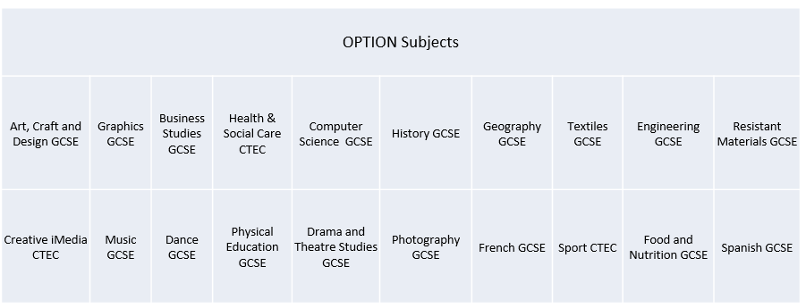
Option Subjects

Slide 6
Option Pathways
Level 1 programme
    Additional English and Maths
    Work skills
    Option choice

Slide 7
Option Pathways
Core pathway
    Computer Science, French, Geography or History
    2 option choices including those above

Slide 8
Option Pathways
Ebacc pathway
    Geography or History
    French or Spanish
    Option choice

Slide 9
Options Process
Attend Options Evening
Speak to teachers and parents/ carers
Read the I.L.P. booklet
Attend Parents evening on 19/01/16
Make an appointment to meet with your College Leader
Choose your options
Letter confirming subject choices by 24/03/17
Hand in completed option form by 10/02/17

Slide 10
Curriculum Preference form
Which pathway?
Target grades?
Subjects choices

Slide 11
How do I choose?
Read the booklet
Take advice from teachers and parents
Make your choices with your College Leader

Slide 12
Personal data
What are my interests and goals?
What is my plan for the next 7 years?
What is my future career path?

Slide 13
Post-16
What do I want to study after key stage 4?
Have I kept my options open at key stage 4?

Slide 14
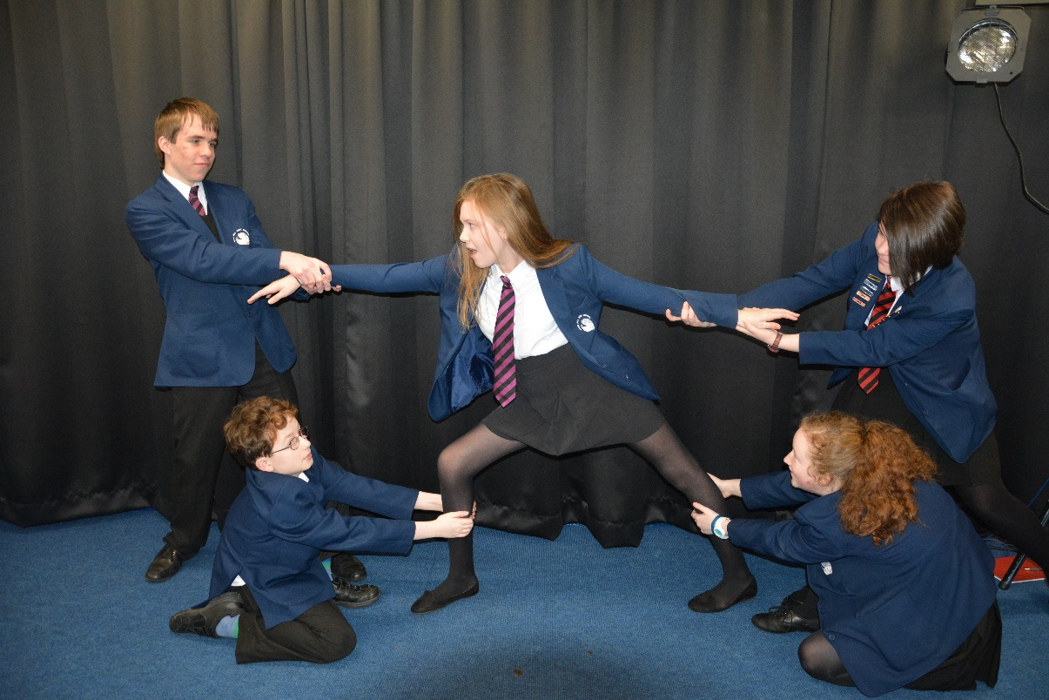
DON’T choose a subject because your friend is taking it!

Slide 15
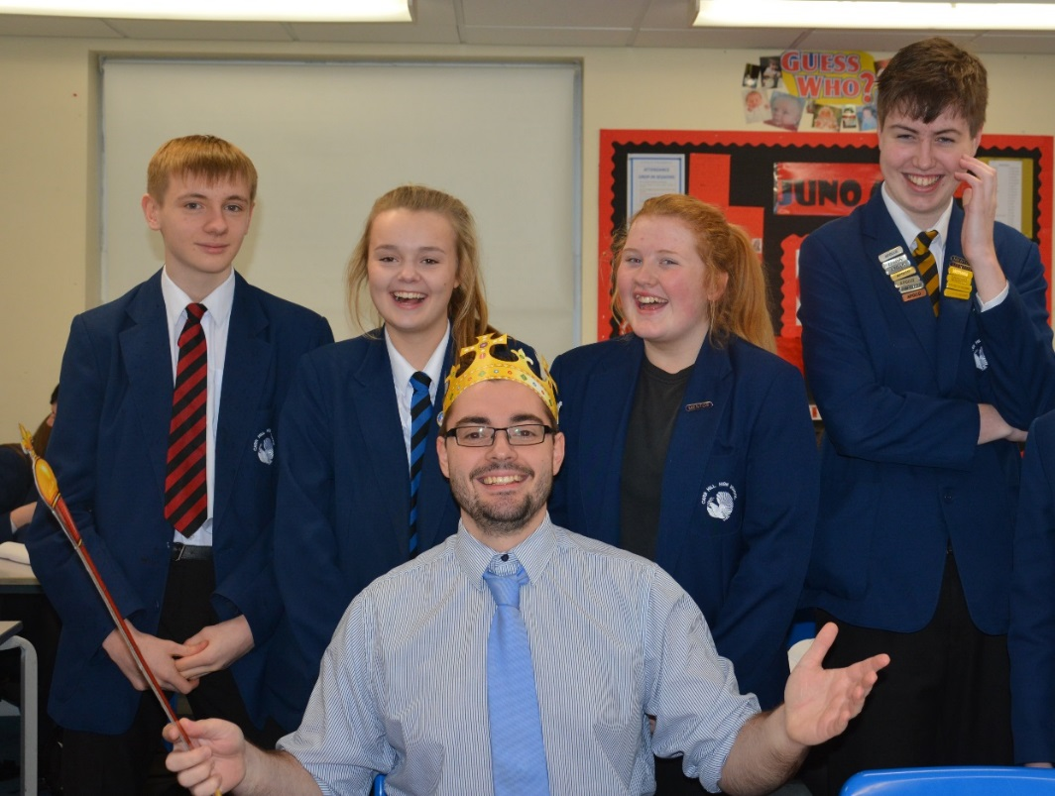
DON’T choose a subject because you like the teacher!

Slide 16
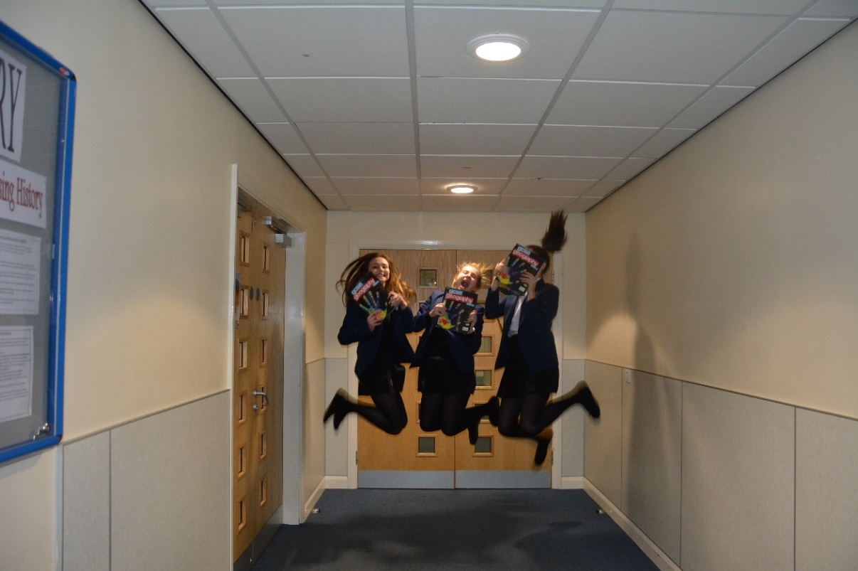
DO choose subjects you enjoy

Slide 17

DO choose subjects that will help your career

Slide 18
What happens next?
Forms are processed
We decide which courses will run

Slide 19
Deadlines
Parents Evening – Thursday the 19th of January
OPTION FORM HANDED IN BY FRIDAY THE 10th OF FEBRUARY

