Slide 1
YEAR NINE OPTIONS
2018
Notes:
Welcome to option evening – this talk is on the Core pathway. The Ebacc pathway talk is in the hall and the level one programme is in MAS

Slide 2
Individual Learning Programme
Option pathway
Course information
Guidance on how to choose
Subjects
Target grades
Notes:
Booklet includes information on their pathway – please collect it from the Allen Wood Studio if you haven’t already done so.
Course information includes a page for each of the optional subjects and how they are assessed and what content is covered
Guidance on how to choose subjects a section that can be completed with your parents and carers to help you
Full ilst of subjects and the likely target grades for the end of year 11

Slide 3
Qualifications
GCSEs
    Graded 9-1
    Exams at the end – no controlled assessments
BTECs/CNATs/Certificates
    Graded Pass to Distinction*/ A*-C
    Include at least 1 externally examined unit
    Work is externally moderated
Notes:
GCSEs are now all graded 1 – 9 with a 9 being the highest grade, A grade 7 is equivalent to the old A grade and a grade 4 to the grade C
BTEC/CTECs are the more vocational style courses. They do however include and externally examined unit and a large number of coursework style assessments. They are the equivalent of 1 GCSE

Slide 4
Core Subjects
1. Mathematics
2. English Language
3. English Literature
4. Dual Award Science or Triple Science
5. Religious Studies
6. PSHEE, PE
Notes:
These are the compulsory subjects. Almost all students will take both English language and literature. Triple science is not an option – students will be allocated to triple of double science much later in the year based on their progress throughout key stage three and their performance in assessments and exams.
PSHE and PE are non examined core subjects – i.e. no GCSE PE the option. Computing is the core national curriculum and is not the computer science GCSE or Creative imedia ICT course which are option subjects, (Don’t mention ECDL as we don’t know how we will deliver this to year 9 as yet)

Slide 5
Option Subjects
SUBJECTS
Art, Craft and Design | Business | Computer Science | Dance | Design & Technology – textiles based materials | Design & Technology – timber & polymers | Drama | Engineering Design | Food Preparation & Nutrition | French
Geography | Health & Social Care | History | ICT | Music | Photography | Physical Education | Spanish | Sport
Notes:
These are the subjects we are offering this year – the subjects we actually then deliver depend on student choices. It is possible that not all of these subjects will run. For the more practical subjects we need a minimum of 15 students and for the literacy based subjects we need 20 students. We always do our best to run as many courses as possible but if the class is really small then we cant run it.
Technology – these are the last set of subjects to change to the new GCSES from September 2017. When courses change the new specifications from exam boards have to be submitted to Ofqual – a government agency - for approval and most of the technology courses have only just completed this process. As such we have not made final decision on which courses we will offer next year in the case of graphics, textiles and resistant materials therefore we have included the old information which gives you the information about the content but the assessment information will change once final decisions have been made. Of the three we will only run two depending on student interest.

Slide 6
Option Pathways
Level 1 programme
    Additional English and Maths
    Work skills
    Level 1 Engineering or Health & Social Care

Slide 7
Option Pathways
Core pathway
    Computer Science, French, Spanish, Geography or History
    2 option choices including those above
Notes:
Students are now required by the government to study a range of E-bacc subjects at KS4. This includes Maths, English and dual science all of which are compulsory and then at least one subject from Computer Science, French Geography or History. You can then choose two more subjects from the whole list of options including more ebacc subjects if you wish. It is important at this point to try and keep your options as broad as you can. You cant choose art + photography or sport and PE for example.

Slide 8
Option Pathways
Ebacc pathway
    Geography or History
    French or Spanish
    Option choice

Slide 9
Options Process
Attend Options Evening
Speak to teachers and parents/ carers
Read the I.L.P. booklet
Attend Parents evening on 18/01/18
Make an appointment to meet with your College Leader
Choose your options
Letter confirming subject choices by 23/03/18
Hand in completed option form by 08/02/18
Notes:
The process is as above – take the opportunity tonight to teachers about the different subjects and take the booklet away to read. Parents evening is next week an opportunity to find out how your child is currently progressing, At parents evening their will be appointment sheets next to the sign in sheets –please sign up for an option appointment with your college leader – parents and students meet to discuss the option choices before completing the individual option form that each college leader has for students. Forms need to be handed in the 10th of February,

Slide 10
Curriculum Preference form
Which pathway?
Target grades?
Subjects choices
Notes:
In the middle of your booklet is the curriculum preference form which details all the likely target grades for each subject based on your progress from KS2.

Slide 11
How do I choose?
Read the booklet
Take advice from teachers and parents
Make your choices with your College Leader
Notes:
Read the booklet carefully and discuss subjects with teachers and your parents. Make the final decisions when you meet with your college leader.

Slide 12
Personal data
What are my interests and goals?
What is my plan for the next 7 years?
What is my future career path?
Notes:
This section is a guide that you may wish to fill in with your parents and carers - what are you good at, what are your interests? What are you future goals –what is your plan for the next seven years? Are you aiming for an apprenticeship, a degree – do you have a specific career in mind and do you know what courses are needed? Questions to guide your thinking particularly if you don’t know what you want to do yet.
Please don’t think you have to know now – this is why you keep your options open and broad. If you take ebacc subjects and don’t narrow to one type of subject only you wont lose any opportunities. In the future. I always use my own experience – didn’t know what I wanted to do but enjoyed science so just made sure I had a mixture of subject at KS4.
If you know already what you want to do – great – make sure you’ve researched it properly and know what – if any subjects are required – students often guess at what is required. E.g. if you wanted to do engineering at university you don’t need engineering at KS4 or 5- you need physics and maths. Give any examples you can think of like this – particularly for the ebacc pathway. Eg if you wanted to be a journalist –you don’t need a degree in journalism – you need to be able to write well – take history!

Slide 13
Post-16
What do I want to study after key stage 4?
Have I kept my options open at key stage 4?
Notes:
Very few subjects that you cant study at post-16 as long as you don’t narrow your choices too early.

Slide 14
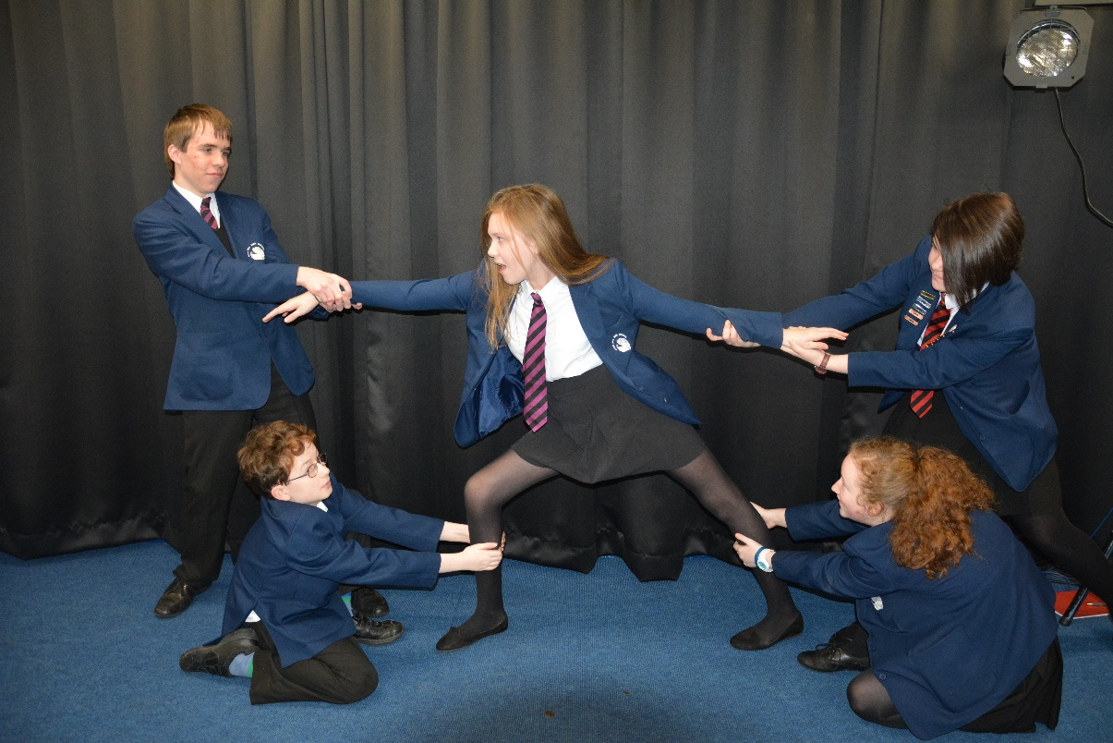
DON’T choose a subject because your friend is taking it!
Notes:
Remember you have to take this subject for two years! Your friend might no be in the same class

Slide 15
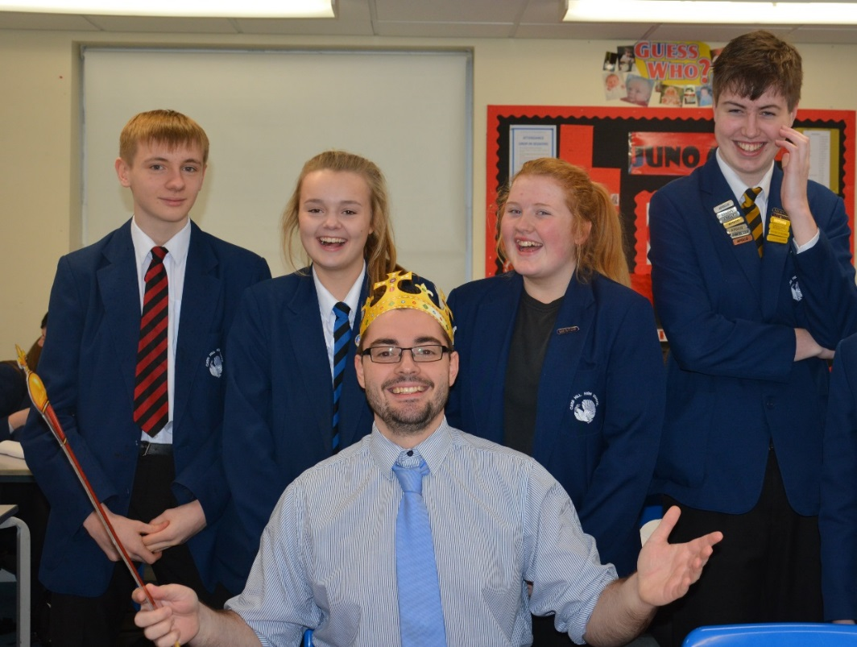
DON’T choose a subject because you like the teacher!
Notes:
There is no guarantee you will get the same teacher at KS4 that you had at KS3 so that is not a good reason!

Slide 16
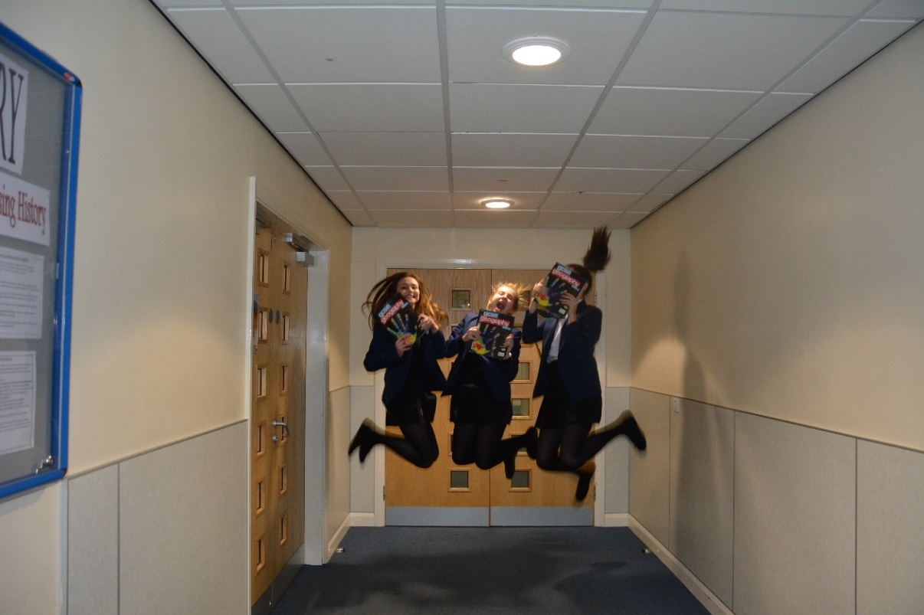
DO choose subjects you enjoy
Notes:
You need to be interested and want to do well

Slide 17
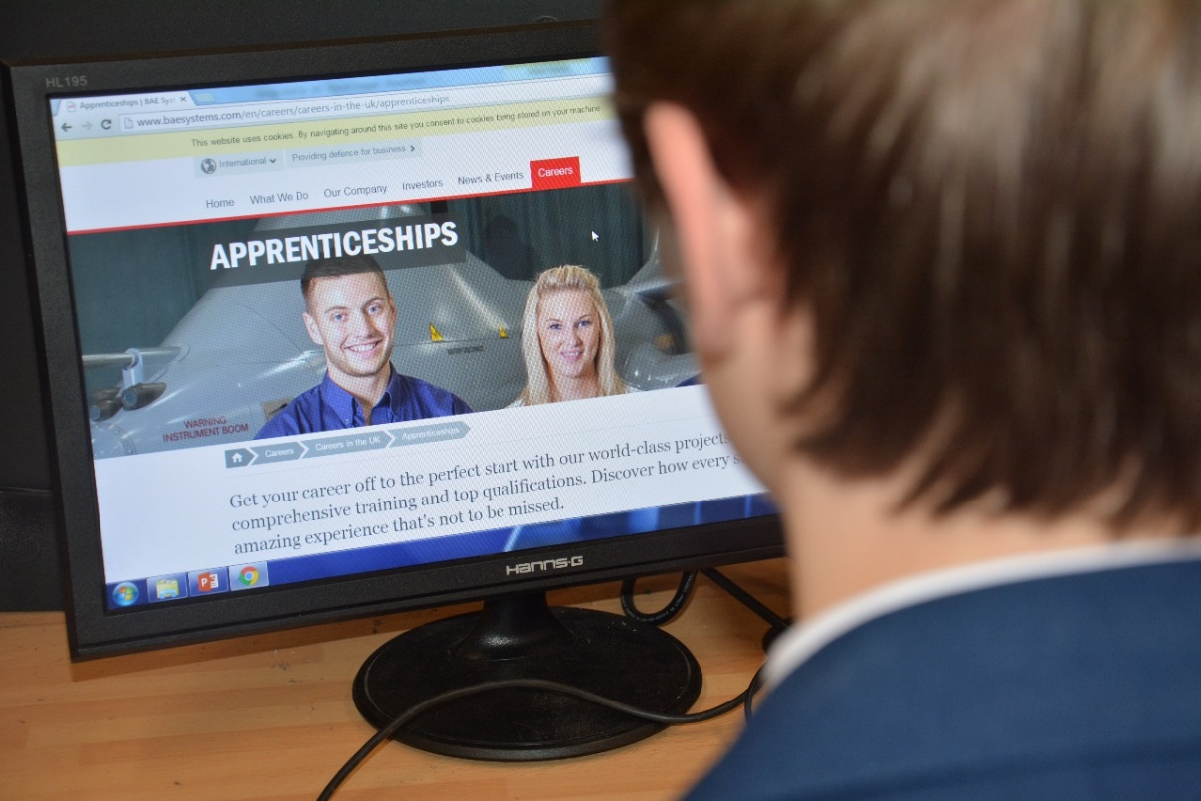
DO choose subjects that will help your career
Notes:
If it’s a subject you need for a career you’ve set your heart on then you need to choose and give 100% even if its not a subject that is near the top of the list of subjects you enjoy

Slide 18
What happens next?
Forms are processed
We decide which courses will run
Notes:
On the 10th when I get all the forms I start processing them. If you haven’t handed in your form then I cannot consider your choices. I make every effort to grant as many 1st choices as possible but there will always be some clashes of subjects so you must consider what 2nd and 3rd choices will be. I wont accept an option form that doesn’t have the reserve choices filled in – it will be returned to you. Over 90% of students had all their first choices last year and if you do end up with a second choice it is extremely unlikely that it would happen for more than one option.
It is inevitable that some courses may not run if there is little interest – it happens every year

Slide 19
Deadlines
Parents Evening – Thursday the 18th of January
OPTION FORM HANDED IN BY THURSDAY THE 8th OF FEBRUARY

