Slide 1



Thanks for Joining Us
Setting
Show my Homework
Targets, making progress and reports
Success in English
Success in Mathematics
Success in Science
Behaviour for Learning
Teaching and Learning including Chromebooks and staying safe online
Get the latest news, updates and reminders every day.
Carr Hill High School
@CarrHillSchool

Slide 2
Setting
Alex Jordinson
Deputy Headteacher

Slide 3
Setting
C Band | H Band
1A
1B | 1C
2A | 2B
2C | 2D
 | 3A
We also have our nurture group for a smaller group of students so we can meet their specific needs.

Slide 4
Show my Homework
Alex Jordinson
Deputy Headteacher
Notes:
Help clubs – Friday lunch room 26
Apps for phones – not always available
Emailed presentation.
Presentation on school website
Majority of problems – wrong password or email

Slide 5
Before a student can access
Show My Homework they need to have logged into their school email

Slide 6
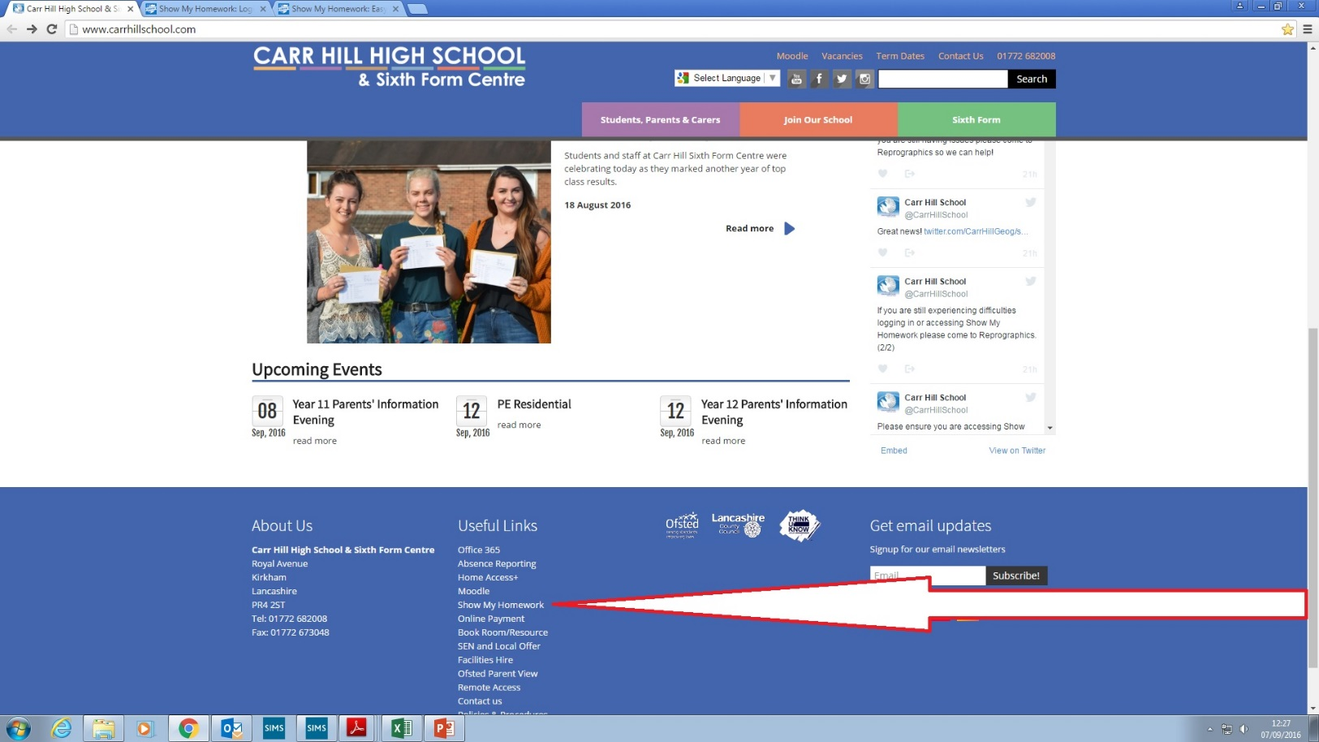
Show my Homework
Using Chrome access the Carr Hill Website and at the bottom under “Useful Links” click “Show my Homework”
Click here

Slide 7
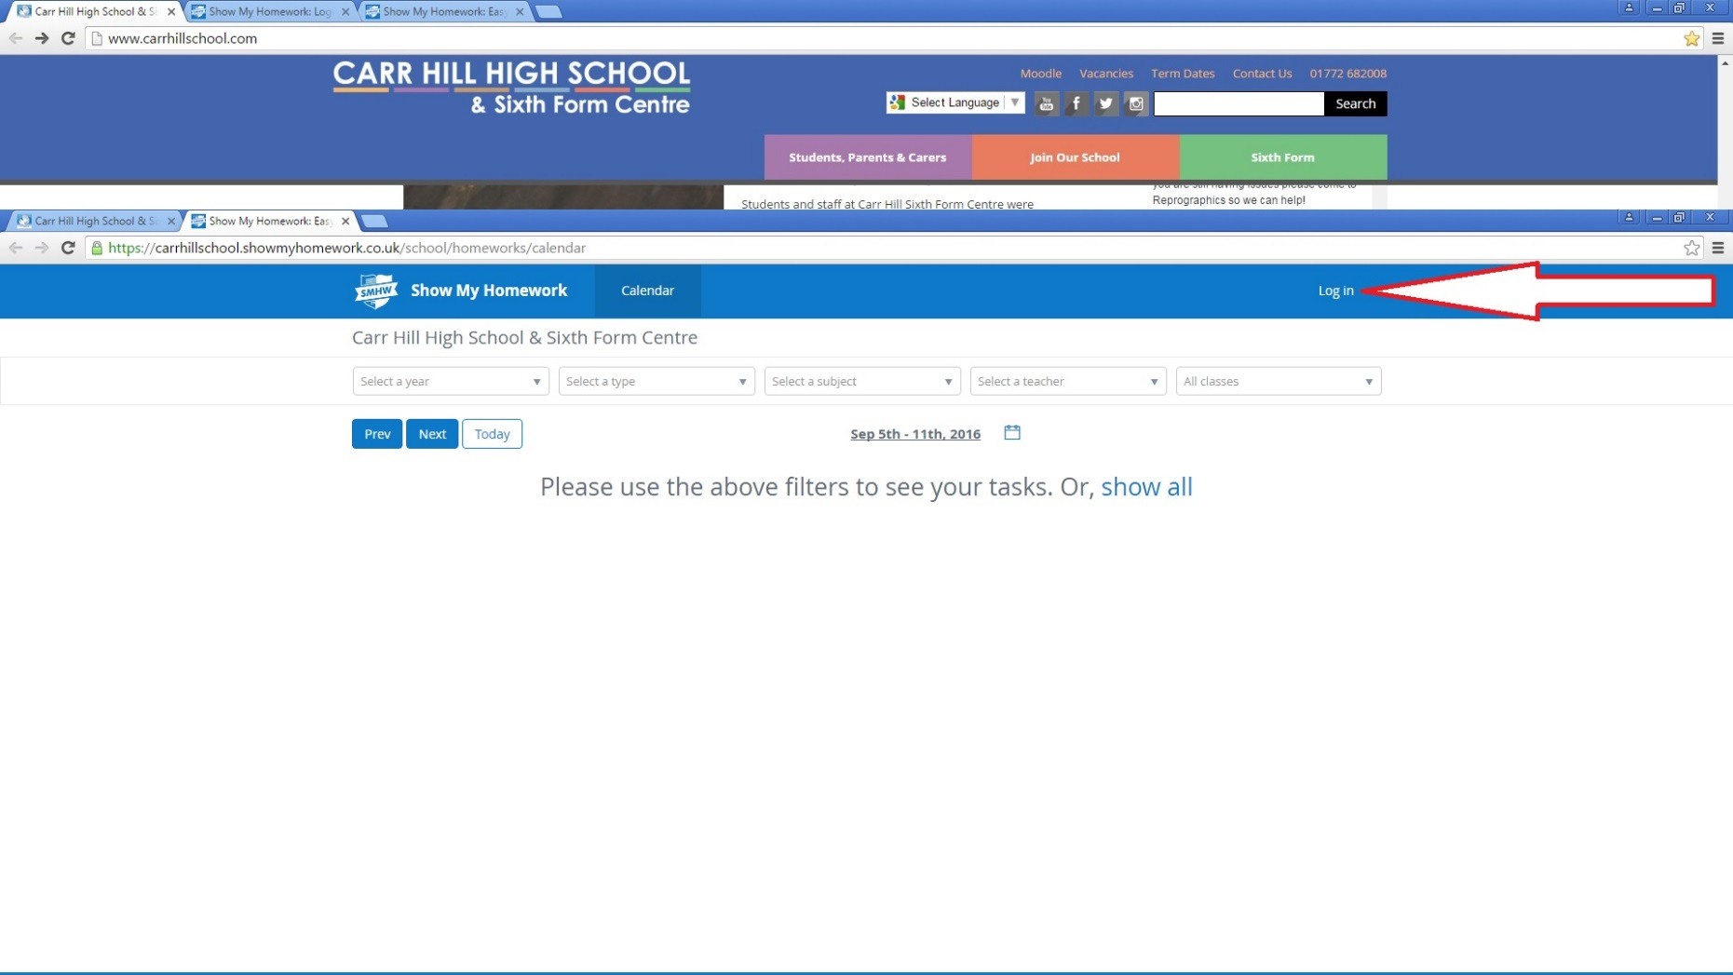
Log in
Click here

Slide 8
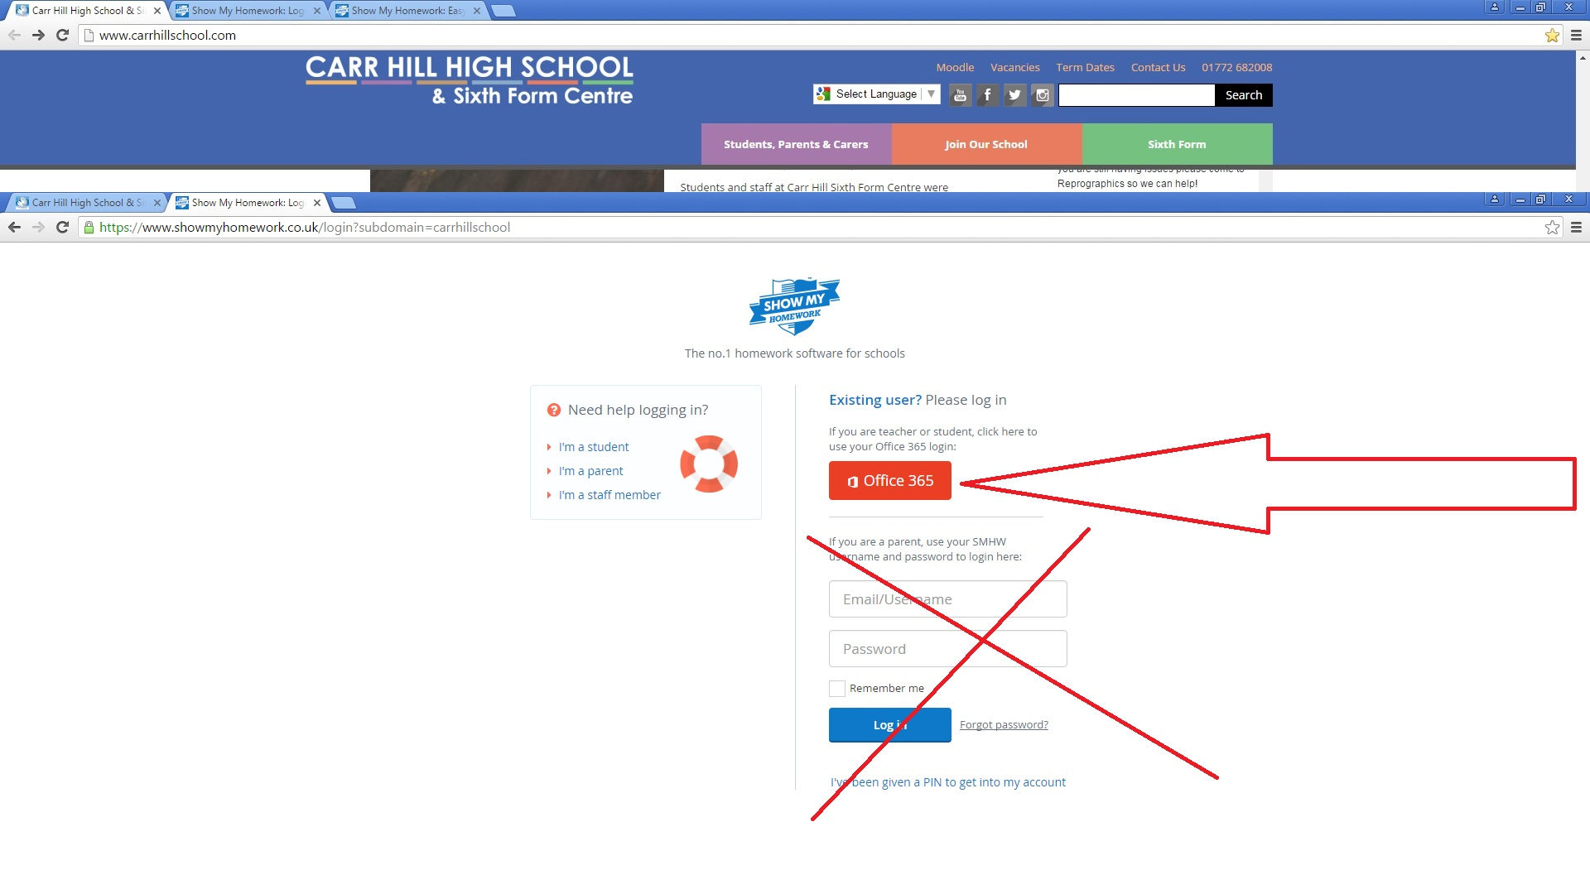
Click here - Use the Red Office 365 button to log in
DO NOT USE THIS SECTION TO LOGIN USE THE ABOVE RED OFFICE 365 BUTTON

Slide 9
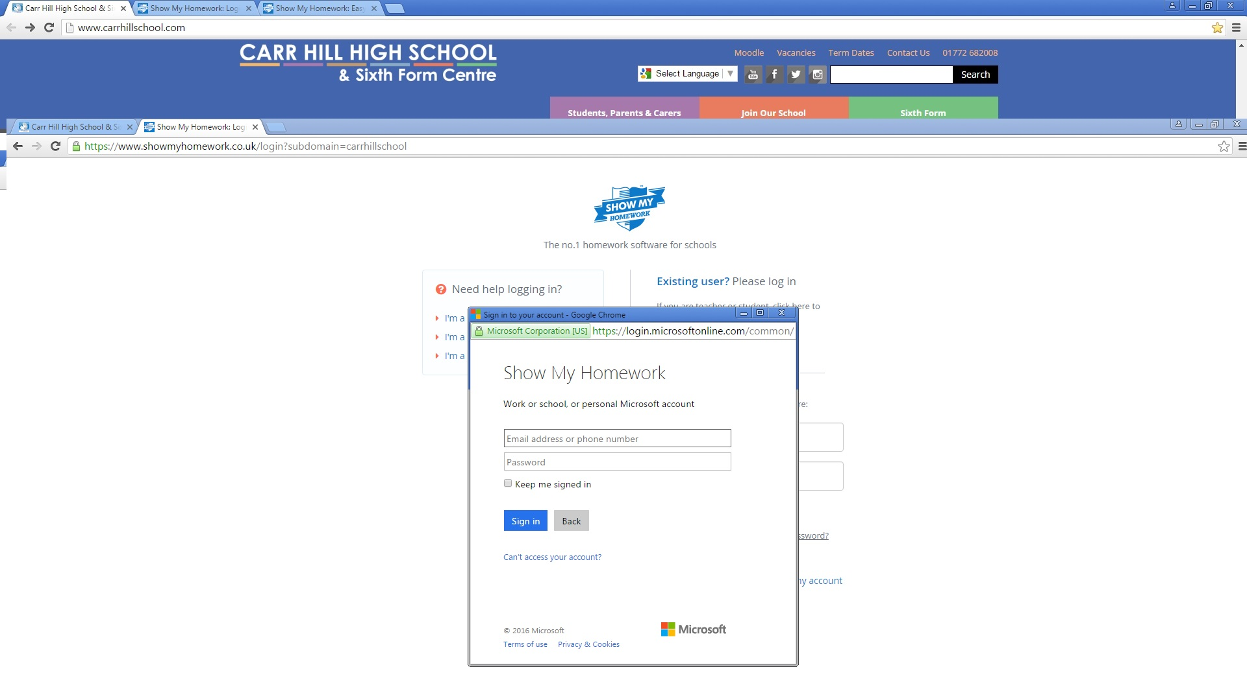
Log in with their full school email address and password

Slide 10
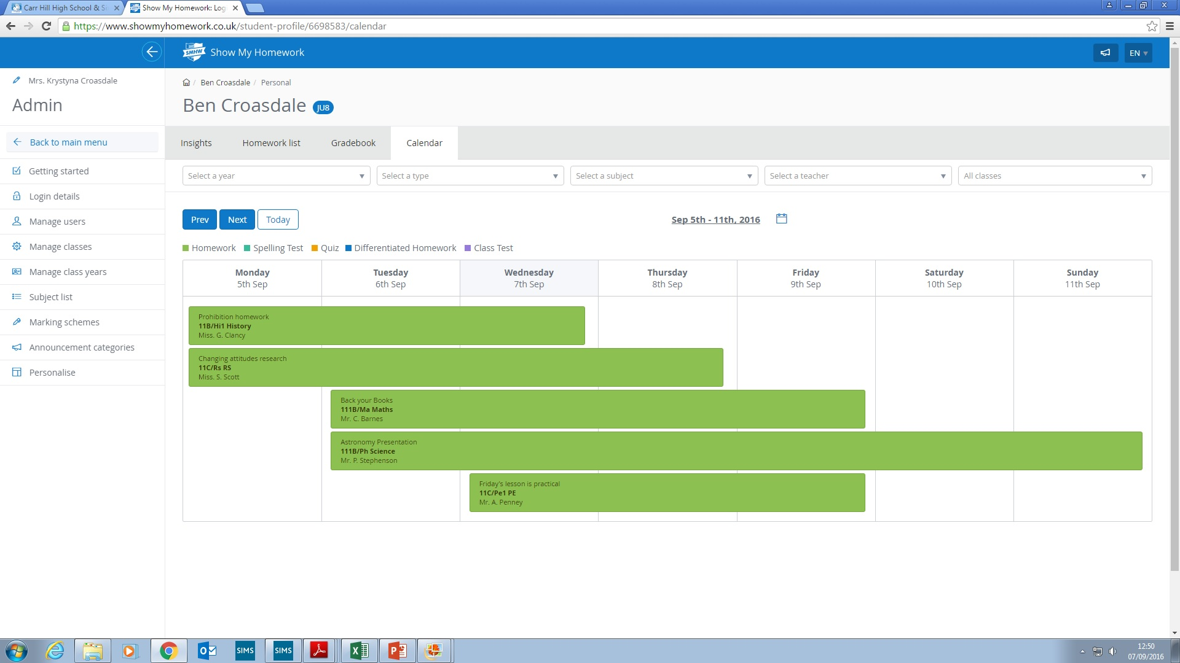
They now have access to their account on Show My Homework

Slide 11
GCSE reform, targets and monitoring progress
Liz Hilton-Peet
Assistant Headteacher

Slide 12
Why and how are GCSEs changing?
GCSEs and A levels in England are being reformed, to match the best systems in the world and keep pace with universities’ and employers’ demands.
GCSE content will be more challenging and rigorous but still suitable for all abilities.
GCSEs will be graded on a new scale of 9 to 1 rather than A* to G, with 9 the highest grade, to distinguish clearly between the reformed and unreformed qualifications.
Assessment is mostly by examination rather than partly by coursework.
Foundation and higher tiers are now only available in maths, science and languages.
Grading is now on a 1-9 scale rather than on an A*-G scale.

Slide 13
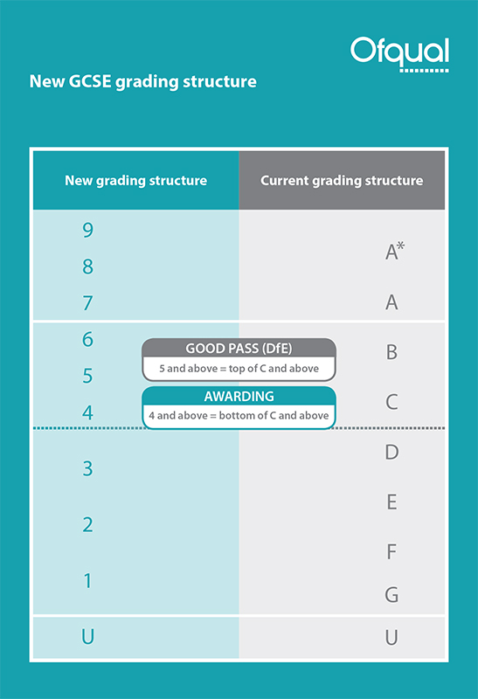
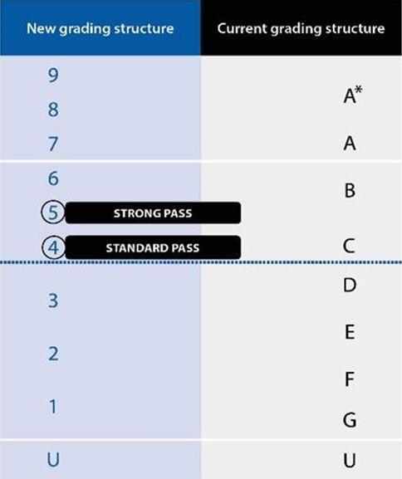

Slide 14
Setting Targets
Above Average School - Physics
KS2 | KS3 |  |  | KS4
Average Scaled Score (Reading / Maths) | Year 7 Target | Year 8 Target | Year 9 Target | Year 10 Target | Year 11 Target
112-120 |  |  |  |  | 8
110-111 |  |  |  |  | 8
107-109 |  |  |  |  | 7
103-106 |  |  |  |  | 6
99-102 |  |  |  |  | 5
93-98 |  |  |  |  | 4
89-92 |  |  |  |  | 3
80-88 |  |  |  |  | 2
Below Level Test |  |  |  |  | 2

Slide 15
Keeping track of progress
Flight paths.
Allows tracking of progress against targets.
Find them in student planners.

Slide 17
Reports
1-9 grade and A-C confidence level reported in all subjects. For example 1A.
Confidence level A – very confident of grade
Confidence level B – confident of grade
Confidence level C – not as confident of grade
Available on Moodle. Paper copies can be requested from the data manager
December, April and July
A subject in the “red” is a cause for concern

Slide 18

English
Kathryn Gardner
Assistant Head of Faculty

Slide 19
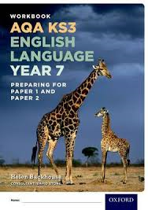
Transition Tests
In the first week of term, year 7 students completed tests in English. The tests focused on extended writing, spelling, punctuation and grammar skills as well as assessing reading comprehension.
The tests are devised by AQA which is the GCSE board we follow. In this way, we are able to see how students have been able to transfer literacy skills taught at KS2 and apply these to KS3/4 style test papers.
Results from the tests enable us to differentiate work and provide targeted interventions to improve pupil progress.

Slide 20
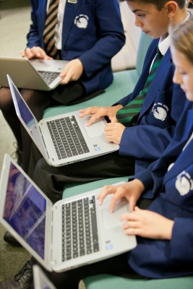
Interventions include one to one or work within small groups. These will usually be within their normal English lessons and they include both in-class support and withdrawal from lessons on a short term basis. The latter is usually done within timetabled library lessons.
If other arrangements for more sustained intervention are needed, you will always be informed and regularly updated.

Slide 21
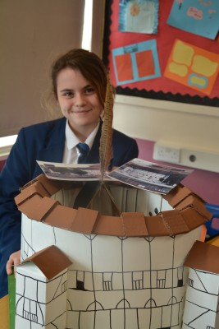
The Year 7 Course
The year 7 English course consolidates and develops skills taught at KS2 whilst preparing students for forthcoming GCSE English and Literature study.
Students will read a range of fiction and non-fiction texts including Shakespeare and other pre twentieth century texts. They learn to develop the skills of analysis. A variety of writing styles are practised and there is a focus on improving technical accuracy – spelling, punctuation and grammar.
In addition to this curricular work, the English department offers a range of extra-curricular activities and competitions to encourage students to write for different audiences and to promote a love of literature and reading.

Slide 22


Reading Challenge
In English, we have created the Carr Hill Reading Challenge! Students are challenged to read a range of fiction and non-fiction texts. Then, they record and review their ideas about these texts in their booklets.
As students read more widely, they receive certificates to celebrate their successes.

Slide 23
Parents and Carers
You can help to support your child by encouraging them to read widely and regularly.
Regular reading impacts on comprehension skills and writing skills as well as helping your child to become an independent learner.
Thank you for encouraging your child to complete such tasks regularly as on-going homework.

Slide 24

Mathematics
James Myers
Assistant Head of Mathematics (Tracking and Intervention)

Slide 25
What is each students starting point?
All students sit the PTM paper in lesson.
Assess each students starting point after summer break.
Identify areas of weakness in a detailed report.
Takes into consideration age of student on day of test.
Notes:
The first 3 just enable the smooth running of a classroom allowing the teachers to concentrate on the curriculum as much as possible.
The final point I will refer to several times throughout the presentation.
“The one person who has the greatest impact on a students results are the student themselves.

Slide 26
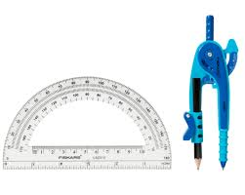
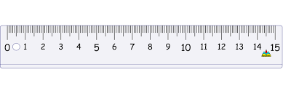
What we expect from the students?
Your Maths book should be backed.
On your desks should be:
Your pens: Blue/Black, Red and Purple.
Maths Book (backed). Planner. Calculator.
Geometry Equipment: Ruler, Compass and Protractor.
At the start of each lesson:
Rule off from the previous lesson.
Always write ‘cwk’ and the date and underline both.

Slide 27
What will this year look like?
Notes:
All staff work from this timeline.
Each row is an half term.
First coloured sections are different topics within the subject.
Each section has a detailed sow associated with it.
The entire curriculum is completed by mid January.
From then on it is all targeted revision. Which I will explain on the next slide.

Slide 28
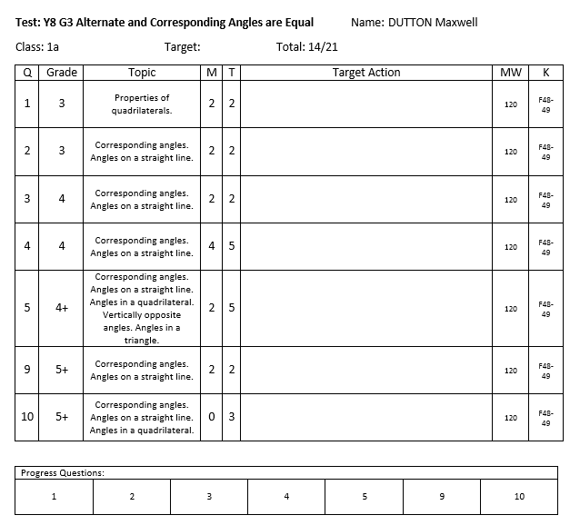
What is mastery time?
Notes:
Once we have covered the entire specification we then concentrate on using the assessments to identify each students areas of weakness.
After each assessment the teacher will receive a class report and each individual will receive an individual feedback sheet.
The teacher will initially address any misconceptions and areas of weakness shared by the class and then go onto deal with any individual issues using appropriate resources ( i.e. laptops and computer rooms).
It is essential students take responsibility at this point and take the opportunity to address issues independently maximise their final grade.

Slide 29
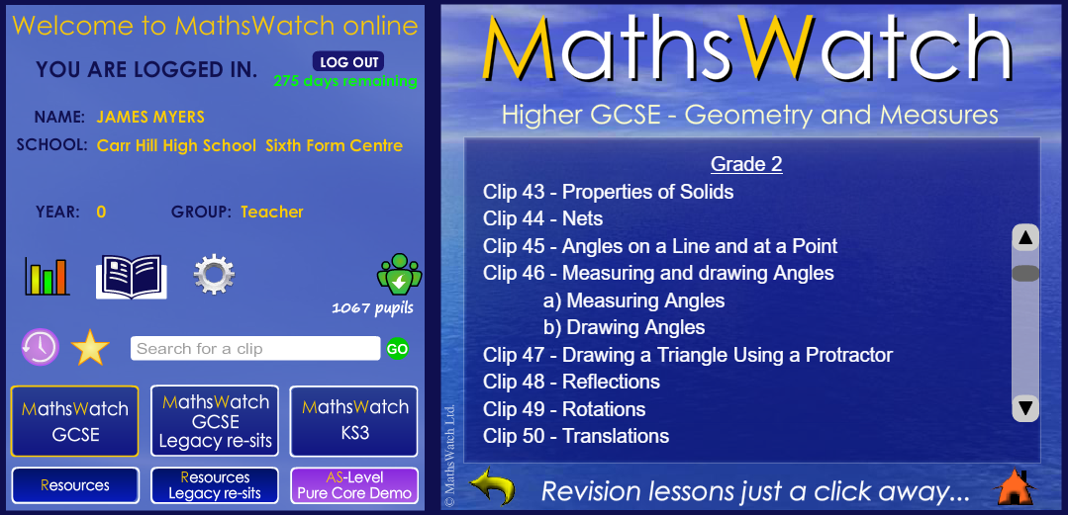
What is Mathswatch?
Notes:
Once we have covered the entire specification we then concentrate on using the assessments to identify each students areas of weakness.
After each assessment the teacher will receive a class report and each individual will receive an individual feedback sheet.
The teacher will initially address any misconceptions and areas of weakness shared by the class and then go onto deal with any individual issues using appropriate resources ( i.e. laptops and computer rooms).
It is essential students take responsibility at this point and take the opportunity to address issues independently maximise their final grade.

Slide 30
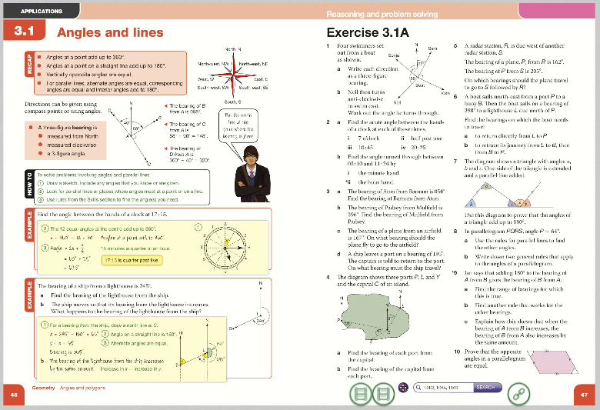
What is Kerboodle?
Notes:
Once we have covered the entire specification we then concentrate on using the assessments to identify each students areas of weakness.
After each assessment the teacher will receive a class report and each individual will receive an individual feedback sheet.
The teacher will initially address any misconceptions and areas of weakness shared by the class and then go onto deal with any individual issues using appropriate resources ( i.e. laptops and computer rooms).
It is essential students take responsibility at this point and take the opportunity to address issues independently maximise their final grade.

Slide 31
What support is available?
Their classroom teacher (at the appropriate time).
Tuesday and Thursday lunchtime room 4.
The Maths office.
Their mentor.
Web based resources.
Mymaths (login: carr password: isosceles)
Mathswatch (school id: carrhill Login: asmith@carrhill password: numbers)
Just Maths (User name: CarrStudent Password: Carr)
Kerboodle (Demonstrated in lesson)
The internet
Notes:
Intervention has already begun and will be changing throughout the year depending on assessment results. When students are timetabled for extra intervention you will be informed.
The intervention days are run throughout the year and have proved to be quite successful.

Slide 32




Revision Guides

Slide 33
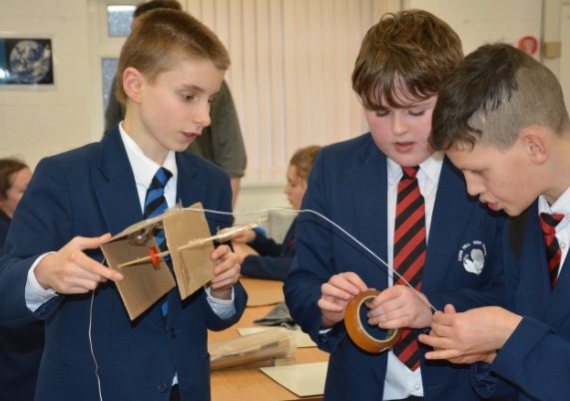
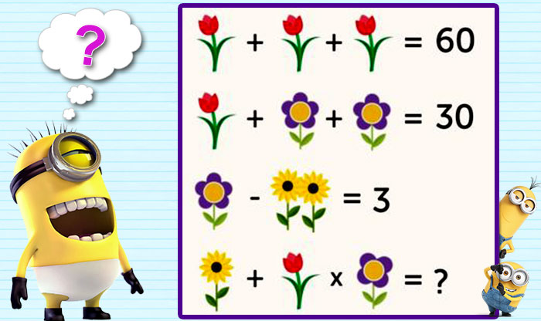
Extra-Curricular Activities
STEM Club (Every Thursday Room 6)
Maths Club (Wednesday Lunch Time)

Slide 34
Positive Attitude
Students’ ideas about their ability and potential are extremely important.
Messages students pick up from their parents about maths can change students’ learning and achievement.
It was not their parents lack of maths knowledge that harmed students’ performance but their parents’ anxiety.
Communicate positive messages, saying that maths is exciting and it is an open subject that anyone can learn with hard work.

Slide 35

Science
Cathy North
Head of Science

Slide 36
Year 7 Structure

Slide 37
Year 7 students:
Undertake a Transition examination in the first week which will help us direct intervention where need for Science skills.
Take assessments in pairs of topics to enable them to revise more content each time and develop revision techniques.
Will also undertake an examination towards the end of the year.
Will develop Scientific skills and learn how to think in a Scientific way- Independent research, Investigation, “trial and error”.
Will learn from their mistakes and develop resilience.
Notes:
The first 3 just enable the smooth running of a classroom allowing the teachers to concentrate on the curriculum as much as possible.
The final point I will refer to several times throughout the presentation.
“The one person who has the greatest impact on a students results are the student themselves.

Slide 38
In Science lessons students will:
Do practical work where possible.
Extend and develop Maths skills so will need a calculator.
Meet new words that they will have to remember the meanings of.
Explore the 10 Big ideas about Science through investigation and research.
Experience the kind of questions found in AQA GCSE’s.
Notes:
The first 3 just enable the smooth running of a classroom allowing the teachers to concentrate on the curriculum as much as possible.
The final point I will refer to several times throughout the presentation.
“The one person who has the greatest impact on a students results are the student themselves.

Slide 39
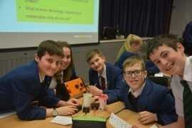
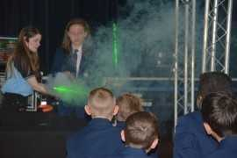
Enrichment Activities
Faraday Challenge
STEM clubs

Slide 40
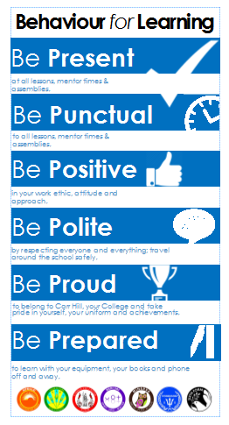
Behaviour For Learning
Lisa Coulthard, Assistant Headteacher

Slide 41
Expectations:

Slide 42
Reward Systems:
  Merits - these are issued on a daily basis to recognise achievement across the school and are recorded on SIMs.
  On a half termly basis student merits will be counted and recognised through College Celebration Assemblies.
  College badges in recognition of annual merit totals .
  Faculty rewards – positive text messages, praise post cards, telephone calls, verbal praise.
  6 ‘P’ Card, which reflects our code of conduct and recognises achievement and behaviour out of the classroom.
  End of year College Celebration Events
  End of year Whole School Celebration Events which takes place at Ribby Hall for invited students.

Slide 43
6 – P Card:
6 P Card – Achievement and conduct out of the class
Each student begins each half term with 10 merits recorded on their ‘P Card’. At the end of a half term these merits will be transferred a students behaviour record and will count towards yearly totals.
These Merits will be entered into a prize draw each half-term, 1 merit = 1 entry.
There will be 2 draws in each College – one for those who have maintained 10 merits and one for those with 6-9 merits
Opportunities will be given to students to earn additional merits
Each half term certificates will be awarded to students based on the number of merits earned on their P Card.
Merits can be earned by getting involved in activities, and by enhancing the life of the school.
Merits be can lost for failing to adhere to our code of conduct outside of the classroom.
There is an expectation that all students will have their card on their person at all times. Failure will result in a College Detention.

Slide 44
Starting Lessons off positively:
In classrooms students must follow this agreed procedure that staff will enforce:
Enter quietly when instructed to do so
Stand in silence behind chairs
Wait for your teachers instructions
When asked, ensure that you have out all your equipment including your handbook.

Slide 45
Consequences of not following instructions:
Lesson Time:
Stage 1 - Formal Warning
Stage 2 – Demerit & Move
Stage 3 – Time Out
Break/Lunch:
Serious Defiance Detentions
Serious Defiance
Exclusion (run from 8.55am – 4pm)
Members of SLT also have the authority to use serious defiance detentions and exclusion where they see appropriate.

Slide 46
We want to all students to have access to a happy and safe learning environment where they can thrive to achieve great success in the future.

Slide 47
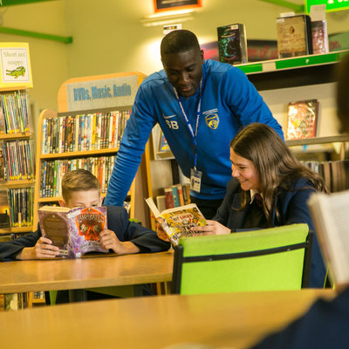
Learning at Carr Hill
Danny Morton
Assistant Headteacher

Slide 48
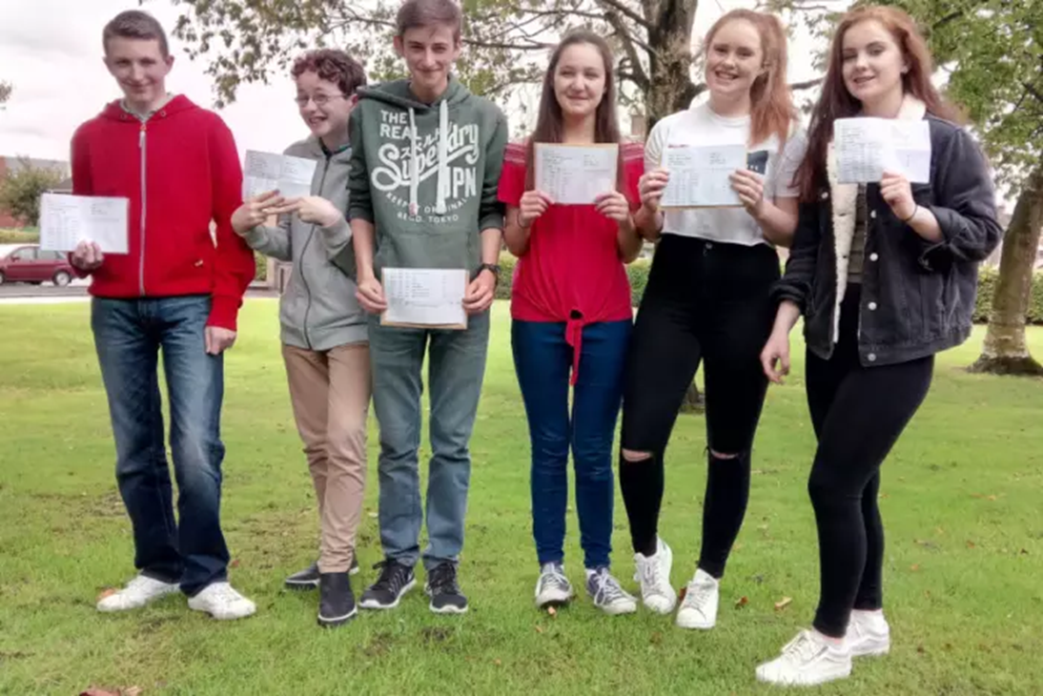
Our Aim Your Aim
Engagement
Challenge
Progression

Slide 49

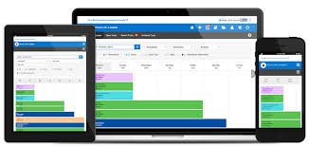
Homework

Slide 50



Feedback

Slide 51

Chromebooks
Danny Morton
Assistant Headteacher

Slide 52
“It is important for us to embrace the use of technology to maintain an innovative approach to teaching and learning which fully prepares students for further education and employment in a technological world”

Slide 53
What is a Chromebook?
Laptop-style device
Google operating system
Secure, safe & simple to use
Long life-span
Light in weight
Robust
Notes:
Google Chrome operating system
Laptop-style device
Operating on the cloud
Secure, safe and simple to use
Long life-span
Break down barriers to learning
Preparation for a technically advanced world
Working methods in school; the ability to use the keyboard

Slide 54

Prefer to bring you own device?
Our scheme is flexible to support a range of devices with an integrated keyboard
Equal access to school resources for every student
Notes:
You will receive a letter which contains all details of the chromebook school

Slide 55

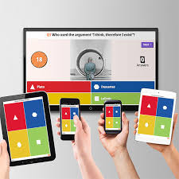





How do we use them in school?

