Slide 1
Thanks for Joining Us
Welcome from the Deputy Headteacher
Behaviour for Learning
Homework and Progress
Success in English
Success in Mathematics
Success in Science
Teaching and Learning
All information from this presentation will be available on the website from 1pm on Monday.
In Pursuit of Excellence Proud to Belong

Slide 2
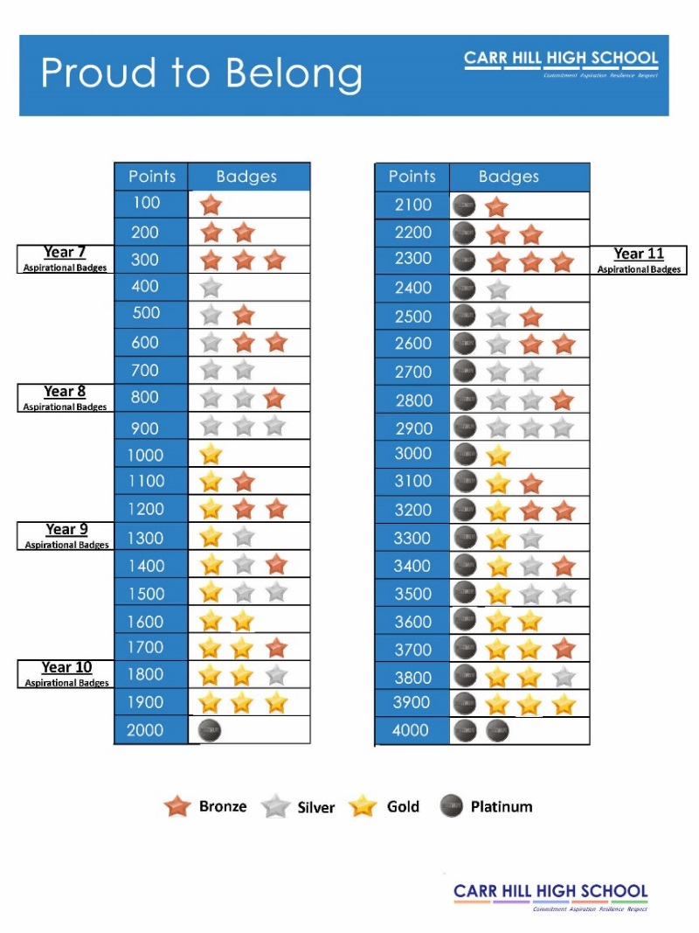
Praise and rewards
Merits - these are issued on a daily basis to recognise achievement across the school
On a weekly basis, mentors will recognise and praise achievement as part of mentor time.
Pastoral Leaders will recognise and praise achievement as part of weekly assemblies.
On a half termly basis student merits will be counted and recognised through Celebration Assemblies
Faculty rewards – positive text messages, praise post cards, telephone calls, verbal praise
6 ‘P’ Card, which reflects our code of conduct and recognises achievement and behaviour out of the classroom .
In Pursuit of Excellence Proud to Belong
Notes:
It is vital we celebrate, at every opportunity, the successes, progress and improvements of our students both within and out of the classroom.
We use the following rewards
Merits - these are issued on a daily basis to recognise achievement across the school and are recorded on SIMs.
On a weekly basis, mentors will recognise and praise achievement as part of mentor time. Pastoral Leaders will recognise and praise achievement as part of weekly assemblies.
On a half termly basis student merits will be counted and recognised through Celebration Assemblies
Badges in recognition of annual merit totals
Faculty rewards – positive text messages, praise post cards, telephone calls, verbal praise
6 ‘P’ Card, which reflects our code of conduct and recognises achievement and behaviour out of the classroom . (Replaces current conduct card and proud to belong card).
6 P Card – Achievement and conduct out of the class
Each student begins each half term with 10 merits recorded on their ‘P Card’. At the end of a half term these merits will be transferred a students behaviour record and will count towards yearly totals.
Merits can be earned by getting involved in activities, and by enhancing the life of the school.
Merits can lost for failing to adhere to our code of conduct outside of the classroom.
There is an expectation that all students will have their card on their person at all times. Failure will result in a Pastoral Detention

Slide 3
6 – P Card:
6 P Card – Achievement and conduct out of the class
Each student begins each half term with 10 merits recorded on their ‘P Card’. At the end of a half term these merits will be transferred a students behaviour record and will count towards yearly totals.
These Merits will be entered into a prize draw each half-term, 1 merit = 1 entry.
There will be 2 draws– one for those who have maintained 10 merits and one for those with 6-9 merits
Opportunities will be given to students to earn additional merits
Each half term certificates will be awarded to students based on the number of merits earned on their P Card.
Merits can be earned by getting involved in activities, and by enhancing the life of the school.
Merits be can lost for failing to adhere to our code of conduct outside of the classroom.
There is an expectation that all students will have their card on their person at all times. Failure will result in Detention.
In Pursuit of Excellence Proud to Belong
Notes:
It is vital we celebrate, at every opportunity, the successes, progress and improvements of our students both within and out of the classroom.
We use the following rewards
Merits - these are issued on a daily basis to recognise achievement across the school and are recorded on SIMs.
On a weekly basis, mentors will recognise and praise achievement as part of mentor time. Pastoral Leaders will recognise and praise achievement as part of weekly assemblies.
On a half termly basis student merits will be counted and recognised through Celebration Assemblies
Badges in recognition of annual merit totals
Faculty rewards – positive text messages, praise post cards, telephone calls, verbal praise
6 ‘P’ Card, which reflects our code of conduct and recognises achievement and behaviour out of the classroom . (Replaces current conduct card and proud to belong card).
6 P Card – Achievement and conduct out of the class
Each student begins each half term with 10 merits recorded on their ‘P Card’. At the end of a half term these merits will be transferred a students behaviour record and will count towards yearly totals.
Merits can be earned by getting involved in activities, and by enhancing the life of the school.
Merits can lost for failing to adhere to our code of conduct outside of the classroom.
There is an expectation that all students will have their card on their person at all times. Failure will result in a Pastoral Detention

Slide 4
Behaviour for Learning
To help everyone in all classes to do well,
everyone at Carr Hill agrees to:
Always be PRESENT, don’t miss out
Always be PUNCTUAL, every minute counts
Always be POSITIVE, always give 100%
Always be POLITE, treat others with respect and as you would want to be treated
Always be PROUD of yourself, your uniform, your year group and your school
Always be PREPARED to listen, to cooperate and to learn
Rewards | In class process | School Levels | Exclusion Unit
Classroom Merits 10 Merits for all Student – recognises all. Prize draws. Badges to Collect. Contact with home | Classroom Code 4 stage response Time-Out system Detention System | Students are tracked and parents kept informed. Each level triggers a pack of support and intervention. | Individual work stations Middle Leaders/ SLT Supervise Response to repeat Time-Out Tied to ‘on-call’ system.
In Pursuit of Excellence Proud to Belong
Notes:
It is vital we celebrate, at every opportunity, the successes, progress and improvements of our students both within and out of the classroom.
We use the following rewards
Merits - these are issued on a daily basis to recognise achievement across the school and are recorded on SIMs.
On a weekly basis, mentors will recognise and praise achievement as part of mentor time. Pastoral Leaders will recognise and praise achievement as part of weekly assemblies.
On a half termly basis student merits will be counted and recognised through Celebration Assemblies
Badges in recognition of annual merit totals
Faculty rewards – positive text messages, praise post cards, telephone calls, verbal praise
6 ‘P’ Card, which reflects our code of conduct and recognises achievement and behaviour out of the classroom . (Replaces current conduct card and proud to belong card).
6 P Card – Achievement and conduct out of the class
Each student begins each half term with 10 merits recorded on their ‘P Card’. At the end of a half term these merits will be transferred a students behaviour record and will count towards yearly totals.
Merits can be earned by getting involved in activities, and by enhancing the life of the school.
Merits can lost for failing to adhere to our code of conduct outside of the classroom.
There is an expectation that all students will have their card on their person at all times. Failure will result in a Pastoral Detention

Slide 5
Whole School Conduct Levels
Level | Trigger | Consequence
1 | 20 behaviour demerits in a half term and/ or 4 detentions. | Mentor Intervention – 2 Day Internal Exclusion Targets set for 6 weeks and if met brought back down a level. (Assessment made through pupil passport). Parental contact must be made. Optional use of Target Card
2 | 40 behaviour demerits in a half term and/ or 8 detentions. | 3 days Internal Exclusion and parents called in for meeting with Year Leader/ Mentor. Targets set for 6 weeks and if met brought back down a level. (Assessment made through pupil passport). Year Leader writes a behaviour contract. Optional Use of Target Card
3 | 60 behaviour demerits in a half term and/ or 12 detentions. | 4 Days Internal Exclusion and parents called in for meeting with Year Leader. Targets set for 6 weeks and if met brought back down a level. (Assessment made through pupil passport). Year Leader initiates and manages Behaviour for Learning Plan Optional Use of Target Card
4 | 80 behaviour demerits in a half term and/ or 16 detentions. | 5 days in Exclusion Room and parents called in for meeting with the Year Leader and Assistant Headteacher. Targets set for 6 weeks and if met brought back down a level. (Assessment made through pupil passport). Year Leader to initiate Pastoral Support Plan (PSP) PSP to be managed by Assistant Headteacher Optional Use of Target Card
5 | 100 behaviour demerits in a half term and/ or 20 detentions. | Respite Placement sought and parents called in for meeting with Headteacher. Targets set for 6 weeks and if met brought back down a level. (Assessment made through pupil passport). Assistant Headteacher to revise Pastoral Support Plan
In Pursuit of Excellence Proud to Belong
Notes:
It is vital we celebrate, at every opportunity, the successes, progress and improvements of our students both within and out of the classroom.
We use the following rewards
Merits - these are issued on a daily basis to recognise achievement across the school and are recorded on SIMs.
On a weekly basis, mentors will recognise and praise achievement as part of mentor time. Pastoral Leaders will recognise and praise achievement as part of weekly assemblies.
On a half termly basis student merits will be counted and recognised through Celebration Assemblies
Badges in recognition of annual merit totals
Faculty rewards – positive text messages, praise post cards, telephone calls, verbal praise
6 ‘P’ Card, which reflects our code of conduct and recognises achievement and behaviour out of the classroom . (Replaces current conduct card and proud to belong card).
6 P Card – Achievement and conduct out of the class
Each student begins each half term with 10 merits recorded on their ‘P Card’. At the end of a half term these merits will be transferred a students behaviour record and will count towards yearly totals.
Merits can be earned by getting involved in activities, and by enhancing the life of the school.
Merits can lost for failing to adhere to our code of conduct outside of the classroom.
There is an expectation that all students will have their card on their person at all times. Failure will result in a Pastoral Detention

Slide 6
Starting Lessons off positively:
In classrooms students must:
Enter quietly when instructed to do so
Stand in silence behind chairs
Wait for the teachers instructions
When asked, ensure that they have out all their equipment
In Pursuit of Excellence Proud to Belong
Notes:
It is vital we celebrate, at every opportunity, the successes, progress and improvements of our students both within and out of the classroom.
We use the following rewards
Merits - these are issued on a daily basis to recognise achievement across the school and are recorded on SIMs.
On a weekly basis, mentors will recognise and praise achievement as part of mentor time. Pastoral Leaders will recognise and praise achievement as part of weekly assemblies.
On a half termly basis student merits will be counted and recognised through Celebration Assemblies
Badges in recognition of annual merit totals
Faculty rewards – positive text messages, praise post cards, telephone calls, verbal praise
6 ‘P’ Card, which reflects our code of conduct and recognises achievement and behaviour out of the classroom . (Replaces current conduct card and proud to belong card).
6 P Card – Achievement and conduct out of the class
Each student begins each half term with 10 merits recorded on their ‘P Card’. At the end of a half term these merits will be transferred a students behaviour record and will count towards yearly totals.
Merits can be earned by getting involved in activities, and by enhancing the life of the school.
Merits can lost for failing to adhere to our code of conduct outside of the classroom.
There is an expectation that all students will have their card on their person at all times. Failure will result in a Pastoral Detention

Slide 7
Consequences of not following instructions:
Lesson Time:
Stage 1 - Formal Warning
Stage 2 – Demerit & Move
Stage 3 – Time Out
Break/Lunch:
Detentions by Faculty or pastoral staff
After school
Pastoral Head detentions (Monday till 3.50pm)
Serious Defiance detentions (Monday – Friday till 3.40pm)
Headteacher’s Detention (Friday till 4.30pm)
Exclusion
Internal exclusion from 8.55am till 4pm
Fixed term exclusion out of school
In Pursuit of Excellence Proud to Belong
Notes:
It is vital we celebrate, at every opportunity, the successes, progress and improvements of our students both within and out of the classroom.
We use the following rewards
Merits - these are issued on a daily basis to recognise achievement across the school and are recorded on SIMs.
On a weekly basis, mentors will recognise and praise achievement as part of mentor time. Pastoral Leaders will recognise and praise achievement as part of weekly assemblies.
On a half termly basis student merits will be counted and recognised through Celebration Assemblies
Badges in recognition of annual merit totals
Faculty rewards – positive text messages, praise post cards, telephone calls, verbal praise
6 ‘P’ Card, which reflects our code of conduct and recognises achievement and behaviour out of the classroom . (Replaces current conduct card and proud to belong card).
6 P Card – Achievement and conduct out of the class
Each student begins each half term with 10 merits recorded on their ‘P Card’. At the end of a half term these merits will be transferred a students behaviour record and will count towards yearly totals.
Merits can be earned by getting involved in activities, and by enhancing the life of the school.
Merits can lost for failing to adhere to our code of conduct outside of the classroom.
There is an expectation that all students will have their card on their person at all times. Failure will result in a Pastoral Detention

Slide 8
We want to all students to have access to a happy and safe learning environment where they can thrive to achieve great success in the future.
In Pursuit of Excellence Proud to Belong
Notes:
It is vital we celebrate, at every opportunity, the successes, progress and improvements of our students both within and out of the classroom.
We use the following rewards
Merits - these are issued on a daily basis to recognise achievement across the school and are recorded on SIMs.
On a weekly basis, mentors will recognise and praise achievement as part of mentor time. Pastoral Leaders will recognise and praise achievement as part of weekly assemblies.
On a half termly basis student merits will be counted and recognised through Celebration Assemblies
Badges in recognition of annual merit totals
Faculty rewards – positive text messages, praise post cards, telephone calls, verbal praise
6 ‘P’ Card, which reflects our code of conduct and recognises achievement and behaviour out of the classroom . (Replaces current conduct card and proud to belong card).
6 P Card – Achievement and conduct out of the class
Each student begins each half term with 10 merits recorded on their ‘P Card’. At the end of a half term these merits will be transferred a students behaviour record and will count towards yearly totals.
Merits can be earned by getting involved in activities, and by enhancing the life of the school.
Merits can lost for failing to adhere to our code of conduct outside of the classroom.
There is an expectation that all students will have their card on their person at all times. Failure will result in a Pastoral Detention

Slide 9
Progress and Homework
Miss A Jordinson Deputy Head teacher
In Pursuit of Excellence Proud to Belong
Notes:
It is vital we celebrate, at every opportunity, the successes, progress and improvements of our students both within and out of the classroom.
We use the following rewards
Merits - these are issued on a daily basis to recognise achievement across the school and are recorded on SIMs.
On a weekly basis, mentors will recognise and praise achievement as part of mentor time. Pastoral Leaders will recognise and praise achievement as part of weekly assemblies.
On a half termly basis student merits will be counted and recognised through Celebration Assemblies
Badges in recognition of annual merit totals
Faculty rewards – positive text messages, praise post cards, telephone calls, verbal praise
6 ‘P’ Card, which reflects our code of conduct and recognises achievement and behaviour out of the classroom . (Replaces current conduct card and proud to belong card).
6 P Card – Achievement and conduct out of the class
Each student begins each half term with 10 merits recorded on their ‘P Card’. At the end of a half term these merits will be transferred a students behaviour record and will count towards yearly totals.
Merits can be earned by getting involved in activities, and by enhancing the life of the school.
Merits can lost for failing to adhere to our code of conduct outside of the classroom.
There is an expectation that all students will have their card on their person at all times. Failure will result in a Pastoral Detention

Slide 10
Targets and keeping track of progress
KS2 scores | Performance in year 11 | PATHWAY
Average Scaled Score (Reading / Maths)
112-120 | 7-8 | BOOST
109-111
106-108 | 6-7 | CORE 1
101-105
97-100 | 4-5 | CORE 2
94-96
92-93 | 3-4 | FOUNDATION
80-91
In Pursuit of Excellence Proud to Belong
Notes:
It is vital we celebrate, at every opportunity, the successes, progress and improvements of our students both within and out of the classroom.
We use the following rewards
Merits - these are issued on a daily basis to recognise achievement across the school and are recorded on SIMs.
On a weekly basis, mentors will recognise and praise achievement as part of mentor time. Pastoral Leaders will recognise and praise achievement as part of weekly assemblies.
On a half termly basis student merits will be counted and recognised through Celebration Assemblies
Badges in recognition of annual merit totals
Faculty rewards – positive text messages, praise post cards, telephone calls, verbal praise
6 ‘P’ Card, which reflects our code of conduct and recognises achievement and behaviour out of the classroom . (Replaces current conduct card and proud to belong card).
6 P Card – Achievement and conduct out of the class
Each student begins each half term with 10 merits recorded on their ‘P Card’. At the end of a half term these merits will be transferred a students behaviour record and will count towards yearly totals.
Merits can be earned by getting involved in activities, and by enhancing the life of the school.
Merits can lost for failing to adhere to our code of conduct outside of the classroom.
There is an expectation that all students will have their card on their person at all times. Failure will result in a Pastoral Detention

Slide 11
Reports
Two reports per year, one in December and one at the end of the year.
The report will include information on their level of effort in each subject and whether or not they are making expected progress in their subject
Parents evening for year 8 is March 5th
In Pursuit of Excellence Proud to Belong
Notes:
It is vital we celebrate, at every opportunity, the successes, progress and improvements of our students both within and out of the classroom.
We use the following rewards
Merits - these are issued on a daily basis to recognise achievement across the school and are recorded on SIMs.
On a weekly basis, mentors will recognise and praise achievement as part of mentor time. Pastoral Leaders will recognise and praise achievement as part of weekly assemblies.
On a half termly basis student merits will be counted and recognised through Celebration Assemblies
Badges in recognition of annual merit totals
Faculty rewards – positive text messages, praise post cards, telephone calls, verbal praise
6 ‘P’ Card, which reflects our code of conduct and recognises achievement and behaviour out of the classroom . (Replaces current conduct card and proud to belong card).
6 P Card – Achievement and conduct out of the class
Each student begins each half term with 10 merits recorded on their ‘P Card’. At the end of a half term these merits will be transferred a students behaviour record and will count towards yearly totals.
Merits can be earned by getting involved in activities, and by enhancing the life of the school.
Merits can lost for failing to adhere to our code of conduct outside of the classroom.
There is an expectation that all students will have their card on their person at all times. Failure will result in a Pastoral Detention

Slide 12
Homework
Encourages good habits of independent learning and private study.
Allow students to prepare for class.
Allows students to demonstrate application of knowledge, understanding and skills.
Encourages parental involvement.
In Pursuit of Excellence Proud to Belong
Notes:
It is vital we celebrate, at every opportunity, the successes, progress and improvements of our students both within and out of the classroom.
We use the following rewards
Merits - these are issued on a daily basis to recognise achievement across the school and are recorded on SIMs.
On a weekly basis, mentors will recognise and praise achievement as part of mentor time. Pastoral Leaders will recognise and praise achievement as part of weekly assemblies.
On a half termly basis student merits will be counted and recognised through Celebration Assemblies
Badges in recognition of annual merit totals
Faculty rewards – positive text messages, praise post cards, telephone calls, verbal praise
6 ‘P’ Card, which reflects our code of conduct and recognises achievement and behaviour out of the classroom . (Replaces current conduct card and proud to belong card).
6 P Card – Achievement and conduct out of the class
Each student begins each half term with 10 merits recorded on their ‘P Card’. At the end of a half term these merits will be transferred a students behaviour record and will count towards yearly totals.
Merits can be earned by getting involved in activities, and by enhancing the life of the school.
Merits can lost for failing to adhere to our code of conduct outside of the classroom.
There is an expectation that all students will have their card on their person at all times. Failure will result in a Pastoral Detention

Slide 13
Show my Homework All students have received basic Show My Homework training in computing lessons.
In Pursuit of Excellence Proud to Belong
Notes:
It is vital we celebrate, at every opportunity, the successes, progress and improvements of our students both within and out of the classroom.
We use the following rewards
Merits - these are issued on a daily basis to recognise achievement across the school and are recorded on SIMs.
On a weekly basis, mentors will recognise and praise achievement as part of mentor time. Pastoral Leaders will recognise and praise achievement as part of weekly assemblies.
On a half termly basis student merits will be counted and recognised through Celebration Assemblies
Badges in recognition of annual merit totals
Faculty rewards – positive text messages, praise post cards, telephone calls, verbal praise
6 ‘P’ Card, which reflects our code of conduct and recognises achievement and behaviour out of the classroom . (Replaces current conduct card and proud to belong card).
6 P Card – Achievement and conduct out of the class
Each student begins each half term with 10 merits recorded on their ‘P Card’. At the end of a half term these merits will be transferred a students behaviour record and will count towards yearly totals.
Merits can be earned by getting involved in activities, and by enhancing the life of the school.
Merits can lost for failing to adhere to our code of conduct outside of the classroom.
There is an expectation that all students will have their card on their person at all times. Failure will result in a Pastoral Detention

Slide 14
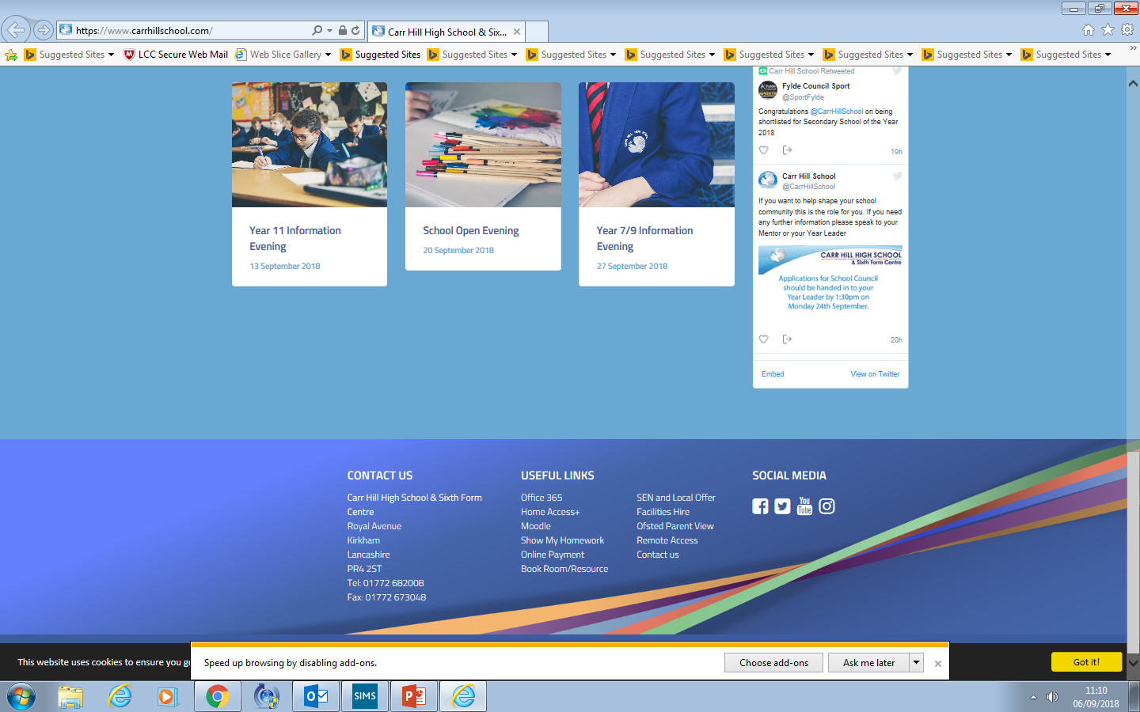
Using Chrome access the Carr Hill Website and at the bottom under “Useful Links” click “Show my Homework”
In Pursuit of Excellence Proud to Belong
Notes:
It is vital we celebrate, at every opportunity, the successes, progress and improvements of our students both within and out of the classroom.
We use the following rewards
Merits - these are issued on a daily basis to recognise achievement across the school and are recorded on SIMs.
On a weekly basis, mentors will recognise and praise achievement as part of mentor time. Pastoral Leaders will recognise and praise achievement as part of weekly assemblies.
On a half termly basis student merits will be counted and recognised through Celebration Assemblies
Badges in recognition of annual merit totals
Faculty rewards – positive text messages, praise post cards, telephone calls, verbal praise
6 ‘P’ Card, which reflects our code of conduct and recognises achievement and behaviour out of the classroom . (Replaces current conduct card and proud to belong card).
6 P Card – Achievement and conduct out of the class
Each student begins each half term with 10 merits recorded on their ‘P Card’. At the end of a half term these merits will be transferred a students behaviour record and will count towards yearly totals.
Merits can be earned by getting involved in activities, and by enhancing the life of the school.
Merits can lost for failing to adhere to our code of conduct outside of the classroom.
There is an expectation that all students will have their card on their person at all times. Failure will result in a Pastoral Detention

Slide 15
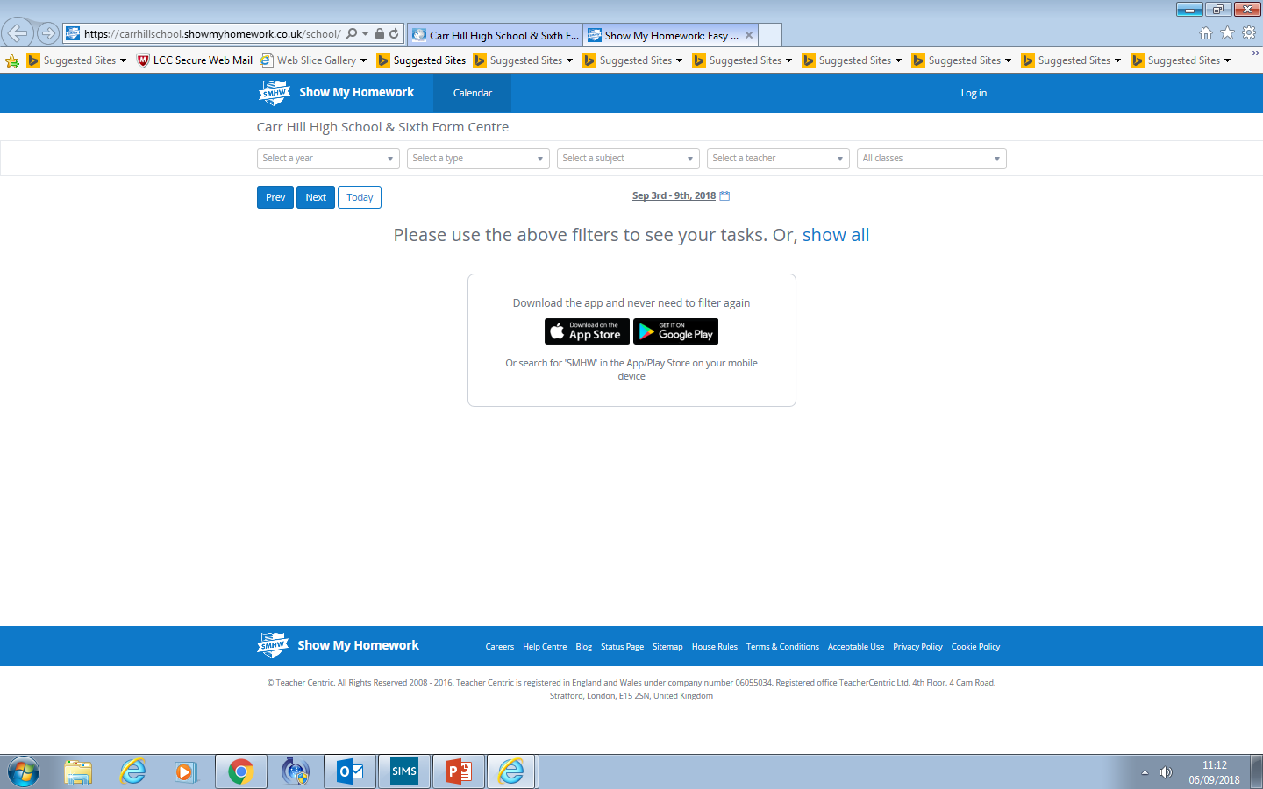
Log in
In Pursuit of Excellence Proud to Belong
Notes:
It is vital we celebrate, at every opportunity, the successes, progress and improvements of our students both within and out of the classroom.
We use the following rewards
Merits - these are issued on a daily basis to recognise achievement across the school and are recorded on SIMs.
On a weekly basis, mentors will recognise and praise achievement as part of mentor time. Pastoral Leaders will recognise and praise achievement as part of weekly assemblies.
On a half termly basis student merits will be counted and recognised through Celebration Assemblies
Badges in recognition of annual merit totals
Faculty rewards – positive text messages, praise post cards, telephone calls, verbal praise
6 ‘P’ Card, which reflects our code of conduct and recognises achievement and behaviour out of the classroom . (Replaces current conduct card and proud to belong card).
6 P Card – Achievement and conduct out of the class
Each student begins each half term with 10 merits recorded on their ‘P Card’. At the end of a half term these merits will be transferred a students behaviour record and will count towards yearly totals.
Merits can be earned by getting involved in activities, and by enhancing the life of the school.
Merits can lost for failing to adhere to our code of conduct outside of the classroom.
There is an expectation that all students will have their card on their person at all times. Failure will result in a Pastoral Detention

Slide 16
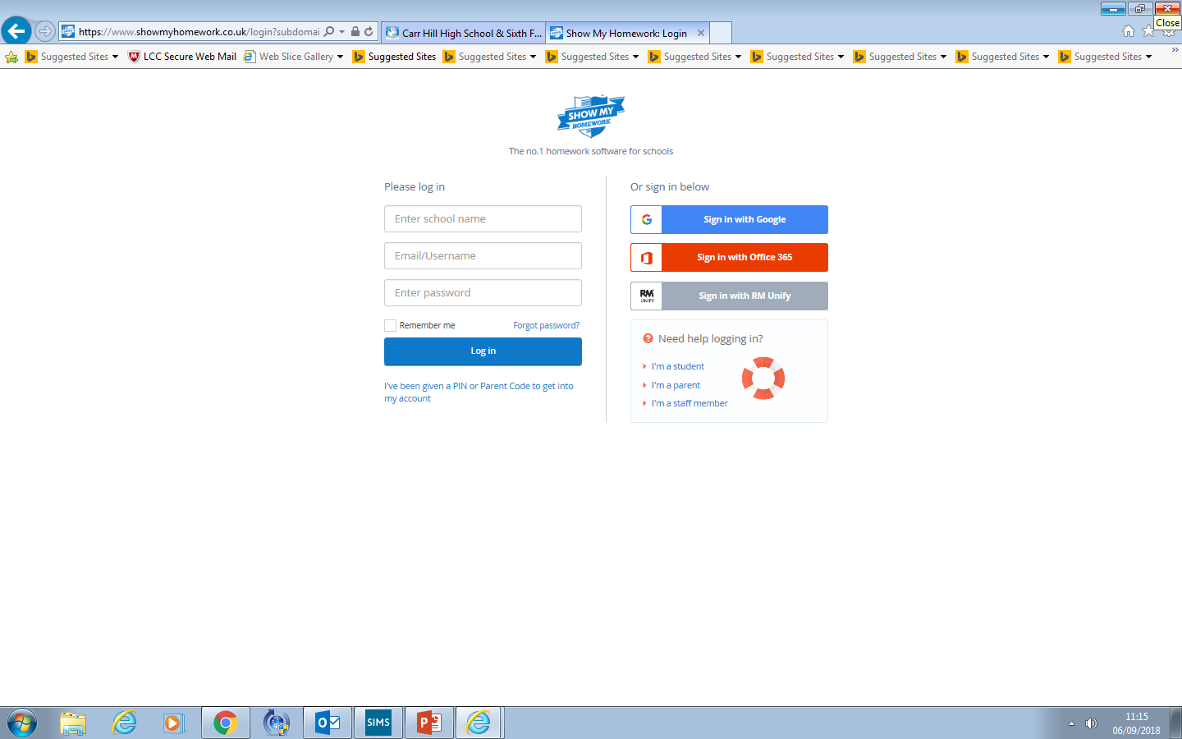
In Pursuit of Excellence Proud to Belong
Notes:
It is vital we celebrate, at every opportunity, the successes, progress and improvements of our students both within and out of the classroom.
We use the following rewards
Merits - these are issued on a daily basis to recognise achievement across the school and are recorded on SIMs.
On a weekly basis, mentors will recognise and praise achievement as part of mentor time. Pastoral Leaders will recognise and praise achievement as part of weekly assemblies.
On a half termly basis student merits will be counted and recognised through Celebration Assemblies
Badges in recognition of annual merit totals
Faculty rewards – positive text messages, praise post cards, telephone calls, verbal praise
6 ‘P’ Card, which reflects our code of conduct and recognises achievement and behaviour out of the classroom . (Replaces current conduct card and proud to belong card).
6 P Card – Achievement and conduct out of the class
Each student begins each half term with 10 merits recorded on their ‘P Card’. At the end of a half term these merits will be transferred a students behaviour record and will count towards yearly totals.
Merits can be earned by getting involved in activities, and by enhancing the life of the school.
Merits can lost for failing to adhere to our code of conduct outside of the classroom.
There is an expectation that all students will have their card on their person at all times. Failure will result in a Pastoral Detention

Slide 17
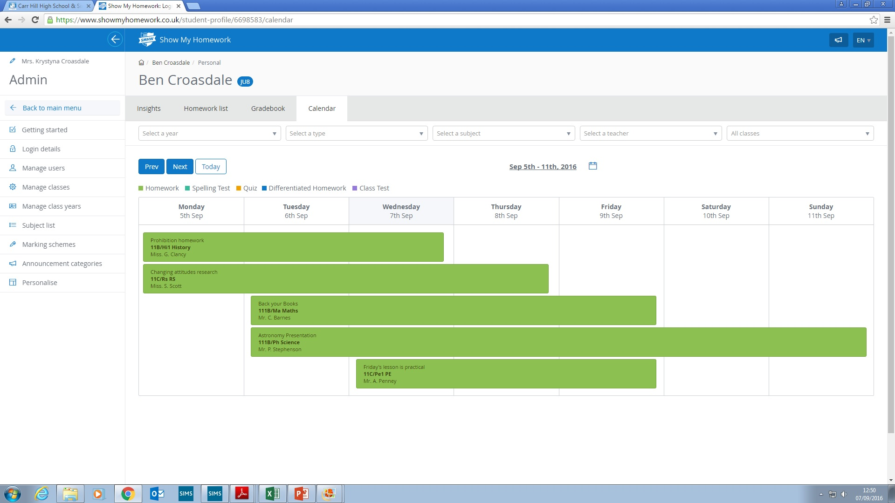
In Pursuit of Excellence Proud to Belong
Notes:
It is vital we celebrate, at every opportunity, the successes, progress and improvements of our students both within and out of the classroom.
We use the following rewards
Merits - these are issued on a daily basis to recognise achievement across the school and are recorded on SIMs.
On a weekly basis, mentors will recognise and praise achievement as part of mentor time. Pastoral Leaders will recognise and praise achievement as part of weekly assemblies.
On a half termly basis student merits will be counted and recognised through Celebration Assemblies
Badges in recognition of annual merit totals
Faculty rewards – positive text messages, praise post cards, telephone calls, verbal praise
6 ‘P’ Card, which reflects our code of conduct and recognises achievement and behaviour out of the classroom . (Replaces current conduct card and proud to belong card).
6 P Card – Achievement and conduct out of the class
Each student begins each half term with 10 merits recorded on their ‘P Card’. At the end of a half term these merits will be transferred a students behaviour record and will count towards yearly totals.
Merits can be earned by getting involved in activities, and by enhancing the life of the school.
Merits can lost for failing to adhere to our code of conduct outside of the classroom.
There is an expectation that all students will have their card on their person at all times. Failure will result in a Pastoral Detention

Slide 18
Contribution for materials
Online payment
Cash at the finance office
In Pursuit of Excellence Proud to Belong
Notes:
It is vital we celebrate, at every opportunity, the successes, progress and improvements of our students both within and out of the classroom.
We use the following rewards
Merits - these are issued on a daily basis to recognise achievement across the school and are recorded on SIMs.
On a weekly basis, mentors will recognise and praise achievement as part of mentor time. Pastoral Leaders will recognise and praise achievement as part of weekly assemblies.
On a half termly basis student merits will be counted and recognised through Celebration Assemblies
Badges in recognition of annual merit totals
Faculty rewards – positive text messages, praise post cards, telephone calls, verbal praise
6 ‘P’ Card, which reflects our code of conduct and recognises achievement and behaviour out of the classroom . (Replaces current conduct card and proud to belong card).
6 P Card – Achievement and conduct out of the class
Each student begins each half term with 10 merits recorded on their ‘P Card’. At the end of a half term these merits will be transferred a students behaviour record and will count towards yearly totals.
Merits can be earned by getting involved in activities, and by enhancing the life of the school.
Merits can lost for failing to adhere to our code of conduct outside of the classroom.
There is an expectation that all students will have their card on their person at all times. Failure will result in a Pastoral Detention

Slide 19
English
In Pursuit of Excellence Proud to Belong
Notes:
It is vital we celebrate, at every opportunity, the successes, progress and improvements of our students both within and out of the classroom.
We use the following rewards
Merits - these are issued on a daily basis to recognise achievement across the school and are recorded on SIMs.
On a weekly basis, mentors will recognise and praise achievement as part of mentor time. Pastoral Leaders will recognise and praise achievement as part of weekly assemblies.
On a half termly basis student merits will be counted and recognised through Celebration Assemblies
Badges in recognition of annual merit totals
Faculty rewards – positive text messages, praise post cards, telephone calls, verbal praise
6 ‘P’ Card, which reflects our code of conduct and recognises achievement and behaviour out of the classroom . (Replaces current conduct card and proud to belong card).
6 P Card – Achievement and conduct out of the class
Each student begins each half term with 10 merits recorded on their ‘P Card’. At the end of a half term these merits will be transferred a students behaviour record and will count towards yearly totals.
Merits can be earned by getting involved in activities, and by enhancing the life of the school.
Merits can lost for failing to adhere to our code of conduct outside of the classroom.
There is an expectation that all students will have their card on their person at all times. Failure will result in a Pastoral Detention

Slide 20
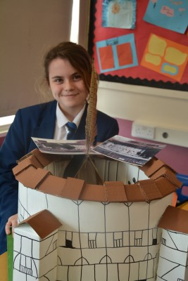
The Year 8 Course
The year 8 English course consolidates and develops skills taught at KS2 and year 7 whilst preparing students for forthcoming GCSE English and Literature study.
Students read a range of fiction and non-fiction texts including contemporary and pre-twentieth century texts. They learn to develop the skills of analysis. A variety of writing styles are practised and there is a focus on improving technical accuracy – spelling, punctuation and grammar.
In addition to this curricular work, the English department offers a range of extra-curricular activities and competitions to encourage students to write for different audiences and to promote a love of literature and reading.
In Pursuit of Excellence Proud to Belong
Notes:
It is vital we celebrate, at every opportunity, the successes, progress and improvements of our students both within and out of the classroom.
We use the following rewards
Merits - these are issued on a daily basis to recognise achievement across the school and are recorded on SIMs.
On a weekly basis, mentors will recognise and praise achievement as part of mentor time. Pastoral Leaders will recognise and praise achievement as part of weekly assemblies.
On a half termly basis student merits will be counted and recognised through Celebration Assemblies
Badges in recognition of annual merit totals
Faculty rewards – positive text messages, praise post cards, telephone calls, verbal praise
6 ‘P’ Card, which reflects our code of conduct and recognises achievement and behaviour out of the classroom . (Replaces current conduct card and proud to belong card).
6 P Card – Achievement and conduct out of the class
Each student begins each half term with 10 merits recorded on their ‘P Card’. At the end of a half term these merits will be transferred a students behaviour record and will count towards yearly totals.
Merits can be earned by getting involved in activities, and by enhancing the life of the school.
Merits can lost for failing to adhere to our code of conduct outside of the classroom.
There is an expectation that all students will have their card on their person at all times. Failure will result in a Pastoral Detention

Slide 21
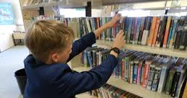
Accelerated Reader
Accelerated Reader is a computer program that helps teachers manage and monitor children’s independent reading practice.
Your child picks a book at their own level and reads it at their own pace. When finished, your child takes a short quiz on the computer.
Students have one lesson each fortnight in the HUB library.
In Pursuit of Excellence Proud to Belong
Notes:
It is vital we celebrate, at every opportunity, the successes, progress and improvements of our students both within and out of the classroom.
We use the following rewards
Merits - these are issued on a daily basis to recognise achievement across the school and are recorded on SIMs.
On a weekly basis, mentors will recognise and praise achievement as part of mentor time. Pastoral Leaders will recognise and praise achievement as part of weekly assemblies.
On a half termly basis student merits will be counted and recognised through Celebration Assemblies
Badges in recognition of annual merit totals
Faculty rewards – positive text messages, praise post cards, telephone calls, verbal praise
6 ‘P’ Card, which reflects our code of conduct and recognises achievement and behaviour out of the classroom . (Replaces current conduct card and proud to belong card).
6 P Card – Achievement and conduct out of the class
Each student begins each half term with 10 merits recorded on their ‘P Card’. At the end of a half term these merits will be transferred a students behaviour record and will count towards yearly totals.
Merits can be earned by getting involved in activities, and by enhancing the life of the school.
Merits can lost for failing to adhere to our code of conduct outside of the classroom.
There is an expectation that all students will have their card on their person at all times. Failure will result in a Pastoral Detention

Slide 22
Parents and Carers
You can help to support your child by encouraging regular and wide reading.
Regular reading impacts on comprehension skills and writing skills as well as helping your child to become an independent learner.
Thank you for encouraging your child to complete such tasks regularly as on-going homework.
A parent guide to Accelerated Reader is available for you to pick up at the end of the end of the evening.
Homework is set regularly via Show My Homework.
In Pursuit of Excellence Proud to Belong
Notes:
It is vital we celebrate, at every opportunity, the successes, progress and improvements of our students both within and out of the classroom.
We use the following rewards
Merits - these are issued on a daily basis to recognise achievement across the school and are recorded on SIMs.
On a weekly basis, mentors will recognise and praise achievement as part of mentor time. Pastoral Leaders will recognise and praise achievement as part of weekly assemblies.
On a half termly basis student merits will be counted and recognised through Celebration Assemblies
Badges in recognition of annual merit totals
Faculty rewards – positive text messages, praise post cards, telephone calls, verbal praise
6 ‘P’ Card, which reflects our code of conduct and recognises achievement and behaviour out of the classroom . (Replaces current conduct card and proud to belong card).
6 P Card – Achievement and conduct out of the class
Each student begins each half term with 10 merits recorded on their ‘P Card’. At the end of a half term these merits will be transferred a students behaviour record and will count towards yearly totals.
Merits can be earned by getting involved in activities, and by enhancing the life of the school.
Merits can lost for failing to adhere to our code of conduct outside of the classroom.
There is an expectation that all students will have their card on their person at all times. Failure will result in a Pastoral Detention

Slide 23
Should you have any queries, please contact either:
Mrs M Aspden - Faculty Leader
Ms C Fry – Assistant Faculty Leader
Mrs K Gardner – Assistant Faculty Leader
Parents and Carers
In Pursuit of Excellence Proud to Belong
Notes:
It is vital we celebrate, at every opportunity, the successes, progress and improvements of our students both within and out of the classroom.
We use the following rewards
Merits - these are issued on a daily basis to recognise achievement across the school and are recorded on SIMs.
On a weekly basis, mentors will recognise and praise achievement as part of mentor time. Pastoral Leaders will recognise and praise achievement as part of weekly assemblies.
On a half termly basis student merits will be counted and recognised through Celebration Assemblies
Badges in recognition of annual merit totals
Faculty rewards – positive text messages, praise post cards, telephone calls, verbal praise
6 ‘P’ Card, which reflects our code of conduct and recognises achievement and behaviour out of the classroom . (Replaces current conduct card and proud to belong card).
6 P Card – Achievement and conduct out of the class
Each student begins each half term with 10 merits recorded on their ‘P Card’. At the end of a half term these merits will be transferred a students behaviour record and will count towards yearly totals.
Merits can be earned by getting involved in activities, and by enhancing the life of the school.
Merits can lost for failing to adhere to our code of conduct outside of the classroom.
There is an expectation that all students will have their card on their person at all times. Failure will result in a Pastoral Detention

Slide 24
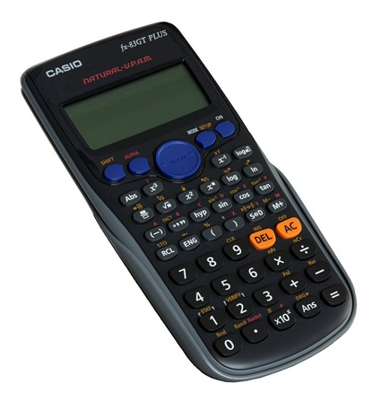
Mathematics
In Pursuit of Excellence Proud to Belong
Notes:
It is vital we celebrate, at every opportunity, the successes, progress and improvements of our students both within and out of the classroom.
We use the following rewards
Merits - these are issued on a daily basis to recognise achievement across the school and are recorded on SIMs.
On a weekly basis, mentors will recognise and praise achievement as part of mentor time. Pastoral Leaders will recognise and praise achievement as part of weekly assemblies.
On a half termly basis student merits will be counted and recognised through Celebration Assemblies
Badges in recognition of annual merit totals
Faculty rewards – positive text messages, praise post cards, telephone calls, verbal praise
6 ‘P’ Card, which reflects our code of conduct and recognises achievement and behaviour out of the classroom . (Replaces current conduct card and proud to belong card).
6 P Card – Achievement and conduct out of the class
Each student begins each half term with 10 merits recorded on their ‘P Card’. At the end of a half term these merits will be transferred a students behaviour record and will count towards yearly totals.
Merits can be earned by getting involved in activities, and by enhancing the life of the school.
Merits can lost for failing to adhere to our code of conduct outside of the classroom.
There is an expectation that all students will have their card on their person at all times. Failure will result in a Pastoral Detention

Slide 25
Mathematics in Year 8
Algebra, number, ratio, geometry and statistics building on the work in year 7.
Learn the skills to enable problem solving.
Each fortnight, one lesson will be used for students to spend time preparing a revision sheet before completing a knowledge check.
Differentiated target classwork and homework will be given to students from these results.
If a student still appears to have gaps in knowledge they will be asked to attend intervention at lunch or after school to catch them up immediately.
The revision sheets will be returned to students each year before the relevant topic for revision.
In Pursuit of Excellence Proud to Belong
Notes:
It is vital we celebrate, at every opportunity, the successes, progress and improvements of our students both within and out of the classroom.
We use the following rewards
Merits - these are issued on a daily basis to recognise achievement across the school and are recorded on SIMs.
On a weekly basis, mentors will recognise and praise achievement as part of mentor time. Pastoral Leaders will recognise and praise achievement as part of weekly assemblies.
On a half termly basis student merits will be counted and recognised through Celebration Assemblies
Badges in recognition of annual merit totals
Faculty rewards – positive text messages, praise post cards, telephone calls, verbal praise
6 ‘P’ Card, which reflects our code of conduct and recognises achievement and behaviour out of the classroom . (Replaces current conduct card and proud to belong card).
6 P Card – Achievement and conduct out of the class
Each student begins each half term with 10 merits recorded on their ‘P Card’. At the end of a half term these merits will be transferred a students behaviour record and will count towards yearly totals.
Merits can be earned by getting involved in activities, and by enhancing the life of the school.
Merits can lost for failing to adhere to our code of conduct outside of the classroom.
There is an expectation that all students will have their card on their person at all times. Failure will result in a Pastoral Detention

Slide 26
How can parents/carers help?
Be positive
Encourage your child to be positive
Encourage your child to be resilient
Encourage your child to ask for help
Ensure your child has the correct equipment for lessons
In Pursuit of Excellence Proud to Belong
Notes:
It is vital we celebrate, at every opportunity, the successes, progress and improvements of our students both within and out of the classroom.
We use the following rewards
Merits - these are issued on a daily basis to recognise achievement across the school and are recorded on SIMs.
On a weekly basis, mentors will recognise and praise achievement as part of mentor time. Pastoral Leaders will recognise and praise achievement as part of weekly assemblies.
On a half termly basis student merits will be counted and recognised through Celebration Assemblies
Badges in recognition of annual merit totals
Faculty rewards – positive text messages, praise post cards, telephone calls, verbal praise
6 ‘P’ Card, which reflects our code of conduct and recognises achievement and behaviour out of the classroom . (Replaces current conduct card and proud to belong card).
6 P Card – Achievement and conduct out of the class
Each student begins each half term with 10 merits recorded on their ‘P Card’. At the end of a half term these merits will be transferred a students behaviour record and will count towards yearly totals.
Merits can be earned by getting involved in activities, and by enhancing the life of the school.
Merits can lost for failing to adhere to our code of conduct outside of the classroom.
There is an expectation that all students will have their card on their person at all times. Failure will result in a Pastoral Detention

Slide 27
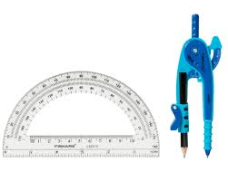
Reminders
We recommend you back your maths book
On your desks should be:
Your pens: Blue/Black, Red and Purple.
Maths Book. Planner. Calculator.
Geometry Equipment: Ruler, Compass and Protractor.
At the start of each lesson:
Rule off from the previous lesson.
Always write ‘cwk’ and the date and underline both.
In Pursuit of Excellence Proud to Belong
Notes:
It is vital we celebrate, at every opportunity, the successes, progress and improvements of our students both within and out of the classroom.
We use the following rewards
Merits - these are issued on a daily basis to recognise achievement across the school and are recorded on SIMs.
On a weekly basis, mentors will recognise and praise achievement as part of mentor time. Pastoral Leaders will recognise and praise achievement as part of weekly assemblies.
On a half termly basis student merits will be counted and recognised through Celebration Assemblies
Badges in recognition of annual merit totals
Faculty rewards – positive text messages, praise post cards, telephone calls, verbal praise
6 ‘P’ Card, which reflects our code of conduct and recognises achievement and behaviour out of the classroom . (Replaces current conduct card and proud to belong card).
6 P Card – Achievement and conduct out of the class
Each student begins each half term with 10 merits recorded on their ‘P Card’. At the end of a half term these merits will be transferred a students behaviour record and will count towards yearly totals.
Merits can be earned by getting involved in activities, and by enhancing the life of the school.
Merits can lost for failing to adhere to our code of conduct outside of the classroom.
There is an expectation that all students will have their card on their person at all times. Failure will result in a Pastoral Detention

Slide 28
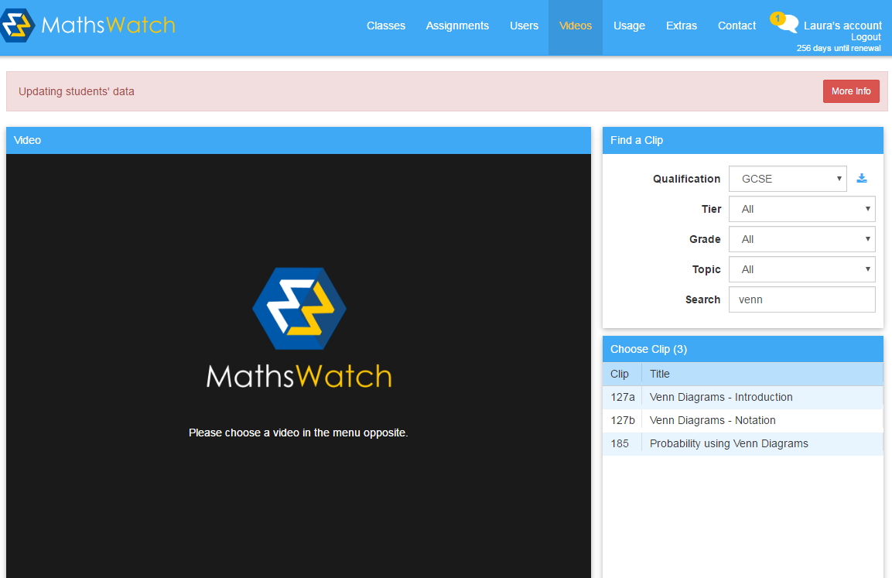
What is Mathswatch?
.
In Pursuit of Excellence Proud to Belong
Notes:
It is vital we celebrate, at every opportunity, the successes, progress and improvements of our students both within and out of the classroom.
We use the following rewards
Merits - these are issued on a daily basis to recognise achievement across the school and are recorded on SIMs.
On a weekly basis, mentors will recognise and praise achievement as part of mentor time. Pastoral Leaders will recognise and praise achievement as part of weekly assemblies.
On a half termly basis student merits will be counted and recognised through Celebration Assemblies
Badges in recognition of annual merit totals
Faculty rewards – positive text messages, praise post cards, telephone calls, verbal praise
6 ‘P’ Card, which reflects our code of conduct and recognises achievement and behaviour out of the classroom . (Replaces current conduct card and proud to belong card).
6 P Card – Achievement and conduct out of the class
Each student begins each half term with 10 merits recorded on their ‘P Card’. At the end of a half term these merits will be transferred a students behaviour record and will count towards yearly totals.
Merits can be earned by getting involved in activities, and by enhancing the life of the school.
Merits can lost for failing to adhere to our code of conduct outside of the classroom.
There is an expectation that all students will have their card on their person at all times. Failure will result in a Pastoral Detention

Slide 29
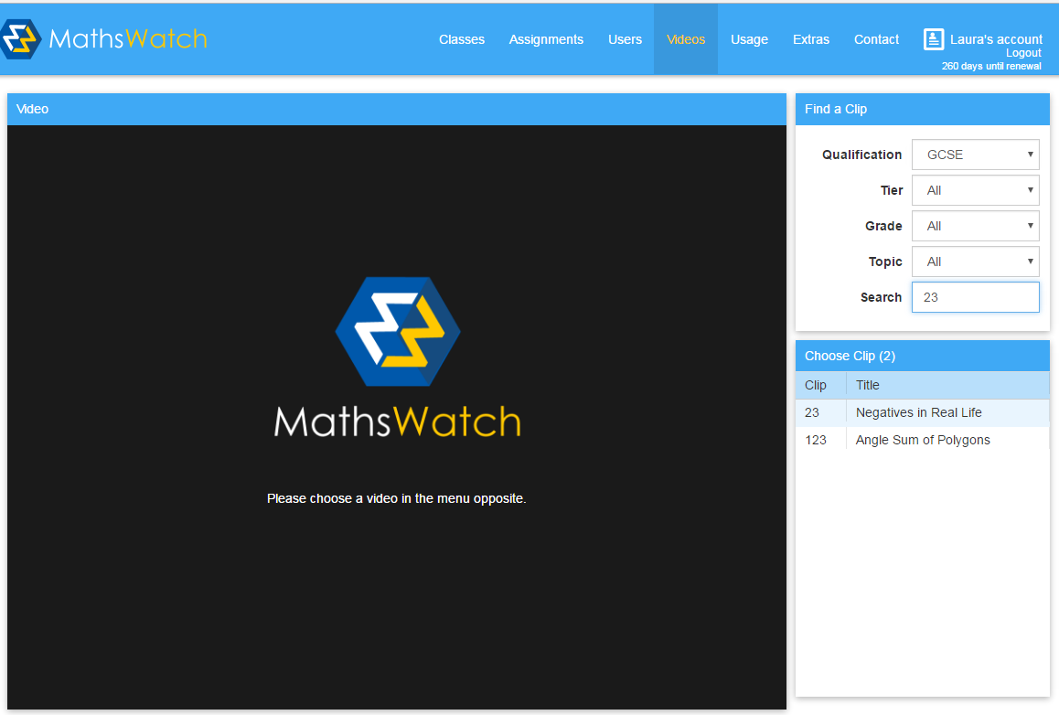
Mathswatch
For all students, you need to log on to vle.mathswatch.com
.
To watch a video:
Login details for Isaac Newton would be:
User name: inewton@carrhill
The password is numbers
Click video
In Pursuit of Excellence Proud to Belong
Notes:
It is vital we celebrate, at every opportunity, the successes, progress and improvements of our students both within and out of the classroom.
We use the following rewards
Merits - these are issued on a daily basis to recognise achievement across the school and are recorded on SIMs.
On a weekly basis, mentors will recognise and praise achievement as part of mentor time. Pastoral Leaders will recognise and praise achievement as part of weekly assemblies.
On a half termly basis student merits will be counted and recognised through Celebration Assemblies
Badges in recognition of annual merit totals
Faculty rewards – positive text messages, praise post cards, telephone calls, verbal praise
6 ‘P’ Card, which reflects our code of conduct and recognises achievement and behaviour out of the classroom . (Replaces current conduct card and proud to belong card).
6 P Card – Achievement and conduct out of the class
Each student begins each half term with 10 merits recorded on their ‘P Card’. At the end of a half term these merits will be transferred a students behaviour record and will count towards yearly totals.
Merits can be earned by getting involved in activities, and by enhancing the life of the school.
Merits can lost for failing to adhere to our code of conduct outside of the classroom.
There is an expectation that all students will have their card on their person at all times. Failure will result in a Pastoral Detention

Slide 30
What support is available?
Their classroom teacher (at the appropriate time).
Tuesday and Thursday lunchtime room 4.
The Maths office.
Their mentor.
Web based resources – Hegarty Maths
In Pursuit of Excellence Proud to Belong
Notes:
It is vital we celebrate, at every opportunity, the successes, progress and improvements of our students both within and out of the classroom.
We use the following rewards
Merits - these are issued on a daily basis to recognise achievement across the school and are recorded on SIMs.
On a weekly basis, mentors will recognise and praise achievement as part of mentor time. Pastoral Leaders will recognise and praise achievement as part of weekly assemblies.
On a half termly basis student merits will be counted and recognised through Celebration Assemblies
Badges in recognition of annual merit totals
Faculty rewards – positive text messages, praise post cards, telephone calls, verbal praise
6 ‘P’ Card, which reflects our code of conduct and recognises achievement and behaviour out of the classroom . (Replaces current conduct card and proud to belong card).
6 P Card – Achievement and conduct out of the class
Each student begins each half term with 10 merits recorded on their ‘P Card’. At the end of a half term these merits will be transferred a students behaviour record and will count towards yearly totals.
Merits can be earned by getting involved in activities, and by enhancing the life of the school.
Merits can lost for failing to adhere to our code of conduct outside of the classroom.
There is an expectation that all students will have their card on their person at all times. Failure will result in a Pastoral Detention

Slide 31
Extra-Curricular Activities
Maths Club (Wednesday Lunch Time)
In Pursuit of Excellence Proud to Belong
Notes:
It is vital we celebrate, at every opportunity, the successes, progress and improvements of our students both within and out of the classroom.
We use the following rewards
Merits - these are issued on a daily basis to recognise achievement across the school and are recorded on SIMs.
On a weekly basis, mentors will recognise and praise achievement as part of mentor time. Pastoral Leaders will recognise and praise achievement as part of weekly assemblies.
On a half termly basis student merits will be counted and recognised through Celebration Assemblies
Badges in recognition of annual merit totals
Faculty rewards – positive text messages, praise post cards, telephone calls, verbal praise
6 ‘P’ Card, which reflects our code of conduct and recognises achievement and behaviour out of the classroom . (Replaces current conduct card and proud to belong card).
6 P Card – Achievement and conduct out of the class
Each student begins each half term with 10 merits recorded on their ‘P Card’. At the end of a half term these merits will be transferred a students behaviour record and will count towards yearly totals.
Merits can be earned by getting involved in activities, and by enhancing the life of the school.
Merits can lost for failing to adhere to our code of conduct outside of the classroom.
There is an expectation that all students will have their card on their person at all times. Failure will result in a Pastoral Detention

Slide 32
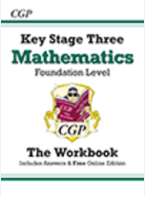
Revision Guides
In Pursuit of Excellence Proud to Belong
Notes:
It is vital we celebrate, at every opportunity, the successes, progress and improvements of our students both within and out of the classroom.
We use the following rewards
Merits - these are issued on a daily basis to recognise achievement across the school and are recorded on SIMs.
On a weekly basis, mentors will recognise and praise achievement as part of mentor time. Pastoral Leaders will recognise and praise achievement as part of weekly assemblies.
On a half termly basis student merits will be counted and recognised through Celebration Assemblies
Badges in recognition of annual merit totals
Faculty rewards – positive text messages, praise post cards, telephone calls, verbal praise
6 ‘P’ Card, which reflects our code of conduct and recognises achievement and behaviour out of the classroom . (Replaces current conduct card and proud to belong card).
6 P Card – Achievement and conduct out of the class
Each student begins each half term with 10 merits recorded on their ‘P Card’. At the end of a half term these merits will be transferred a students behaviour record and will count towards yearly totals.
Merits can be earned by getting involved in activities, and by enhancing the life of the school.
Merits can lost for failing to adhere to our code of conduct outside of the classroom.
There is an expectation that all students will have their card on their person at all times. Failure will result in a Pastoral Detention

Slide 33
Should you have any queries, please contact either:
Mr J Myers- Faculty Leader
Mrs L Potts – Assistant Faculty Leader
Mr L Topping – Assistant Faculty Leader
Parents and Carers
In Pursuit of Excellence Proud to Belong
Notes:
It is vital we celebrate, at every opportunity, the successes, progress and improvements of our students both within and out of the classroom.
We use the following rewards
Merits - these are issued on a daily basis to recognise achievement across the school and are recorded on SIMs.
On a weekly basis, mentors will recognise and praise achievement as part of mentor time. Pastoral Leaders will recognise and praise achievement as part of weekly assemblies.
On a half termly basis student merits will be counted and recognised through Celebration Assemblies
Badges in recognition of annual merit totals
Faculty rewards – positive text messages, praise post cards, telephone calls, verbal praise
6 ‘P’ Card, which reflects our code of conduct and recognises achievement and behaviour out of the classroom . (Replaces current conduct card and proud to belong card).
6 P Card – Achievement and conduct out of the class
Each student begins each half term with 10 merits recorded on their ‘P Card’. At the end of a half term these merits will be transferred a students behaviour record and will count towards yearly totals.
Merits can be earned by getting involved in activities, and by enhancing the life of the school.
Merits can lost for failing to adhere to our code of conduct outside of the classroom.
There is an expectation that all students will have their card on their person at all times. Failure will result in a Pastoral Detention

Slide 34
Science
In Pursuit of Excellence Proud to Belong
Notes:
It is vital we celebrate, at every opportunity, the successes, progress and improvements of our students both within and out of the classroom.
We use the following rewards
Merits - these are issued on a daily basis to recognise achievement across the school and are recorded on SIMs.
On a weekly basis, mentors will recognise and praise achievement as part of mentor time. Pastoral Leaders will recognise and praise achievement as part of weekly assemblies.
On a half termly basis student merits will be counted and recognised through Celebration Assemblies
Badges in recognition of annual merit totals
Faculty rewards – positive text messages, praise post cards, telephone calls, verbal praise
6 ‘P’ Card, which reflects our code of conduct and recognises achievement and behaviour out of the classroom . (Replaces current conduct card and proud to belong card).
6 P Card – Achievement and conduct out of the class
Each student begins each half term with 10 merits recorded on their ‘P Card’. At the end of a half term these merits will be transferred a students behaviour record and will count towards yearly totals.
Merits can be earned by getting involved in activities, and by enhancing the life of the school.
Merits can lost for failing to adhere to our code of conduct outside of the classroom.
There is an expectation that all students will have their card on their person at all times. Failure will result in a Pastoral Detention

Slide 35
Year 8 Structure: the 10 Big Ideas
In Pursuit of Excellence Proud to Belong
Notes:
It is vital we celebrate, at every opportunity, the successes, progress and improvements of our students both within and out of the classroom.
We use the following rewards
Merits - these are issued on a daily basis to recognise achievement across the school and are recorded on SIMs.
On a weekly basis, mentors will recognise and praise achievement as part of mentor time. Pastoral Leaders will recognise and praise achievement as part of weekly assemblies.
On a half termly basis student merits will be counted and recognised through Celebration Assemblies
Badges in recognition of annual merit totals
Faculty rewards – positive text messages, praise post cards, telephone calls, verbal praise
6 ‘P’ Card, which reflects our code of conduct and recognises achievement and behaviour out of the classroom . (Replaces current conduct card and proud to belong card).
6 P Card – Achievement and conduct out of the class
Each student begins each half term with 10 merits recorded on their ‘P Card’. At the end of a half term these merits will be transferred a students behaviour record and will count towards yearly totals.
Merits can be earned by getting involved in activities, and by enhancing the life of the school.
Merits can lost for failing to adhere to our code of conduct outside of the classroom.
There is an expectation that all students will have their card on their person at all times. Failure will result in a Pastoral Detention

Slide 36
Year 8 students:
Were set according to their Science examination and the last three tests undertaken in Term three.
Take long assessments and AWL’s in topics to enable them to revise more content each time and develop revision techniques.
Will also undertake an examination towards the end of the year.
Will develop Scientific skills and learn how to think in a Scientific way- Independent research, Investigation, “trial and error”.
Will learn from their mistakes and develop resilience.
In Pursuit of Excellence Proud to Belong
Notes:
It is vital we celebrate, at every opportunity, the successes, progress and improvements of our students both within and out of the classroom.
We use the following rewards
Merits - these are issued on a daily basis to recognise achievement across the school and are recorded on SIMs.
On a weekly basis, mentors will recognise and praise achievement as part of mentor time. Pastoral Leaders will recognise and praise achievement as part of weekly assemblies.
On a half termly basis student merits will be counted and recognised through Celebration Assemblies
Badges in recognition of annual merit totals
Faculty rewards – positive text messages, praise post cards, telephone calls, verbal praise
6 ‘P’ Card, which reflects our code of conduct and recognises achievement and behaviour out of the classroom . (Replaces current conduct card and proud to belong card).
6 P Card – Achievement and conduct out of the class
Each student begins each half term with 10 merits recorded on their ‘P Card’. At the end of a half term these merits will be transferred a students behaviour record and will count towards yearly totals.
Merits can be earned by getting involved in activities, and by enhancing the life of the school.
Merits can lost for failing to adhere to our code of conduct outside of the classroom.
There is an expectation that all students will have their card on their person at all times. Failure will result in a Pastoral Detention

Slide 37
In Science lessons students will:
Do practical work where possible.
Extend and develop Maths skills so will need a calculator.
Meet new words that they will have to remember the meanings of that are Science specific and use the 13 words from the Academic Word List that they need to understand for all subjects.
Explore the 10 Big ideas about Science through investigation and research.
Experience the kind of questions found in AQA GCSE’s.
In Pursuit of Excellence Proud to Belong
Notes:
It is vital we celebrate, at every opportunity, the successes, progress and improvements of our students both within and out of the classroom.
We use the following rewards
Merits - these are issued on a daily basis to recognise achievement across the school and are recorded on SIMs.
On a weekly basis, mentors will recognise and praise achievement as part of mentor time. Pastoral Leaders will recognise and praise achievement as part of weekly assemblies.
On a half termly basis student merits will be counted and recognised through Celebration Assemblies
Badges in recognition of annual merit totals
Faculty rewards – positive text messages, praise post cards, telephone calls, verbal praise
6 ‘P’ Card, which reflects our code of conduct and recognises achievement and behaviour out of the classroom . (Replaces current conduct card and proud to belong card).
6 P Card – Achievement and conduct out of the class
Each student begins each half term with 10 merits recorded on their ‘P Card’. At the end of a half term these merits will be transferred a students behaviour record and will count towards yearly totals.
Merits can be earned by getting involved in activities, and by enhancing the life of the school.
Merits can lost for failing to adhere to our code of conduct outside of the classroom.
There is an expectation that all students will have their card on their person at all times. Failure will result in a Pastoral Detention

Slide 38
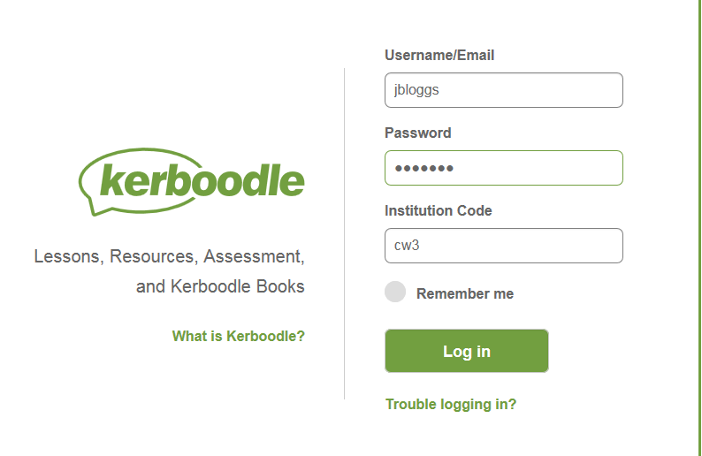
In Pursuit of Excellence Proud to Belong
Notes:
It is vital we celebrate, at every opportunity, the successes, progress and improvements of our students both within and out of the classroom.
We use the following rewards
Merits - these are issued on a daily basis to recognise achievement across the school and are recorded on SIMs.
On a weekly basis, mentors will recognise and praise achievement as part of mentor time. Pastoral Leaders will recognise and praise achievement as part of weekly assemblies.
On a half termly basis student merits will be counted and recognised through Celebration Assemblies
Badges in recognition of annual merit totals
Faculty rewards – positive text messages, praise post cards, telephone calls, verbal praise
6 ‘P’ Card, which reflects our code of conduct and recognises achievement and behaviour out of the classroom . (Replaces current conduct card and proud to belong card).
6 P Card – Achievement and conduct out of the class
Each student begins each half term with 10 merits recorded on their ‘P Card’. At the end of a half term these merits will be transferred a students behaviour record and will count towards yearly totals.
Merits can be earned by getting involved in activities, and by enhancing the life of the school.
Merits can lost for failing to adhere to our code of conduct outside of the classroom.
There is an expectation that all students will have their card on their person at all times. Failure will result in a Pastoral Detention

Slide 39
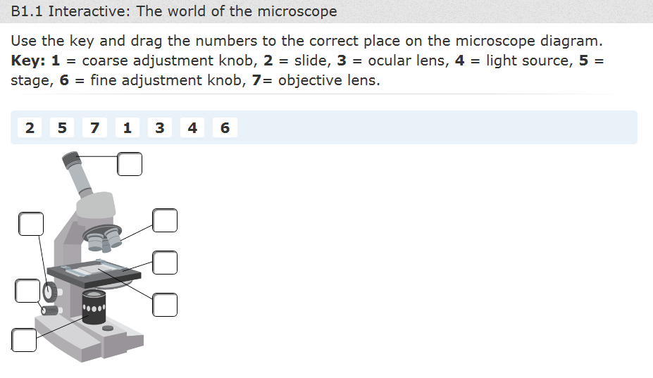
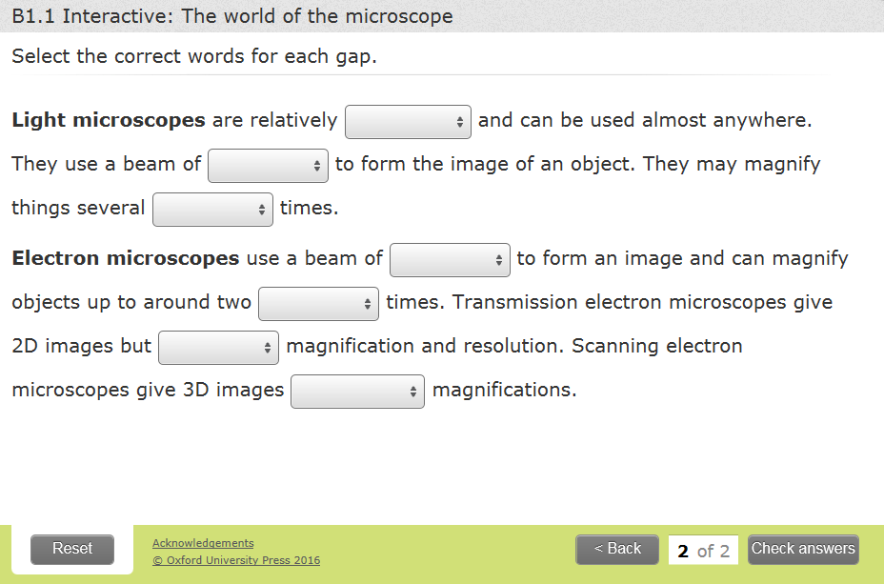
In Pursuit of Excellence Proud to Belong
Notes:
It is vital we celebrate, at every opportunity, the successes, progress and improvements of our students both within and out of the classroom.
We use the following rewards
Merits - these are issued on a daily basis to recognise achievement across the school and are recorded on SIMs.
On a weekly basis, mentors will recognise and praise achievement as part of mentor time. Pastoral Leaders will recognise and praise achievement as part of weekly assemblies.
On a half termly basis student merits will be counted and recognised through Celebration Assemblies
Badges in recognition of annual merit totals
Faculty rewards – positive text messages, praise post cards, telephone calls, verbal praise
6 ‘P’ Card, which reflects our code of conduct and recognises achievement and behaviour out of the classroom . (Replaces current conduct card and proud to belong card).
6 P Card – Achievement and conduct out of the class
Each student begins each half term with 10 merits recorded on their ‘P Card’. At the end of a half term these merits will be transferred a students behaviour record and will count towards yearly totals.
Merits can be earned by getting involved in activities, and by enhancing the life of the school.
Merits can lost for failing to adhere to our code of conduct outside of the classroom.
There is an expectation that all students will have their card on their person at all times. Failure will result in a Pastoral Detention

Slide 40
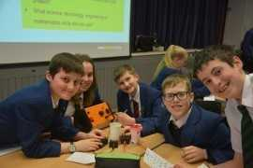
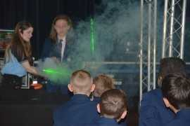
Enrichment Activities
Faraday Challenge
STEM clubs
In Pursuit of Excellence Proud to Belong
Notes:
It is vital we celebrate, at every opportunity, the successes, progress and improvements of our students both within and out of the classroom.
We use the following rewards
Merits - these are issued on a daily basis to recognise achievement across the school and are recorded on SIMs.
On a weekly basis, mentors will recognise and praise achievement as part of mentor time. Pastoral Leaders will recognise and praise achievement as part of weekly assemblies.
On a half termly basis student merits will be counted and recognised through Celebration Assemblies
Badges in recognition of annual merit totals
Faculty rewards – positive text messages, praise post cards, telephone calls, verbal praise
6 ‘P’ Card, which reflects our code of conduct and recognises achievement and behaviour out of the classroom . (Replaces current conduct card and proud to belong card).
6 P Card – Achievement and conduct out of the class
Each student begins each half term with 10 merits recorded on their ‘P Card’. At the end of a half term these merits will be transferred a students behaviour record and will count towards yearly totals.
Merits can be earned by getting involved in activities, and by enhancing the life of the school.
Merits can lost for failing to adhere to our code of conduct outside of the classroom.
There is an expectation that all students will have their card on their person at all times. Failure will result in a Pastoral Detention

Slide 41
Should you have any queries, please contact either:
Miss C North- Faculty Leader
Miss K Webster – Assistant Faculty Leader
Mr S Jones Assistant Faculty Leader
In Pursuit of Excellence Proud to Belong
Notes:
It is vital we celebrate, at every opportunity, the successes, progress and improvements of our students both within and out of the classroom.
We use the following rewards
Merits - these are issued on a daily basis to recognise achievement across the school and are recorded on SIMs.
On a weekly basis, mentors will recognise and praise achievement as part of mentor time. Pastoral Leaders will recognise and praise achievement as part of weekly assemblies.
On a half termly basis student merits will be counted and recognised through Celebration Assemblies
Badges in recognition of annual merit totals
Faculty rewards – positive text messages, praise post cards, telephone calls, verbal praise
6 ‘P’ Card, which reflects our code of conduct and recognises achievement and behaviour out of the classroom . (Replaces current conduct card and proud to belong card).
6 P Card – Achievement and conduct out of the class
Each student begins each half term with 10 merits recorded on their ‘P Card’. At the end of a half term these merits will be transferred a students behaviour record and will count towards yearly totals.
Merits can be earned by getting involved in activities, and by enhancing the life of the school.
Merits can lost for failing to adhere to our code of conduct outside of the classroom.
There is an expectation that all students will have their card on their person at all times. Failure will result in a Pastoral Detention

Slide 42
Learning at Carr Hill Mr D Morton Assistant Head for Teaching & Learning
In Pursuit of Excellence Proud to Belong
Notes:
It is vital we celebrate, at every opportunity, the successes, progress and improvements of our students both within and out of the classroom.
We use the following rewards
Merits - these are issued on a daily basis to recognise achievement across the school and are recorded on SIMs.
On a weekly basis, mentors will recognise and praise achievement as part of mentor time. Pastoral Leaders will recognise and praise achievement as part of weekly assemblies.
On a half termly basis student merits will be counted and recognised through Celebration Assemblies
Badges in recognition of annual merit totals
Faculty rewards – positive text messages, praise post cards, telephone calls, verbal praise
6 ‘P’ Card, which reflects our code of conduct and recognises achievement and behaviour out of the classroom . (Replaces current conduct card and proud to belong card).
6 P Card – Achievement and conduct out of the class
Each student begins each half term with 10 merits recorded on their ‘P Card’. At the end of a half term these merits will be transferred a students behaviour record and will count towards yearly totals.
Merits can be earned by getting involved in activities, and by enhancing the life of the school.
Merits can lost for failing to adhere to our code of conduct outside of the classroom.
There is an expectation that all students will have their card on their person at all times. Failure will result in a Pastoral Detention

Slide 43
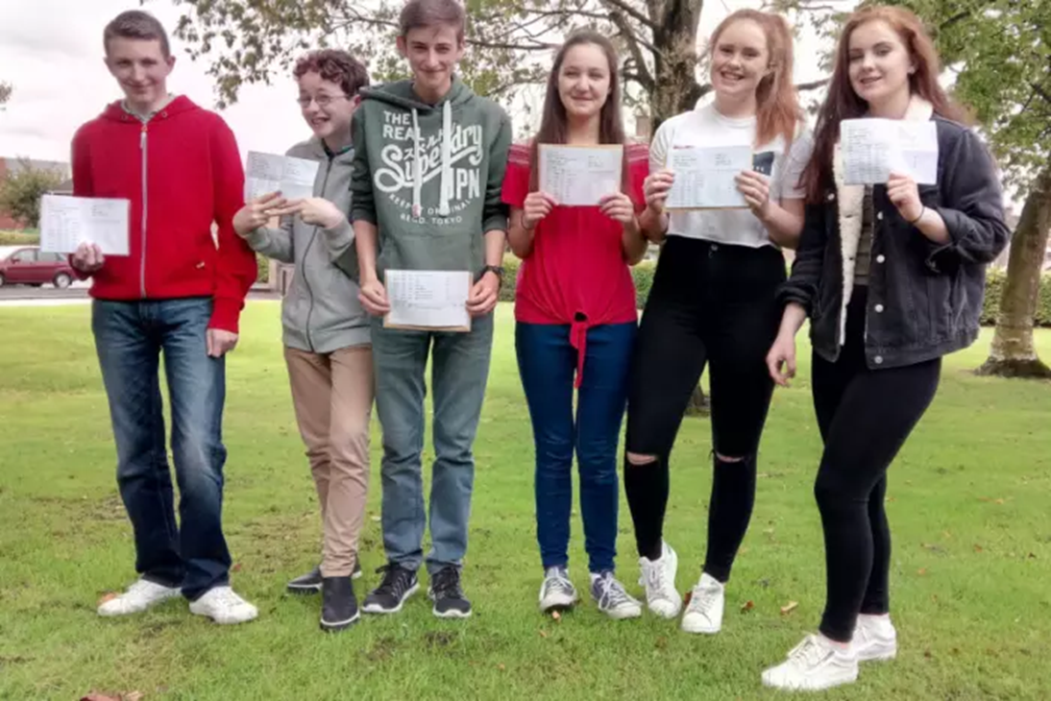
Our Focus Your Aim
Knowing more & learning more
Modelling
Effective Feedback
Literacy
In Pursuit of Excellence Proud to Belong
Notes:
It is vital we celebrate, at every opportunity, the successes, progress and improvements of our students both within and out of the classroom.
We use the following rewards
Merits - these are issued on a daily basis to recognise achievement across the school and are recorded on SIMs.
On a weekly basis, mentors will recognise and praise achievement as part of mentor time. Pastoral Leaders will recognise and praise achievement as part of weekly assemblies.
On a half termly basis student merits will be counted and recognised through Celebration Assemblies
Badges in recognition of annual merit totals
Faculty rewards – positive text messages, praise post cards, telephone calls, verbal praise
6 ‘P’ Card, which reflects our code of conduct and recognises achievement and behaviour out of the classroom . (Replaces current conduct card and proud to belong card).
6 P Card – Achievement and conduct out of the class
Each student begins each half term with 10 merits recorded on their ‘P Card’. At the end of a half term these merits will be transferred a students behaviour record and will count towards yearly totals.
Merits can be earned by getting involved in activities, and by enhancing the life of the school.
Merits can lost for failing to adhere to our code of conduct outside of the classroom.
There is an expectation that all students will have their card on their person at all times. Failure will result in a Pastoral Detention

Slide 44
Feedback
In Pursuit of Excellence Proud to Belong
Notes:
It is vital we celebrate, at every opportunity, the successes, progress and improvements of our students both within and out of the classroom.
We use the following rewards
Merits - these are issued on a daily basis to recognise achievement across the school and are recorded on SIMs.
On a weekly basis, mentors will recognise and praise achievement as part of mentor time. Pastoral Leaders will recognise and praise achievement as part of weekly assemblies.
On a half termly basis student merits will be counted and recognised through Celebration Assemblies
Badges in recognition of annual merit totals
Faculty rewards – positive text messages, praise post cards, telephone calls, verbal praise
6 ‘P’ Card, which reflects our code of conduct and recognises achievement and behaviour out of the classroom . (Replaces current conduct card and proud to belong card).
6 P Card – Achievement and conduct out of the class
Each student begins each half term with 10 merits recorded on their ‘P Card’. At the end of a half term these merits will be transferred a students behaviour record and will count towards yearly totals.
Merits can be earned by getting involved in activities, and by enhancing the life of the school.
Merits can lost for failing to adhere to our code of conduct outside of the classroom.
There is an expectation that all students will have their card on their person at all times. Failure will result in a Pastoral Detention

Slide 45
Thank you for coming
Don’t forget that this presentation will be available on the school website from 1pm on Monday.
In Pursuit of Excellence Proud to Belong
Notes:
It is vital we celebrate, at every opportunity, the successes, progress and improvements of our students both within and out of the classroom.
We use the following rewards
Merits - these are issued on a daily basis to recognise achievement across the school and are recorded on SIMs.
On a weekly basis, mentors will recognise and praise achievement as part of mentor time. Pastoral Leaders will recognise and praise achievement as part of weekly assemblies.
On a half termly basis student merits will be counted and recognised through Celebration Assemblies
Badges in recognition of annual merit totals
Faculty rewards – positive text messages, praise post cards, telephone calls, verbal praise
6 ‘P’ Card, which reflects our code of conduct and recognises achievement and behaviour out of the classroom . (Replaces current conduct card and proud to belong card).
6 P Card – Achievement and conduct out of the class
Each student begins each half term with 10 merits recorded on their ‘P Card’. At the end of a half term these merits will be transferred a students behaviour record and will count towards yearly totals.
Merits can be earned by getting involved in activities, and by enhancing the life of the school.
Merits can lost for failing to adhere to our code of conduct outside of the classroom.
There is an expectation that all students will have their card on their person at all times. Failure will result in a Pastoral Detention

