Slide 1
In Pursuit of Excellence Proud to Belong

Slide 2
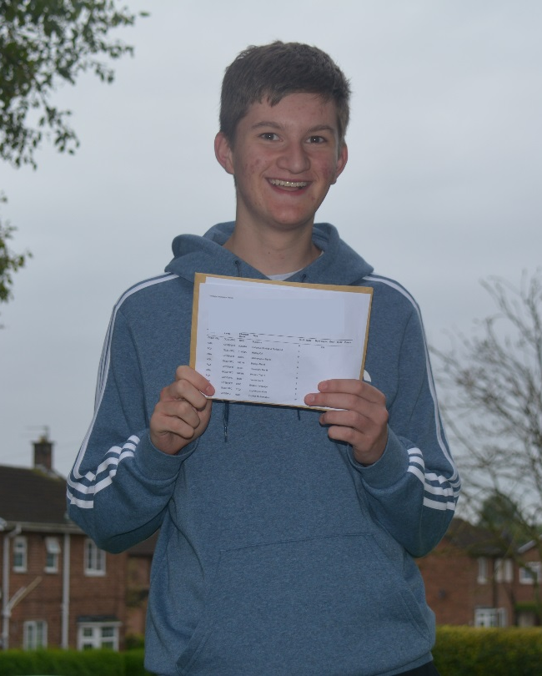
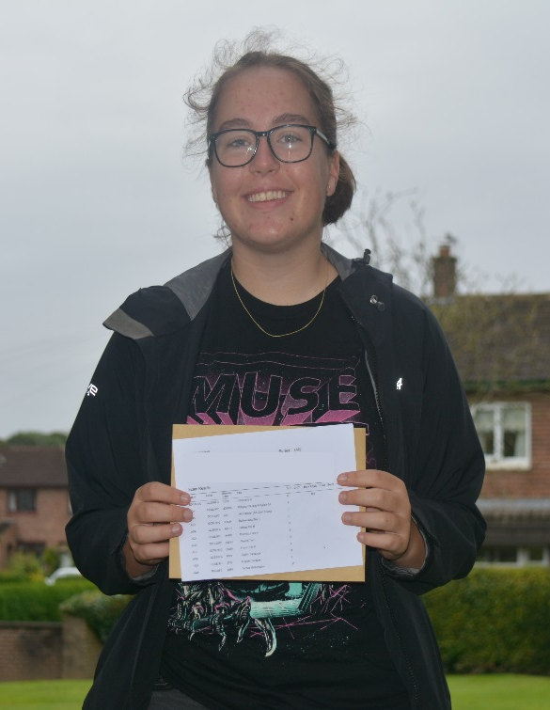
In Pursuit of Excellence Proud to Belong

Slide 3
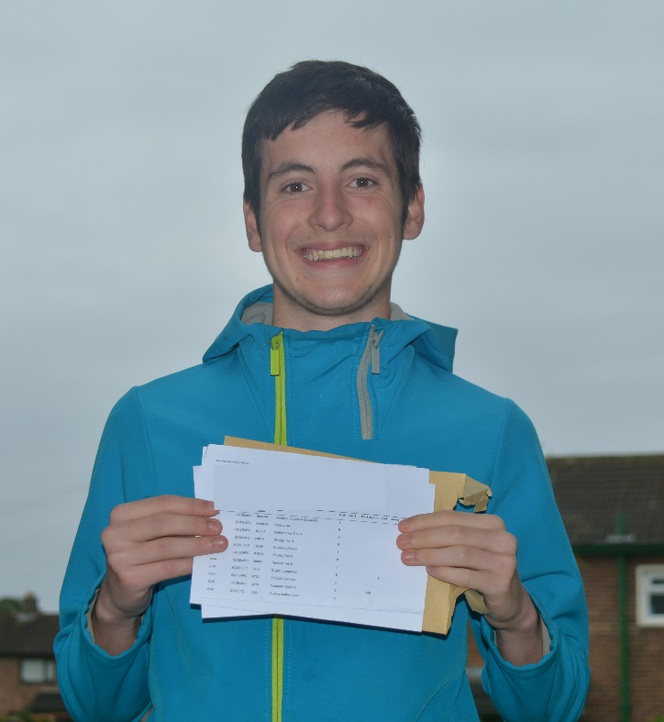
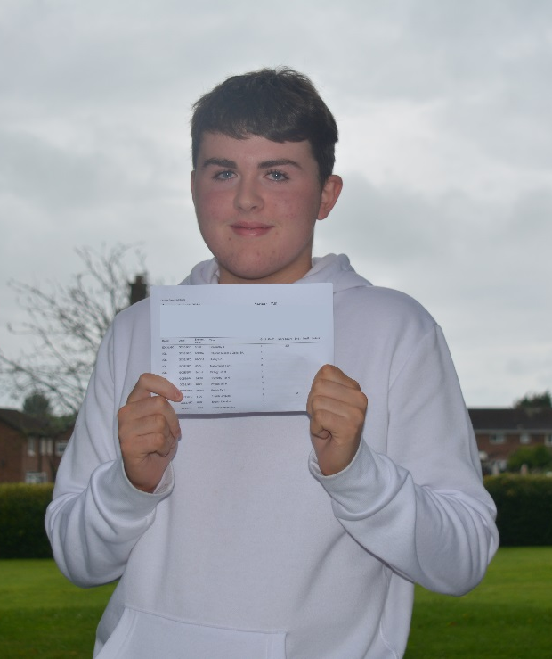
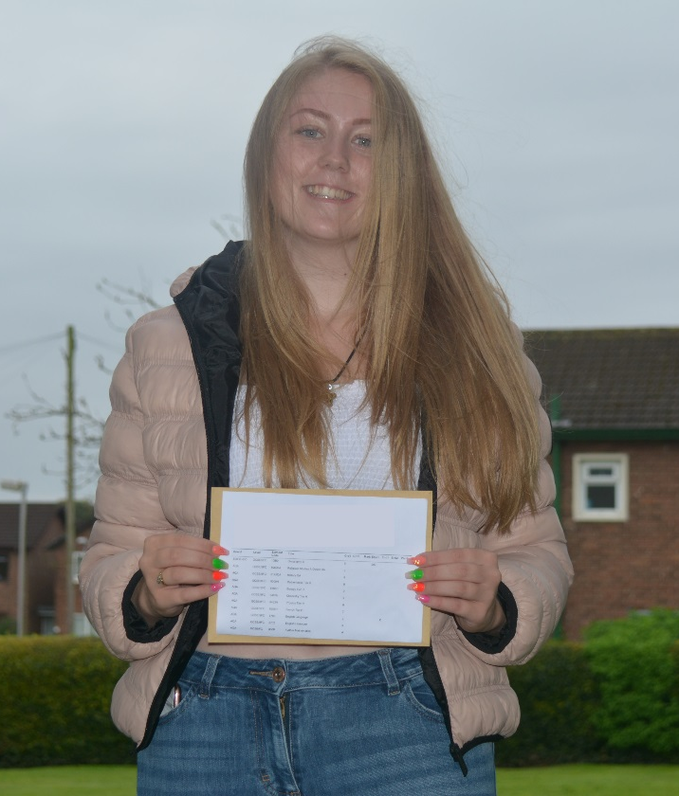
In Pursuit of Excellence Proud to Belong

Slide 4
Parents – We need your help!
All students need a desk and a quiet space to revise.
Revision needs to start now. The new specifications are large and students need to read over notes every night.
Effective learning involves self-testing – can you test your son/daughter on what they have learnt in class to make sure that it has gone in?
Take an active interest in their learning and ask them to tell you what they have learnt each day.
Students should be spending at least 10 hours per week on homework and revision.
In Pursuit of Excellence Proud to Belong

Slide 5
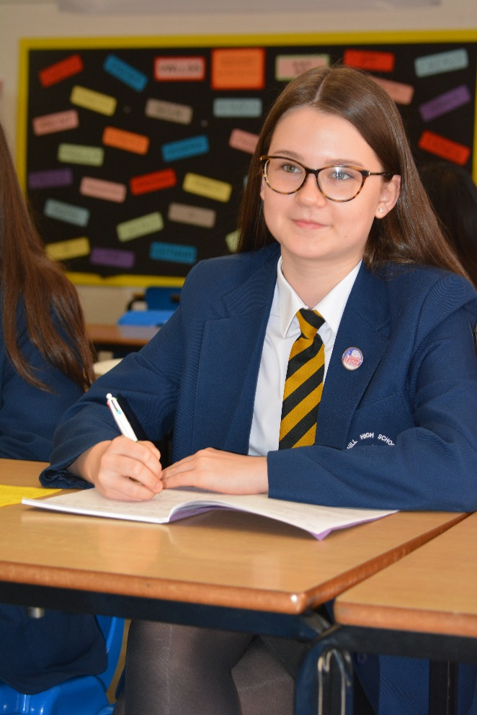
Role Models
Look smart – appropriate length skirt, no makeup or fake tan, ties on etc.
Work hard
Focus on your future
Be respectful
Try your best
Put in at least 10 hours of revision each week
Behave sensibly around school
In Pursuit of Excellence Proud to Belong

Slide 6
Future Prefects
Later in the year, we will be choosing our prefects, including our senior prefects, Head Boy and Head Girl.
This is a fantastic opportunity to develop leadership and organisational skills and to give back to the school
Being a prefect looks great on college and apprenticeship application forms.
In Pursuit of Excellence Proud to Belong

Slide 7
In Pursuit of Excellence Proud to Belong

Slide 8
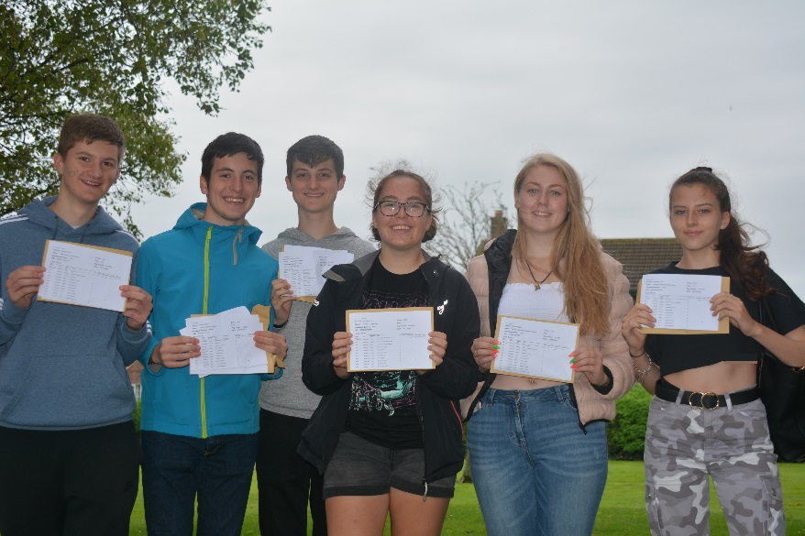
Commitment
Teachers – committed to supporting our students to fulfil their potential, to giving them as much support and guidance as possible to help them achieve their goals.
Students – the real effort and commitment must come from you. At least 10 hours of work at home each week. Maximum effort in all classwork and homework. No excuses – these are your results and you have to work hard for them.
Parents – we need you to make sure the extra work at home is happening. All students need a quiet space to study, free from all distractions (especially electronic devices).
In Pursuit of Excellence Proud to Belong

Slide 9
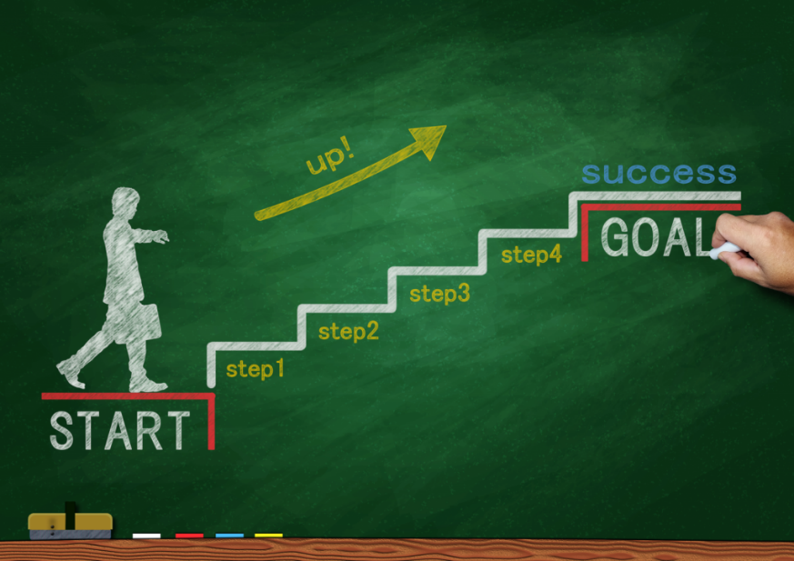
Aspiration
We want out students to set high targets for themselves.
A clear vision of where they want to go in the future and what they need to get there will help with motivation.
Visit many colleges and find out about other opportunities such as apprenticeships
We have a careers advisor in school to help
In Pursuit of Excellence Proud to Belong

Slide 10
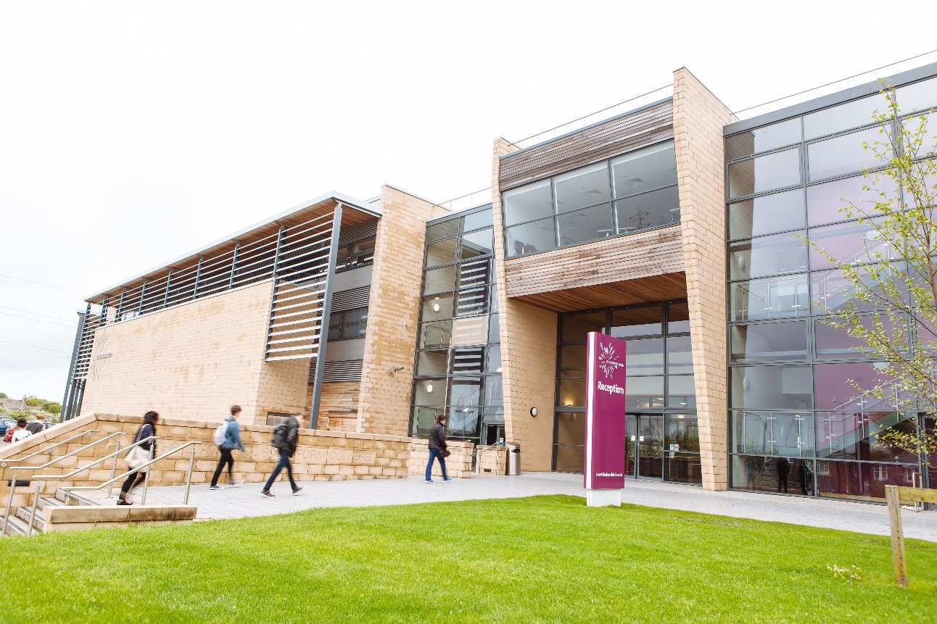
Vision for the future
Blackpool Sixth Form Open Events
Saturday 9th November 10:30-14:30
Wednesday 5th February 17:30-19:30
In Pursuit of Excellence Proud to Belong

Slide 11
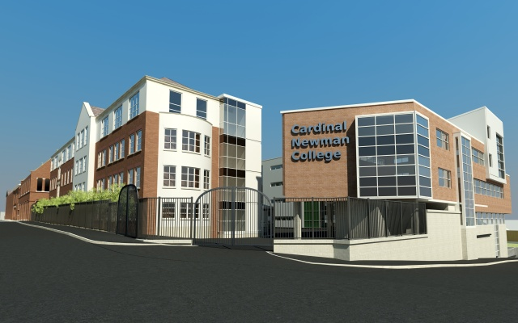
Vision for the future
Cardinal Newman Open Events
Saturday 12th October 2019
10:00 – 13:00
Saturday 16th November 2019 10:00 – 13:00
Saturday 1st February 2020
10:00-13:00
In Pursuit of Excellence Proud to Belong

Slide 12
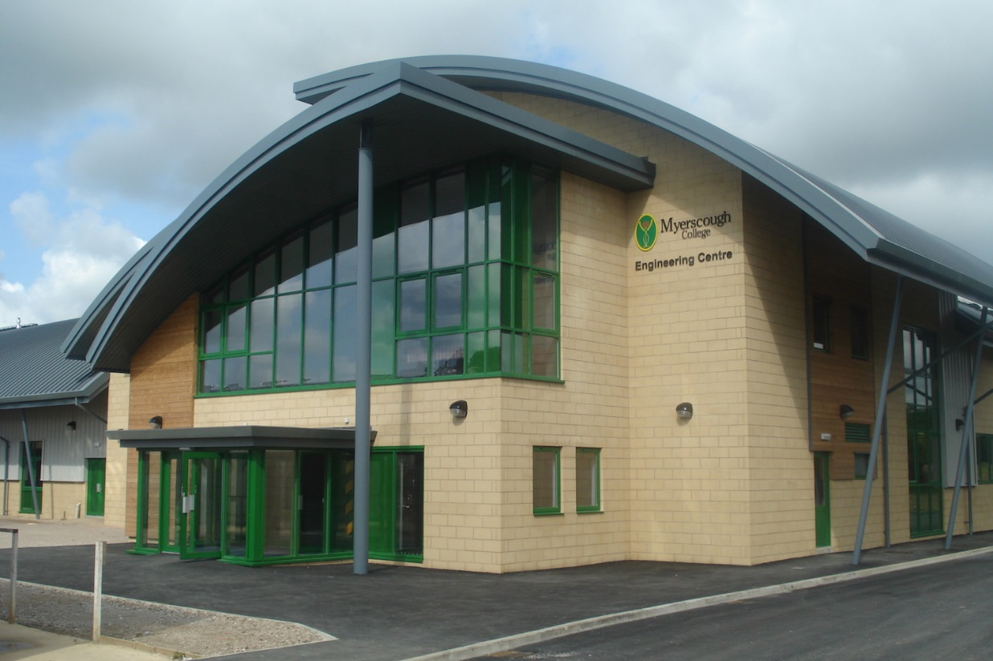
Vision for the future
Myerscough Open Events
Saturday 5th October 2019 - Course Advice Morning 10 till 12.30
Saturday 9th November 2019 - Course Advice Morning 10 till 12.30
Saturday 7th December - 2019 Course Advice Morning 10 till 12.30
In Pursuit of Excellence Proud to Belong

Slide 13
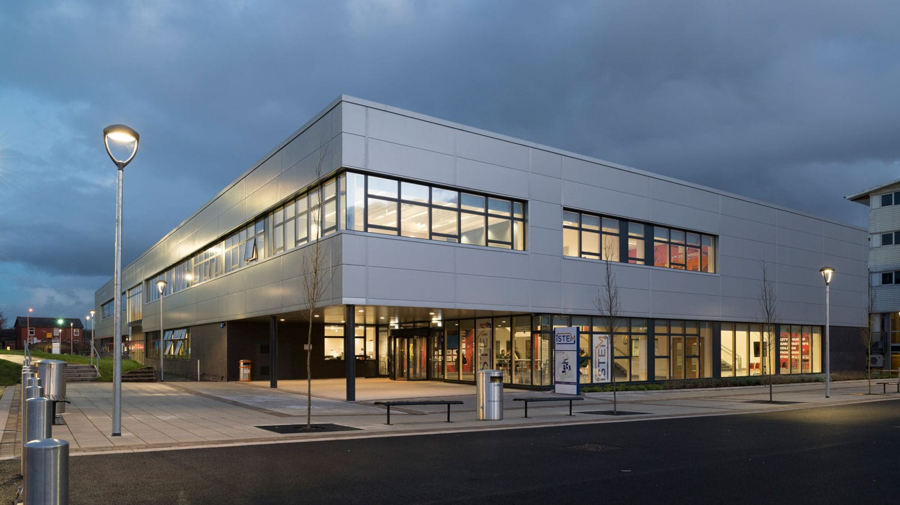
Vision for the future
Preston’s College Open Events
Tuesday 1st October 16:00-19:30
Saturday 2nd November 10:00-14:00
Wednesday 11th March 16:00-19:30
In Pursuit of Excellence Proud to Belong

Slide 14
Resilience
This year will be hard; there will be ups and downs
It is how we respond to challenges and set-backs that determines how successful we will be
Those who continue to work hard despite challenges will do well. Those who give up and stop trying will not.
Parents, we need you to keep encouraging your son/daughter to keep going and never give up!
In Pursuit of Excellence Proud to Belong

Slide 15
Respect
Students:
Respect your teachers – listen carefully in class, follow advice given in feedback, stick to deadlines, be polite, acknowledge how hard teachers are working to support you.
Respect your parents – they are going to nag you this year because they want the best for you!
Respect yourselves – try your best, behave sensibly, give it your best shot. Attend every day and be present in every lesson.
In Pursuit of Excellence Proud to Belong

Slide 16
Respecting yourself also means looking after yourself
This is going to be a difficult couple of years
There will be ups and downs, tears, frustration, panic, self-doubt etc. etc.
Working hard is essential, but so is self-care
Revision must be a priority, but this should be balanced with exercise, healthy eating and time for hobbies, friends and family.
Please let us know if you are concerned .
In Pursuit of Excellence Proud to Belong

Slide 17
In Pursuit of Excellence Proud to Belong

Slide 18
Revision Techniques
In Pursuit of Excellence Proud to Belong

Slide 19
Get organised!
All students need a quiet space with a desk or table to complete their revision (no distractions)
Notes need to be in order and books/files organised
Students should have an array of past exam questions to practise
Make sure all coursework submission dates are on your calendar.
In Pursuit of Excellence Proud to Belong

Slide 20
Eat the frog!
“I don’t know how to revise” translates as “I don’t want to revise” or “I feel overwhelmed and don’t know where to start” or “I’m anxious about my exams.”
The best place to start is the most difficult subject and the topics which students feel the least secure.
We need to encourage students to revise little and often, every evening and every weekend. Procrastination is the thief of all time.
In Pursuit of Excellence Proud to Belong

Slide 21
Read, write, cover, check…
Write out your notes – cover over small sections and see if you can remember what you have written.
Alternatively, make a short quiz based on what you have revised and answer it at the end of your revision/get someone to test you.
Don’t go on to the next bit until you know the bit you have already revised!
In Pursuit of Excellence Proud to Belong
In Pursuit of Excellence Proud to Belong
In Pursuit of Excellence Proud to Belong

Slide 22
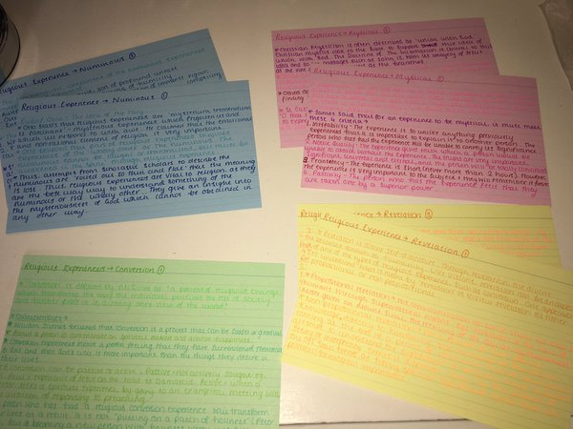
Cue cards
Try making cards with key terms/scholars on one side and an explanation on the other.
Don’t forget to test yourself by turning them over, explanation down, and trying to recall all information.
Colour stimulates long term memory, so colour coding for different topics works really well.
In Pursuit of Excellence Proud to Belong

Slide 23
Record yourself
Some students find it really useful to record their revision notes and play them back. Hearing the notes spoken can help you to remember them if you are an auditory learner.
In Pursuit of Excellence Proud to Belong

Slide 24
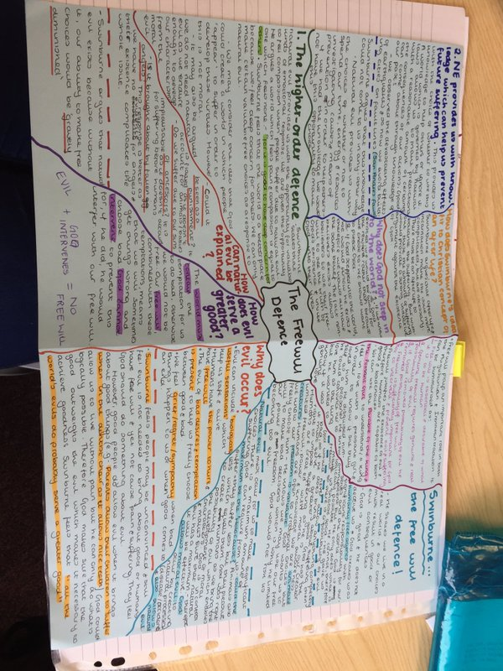
Mind-mapping
Mind-maps can really help you to consolidate the knowledge you have gained.
Many people find that mind-maps help them to recall knowledge around a central theme.
In Pursuit of Excellence Proud to Belong

Slide 25
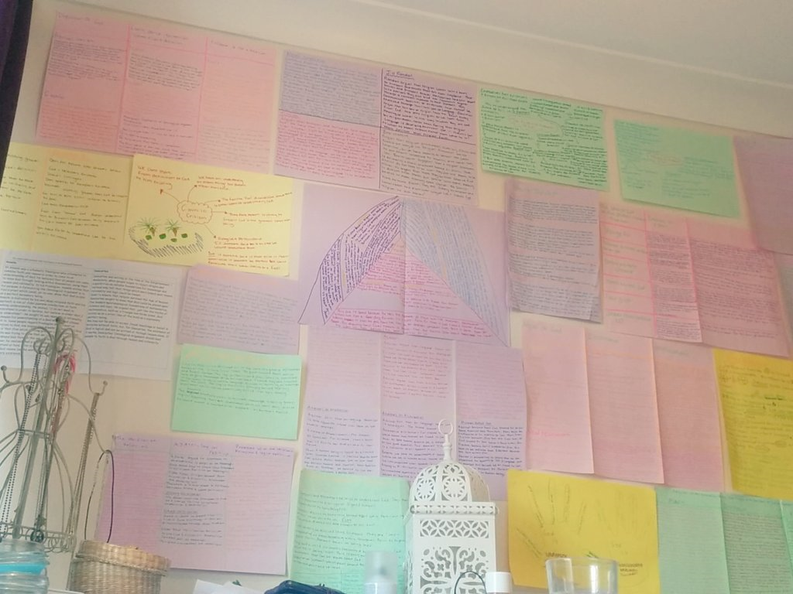
Revision Wall
Get your revision notes everywhere!
Read them whilst you’re brushing your teeth, making your breakfast – have prompts to help you remember dates/facts/people all over your house.
In Pursuit of Excellence Proud to Belong

Slide 26
Remember, it is self-testing/peer testing which makes revision effective. When you have revised a topic, you must make sure that you know it by testing yourself (through a quiz, a parent asking you questions or completing an exam question) before you move on to the next topic.
In Pursuit of Excellence Proud to Belong

Slide 27
How can we ensure we support our children/young people to achieve their dreams?
In Pursuit of Excellence Proud to Belong

Slide 28
Attendance
95% attendance = ½ a day of lessons missed every two weeks
95% attendance – TWO weeks of lessons missed each year
In Pursuit of Excellence Proud to Belong

Slide 29
Behaviour
Present | Being both physically present in class and mentally in the room and ready to learn.
Punctual | 5 minutes lateness to every lesson in a day costs 25 minutes of learning. Over a week, that’s over 2 hours of learning lost. Over a term, almost 30 hours lost.
Positive | This year will be tough with some knocks and set-backs. Resilience and positivity needed.
Polite | Staff at school expect manners and courtesy from students as an absolute minimum. Students should also be polite to each other.
Proud | Proud of our school community and proud of ourselves.
Prepared | All books and equipment. Prepared for all assessments and PPEs.
In Pursuit of Excellence Proud to Belong

Slide 30
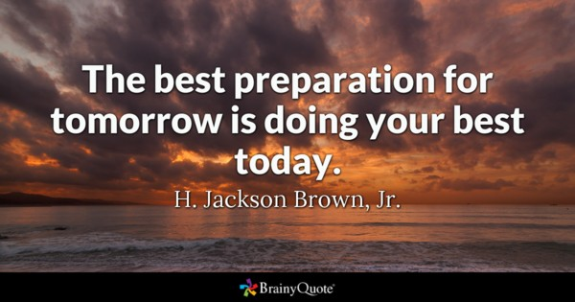
Coping Strategies:
Exercise
sleep
Reading
Walking
Talking to other students / friends / family / teachers
Listening to music
Going out with friends
Puzzles/games
Gym
Scheduling activities which you would like to take part in, including revision
In Pursuit of Excellence Proud to Belong

Slide 31
In Pursuit of Excellence Proud to Belong

