Slide 1
Year 11 Parents’ Evening - information
What can you do to support your son/daughter?
Make sure they have created and are following a revision timetable which shows 10 hours of extra work per week (including homework)
Encourage them to keep part time work to an absolute minimum. We recommend no more than 5 hours per week and no part time work after the Easter holidays.
Support them in trying a range of revision techniques such as the techniques included in this presentation and GCSEPod.
Get involved in their revision, testing them with flash cards for example.
Encourage them to revise away from all distractions, such as mobile phones.

Slide 2
In the lead up to the exams - March onwards
Revision will need to be even more of a priority – 15-20 hours per week.
Healthy eating and exercise should be encouraged alongside revision.
Practice questions should now be a key part of revision.
Encourage attendance at support sessions lunchtimes/after school.
Let us know if you have any concerns.

Slide 3
For the exams themselves…
A good breakfast is really important.
Please make sure students have an analogue watch to wear to help with question timings.
Encourage positivity - if the work has been done, the outcome will be a great grade!
Make sure students have a few good quality black biros (Bic Cristal are a good choice).

Slide 4
Revision Techniques

Slide 5
Get organised!
Make sure your notes are in order and your books/files are organised
Make sure you have all past paper questions/sample questions and model answers.
Know your deadlines for coursework submission.

Slide 6
Eat the frog!
Don’t succumb to the temptation to revise things you already know.
Eat the frog – revise the bits you find the most difficult/least interesting – they are the bits you need to focus on.
Don’t put things off – just do them and you will feel so much better!

Slide 7
Past exam questions
As you are revising, make sure that you have all of the PEQs you can find and also the spec so that you know how the knowledge you are learning will be assessed in the actual exams.

Slide 8
Read, write, cover, check…
Write out your notes – cover over small sections and see if you can remember what you have written.
Alternatively, make a short quiz based on what you have revised and answer it at the end of your revision/get someone to test you.
Don’t go on to the next bit until you know the bit you have already revised!

Slide 9
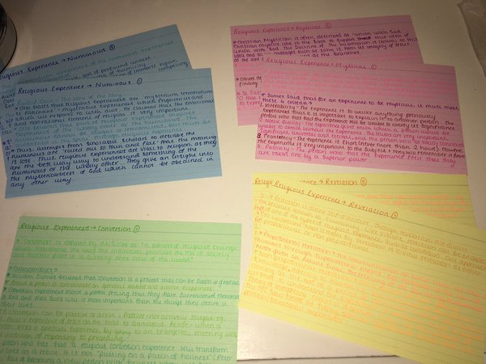
Cue cards
Try making cards with key terms/scholars on one side and an explanation on the other.
Don’t forget to test yourself by turning them over, explanation down, and trying to recall all information.
Colour stimulates long term memory, so colour coding for different topics works really well.

Slide 10
Record yourself
Some students find it really useful to record their revision notes and play them back. Hearing the notes spoken can help you to remember them if you are an auditory learner.

Slide 11
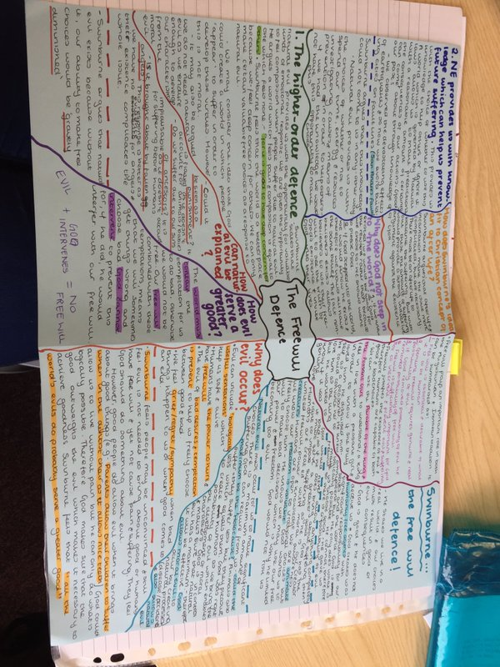
Mind-mapping
Mind-maps can really help you to consolidate the knowledge you have gained.
Many people find that mind-maps help them to recall knowledge around a central theme.

Slide 12
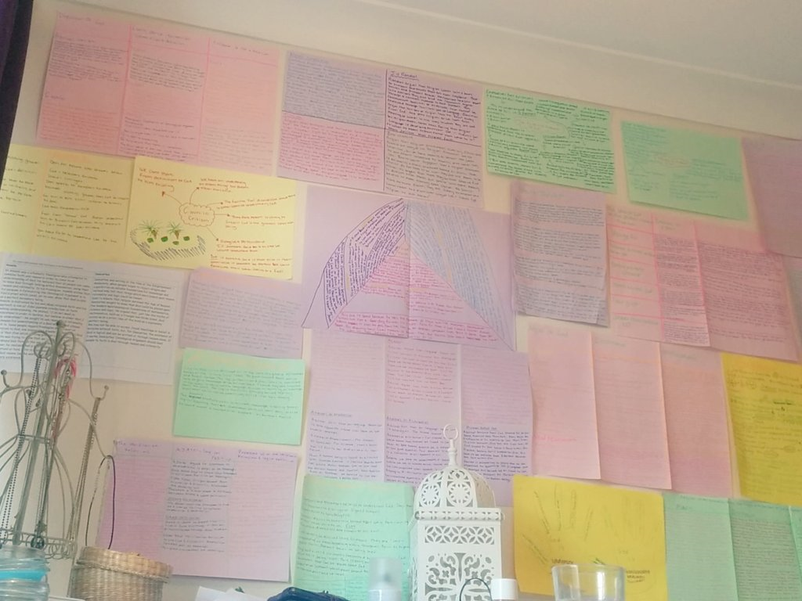
Revision Wall
Get your revision notes everywhere!
Read them whilst you’re brushing your teeth, making your breakfast – have prompts to help you remember dates/facts/people all over your house.

Slide 13
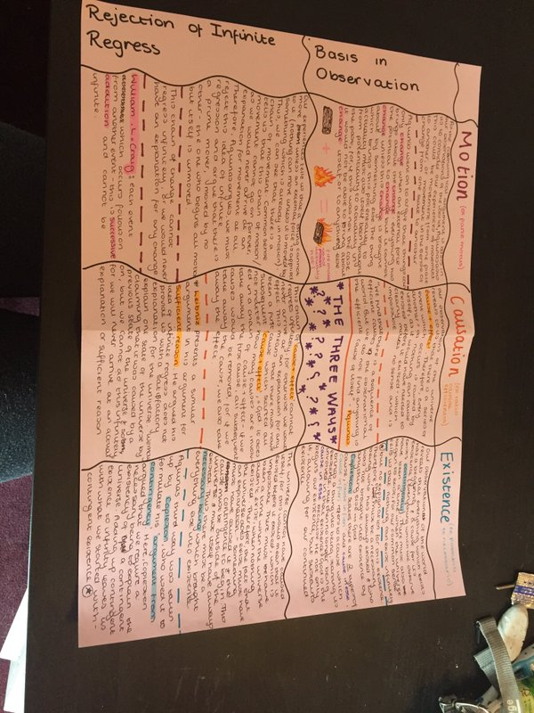
Create consolidation sheets
Bring your lesson notes, booklets and extra reading together on consolidation sheets – make sure your notes are together in one place.

