Slide 1

Year 11 Information Evening

Slide 2
2018 results highlights
Maths improved by 6% to 68% and was very close to national average of 70%
Science results showed massive improvement and 65% left with 2 sciences which is above national average
17 grade 9s in Biology, Chemistry, Physics
RS improved by 13% and so 54% of students left with an RS GCSE
Art, Computing, Photography, Textiles, Biology, Physics, Chemistry, PE results on or above national average at grade 4+
100% pass rate in Dance, Performing Arts and Sport
Ebacc (Maths, English, Science, MFL, Humanity) up from 9% to 20% at grade 4+
Girls’ pass rate nationally was 71%. We were 70%

Slide 3
2018 areas to work on
We are still not where we need to be in English – so our basics figure won’t change much on 2017
History took a dip in 2018 after good results in 2017 as did Business Studies
Boys need to do better overall but especially in English - so our P8 figure is not likely to change much on 2017!

Slide 4
The gender gap
 | Carr Hill Maths (NA 71%) | Carr Hill Language (NA 70%) | Carr Hill Literature (NA 73%) | English best
Male | 66% (69%) | 47% (50%) | 48% (50%) | 55% (58%)
female | 71% | 66% | 70% | 71%

Slide 5
Year 11 results – vocational courses

Slide 6
Year 11 results – reformed GCSE courses
Name | 9 % | 9 - 8 % | 9 - 7 % | 9 - 6 % | 9 - 5 % | 9 - 4 % | 9 - 3 % | 9 - 2 % | 9 - 1 % | Total Grades
Art | 8.3 | 12.5 | 25 | 29.2 | 45.8 | 79.2 | 95.8 | 100 | 100 | 24
Biology | 6.8 | 16.9 | 32.2 | 61 | 79.6 | 96.6 | 93.5 | 98.4 | 98.4 | 59
Chemistry | 8.5 | 13.5 | 32.2 | 50.8 | 79.6 | 93.2 | 93.5 | 96.8 | 96.8 | 59
Computing | 0 | 4.5 | 13.6 | 22.7 | 36.4 | 63.6 | 86.4 | 90.9 | 95.5 | 22
English Language | 1.6 | 3.2 | 9.7 | 22.6 | 37.6 | 55.4 | 82.8 | 94.1 | 97.3 | 186
English Literature | 1.6 | 4.9 | 12 | 20.2 | 40.4 | 57.9 | 77 | 90.7 | 97.8 | 183
Food & Nutrition | 0 | 7.7 | 15.4 | 23.1 | 23.1 | 23.1 | 69.2 | 84.6 | 100 | 13
French | 0 | 4 | 8 | 26 | 46 | 60 | 80 | 96 | 100 | 50
Geography | 5.3 | 8.8 | 14 | 29.8 | 36.8 | 56.1 | 73.7 | 87.7 | 98.2 | 57
History | 1.9 | 7.5 | 16.8 | 23.4 | 31.8 | 40.2 | 55.1 | 72.9 | 91.6 | 107
Maths | 2.7 | 7.5 | 12.9 | 28.5 | 46.8 | 68.3 | 80.6 | 89.8 | 96.2 | 186
Music | 0 | 0 | 0 | 0 | 33.3 | 66.7 | 100 | 100 | 100 | 3
PE Full Course | 25 | 46.4 | 71.4 | 85.7 | 89.3 | 92.9 | 96.4 | 100 | 100 | 28
Photography | 9.1 | 18.2 | 36.4 | 54.5 | 90.9 | 100 | 100 | 100 | 100 | 11
Physics | 13.6 | 22 | 37.3 | 57.6 | 83.1 | 94.9 | 98.3 | 98.3 | 98.3 | 59
RS Full Course | 1.7 | 5.6 | 14.4 | 25 | 37.8 | 52.8 | 73.3 | 91.7 | 97.8 | 180
Spanish | 8.7 | 13 | 26.1 | 39.1 | 47.8 | 56.5 | 78.3 | 87 | 95.7 | 23
Summary | 3.8 | 8.6 | 17.6 | 30.7 | 46.9 | 63.1 | 79.8 | 91.2 | 97.1 | 1256

Slide 7
Year 11 Results – unreformed courses

Slide 8
High performers top 10
 | Grade 9 | Grade 8 | Grade 7 | total
JW (f) | 8 | 2 |  | 10
JM (f) | 6 | 3 |  | 9
AL (f) | 5 | 2 | 2 | 9
MO (m) | 4 | 4 | 1 | 9
LB (f) | 3 | 2 | 3 | 8
HH (f) | 4 | 1 | 3 | 8
NW (f) | 2 | 3 | 4 | 9
AC (f) | 1 | 4 | 5 | 10
AF (m) | 2 | 3 | 3 | 8
JT (m) | 2 | 3 | 2 | 7

Slide 9
Year 11 Key dates
Week beginning 15th October – English Language PPE
Week beginning 19th November – English Language and Science PPEs
Week beginning 14th January – PPEs for all subjects except Science and English Language
Week beginning 4th March – PPEs for English Literature and Science
Week beginning 17th March - Maths

Slide 10

How much work?
We recommend that Year 11 students spend a minimum of 10 hours per week on school work.
This should include homework, reading over notes and revising for assessments.

Slide 11

What’s the secret?
Hard work!
It’s not about ability
It’s not about ‘smarts’
It’s about hard graft!
Students who work hard and make their studies a priority will do well and achieve their targets.

Slide 12

This year will be challenging
Vision - Put some time into thinking about where you want to go after school and what you need to get there.
Effort – If you want good outcomes, you need to put in time and effort. At least 10 hours per week.
Systems – Organisation is the key to success. Keep your notes neat and organised so you have quality materials from which to revise.
Practice – Include answering past exam questions as part of your weekly work/revision
Attitude – Can do! There will be set backs, there will be times when you feel like you aren’t going to get the results you want, but keep going and you will get there! Never give up.

Slide 13
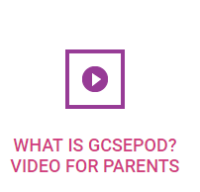
GCSEPod
– A fantastic new resource
Revision in short bursts
Accessible via PCs, tablets and smart phones – revision on-the-go
Can be used to consolidate learning after each topic
Can be used to examine topics not yet covered to get ahead of the game
Can be used alongside other revision techniques to boost progress and performance.

Slide 14


Slide 15

Attendance
95% attendance = ½ a day of lessons missed every two weeks
95% attendance – TWO weeks of lessons missed each year

Slide 16
Year 11 celebration of Achievement
Wednesday 26th June – Prom at The Villa Wrea Green
Demerits/ Detentions/ Exclusions
GCSE results day – Thursday August 22nd

Slide 17
Next Steps – Post 16 Open Events
Saturday 22nd September
Open Day Blackpool and the Fylde College 10:00-14:00
Open Day Blackpool Sixth Form College 10:30-14:30
Open Day Runshaw College 11:00-15:00

Slide 18
October
Saturday 6th October - Myerscough College Course advice morning 09:45-12:30
Thursday 11th October – Open Evening Runshaw College 16:00-20:00
Saturday 13th October – Open Day Blackpool Sixth Form College 10:30-14:30
Saturday 13th October – Open Day at Cardinal Newman College 10am-1pm
Tuesday 16th October – Advice evening 16:00 – 19:30pm
Wednesday 17th and Thursday 18th October – National Apprenticeship show at USN Bolton Arena

Slide 19
November
Wednesday 7th November - Open Evening Blackpool and the Fylde College 16:30-19:00
Saturday 10th November – Myerscough College Course advice morning 09:45-12:30
Saturday 17th November – Open Day Cardinal Newman College
Thursday 20th November – Open Evening Runshaw College 16:00-20:00

Slide 20
December
Wednesday 5th December – Meet the Experts at Blackpool and the Fylde College for personalised careers advice 16:30-19:00
We also have Post 16 providers coming into school to give assemblies and will have representatives from local colleges at Parent’s Evening on Thursday 8th November

Slide 21
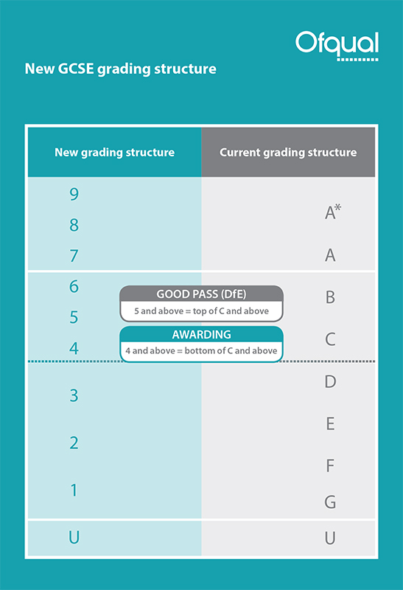
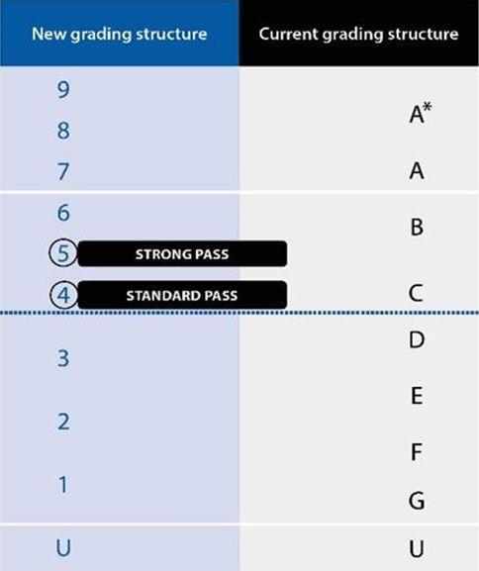

Slide 22
English
Mrs Aspden
Faculty Leader for English

Slide 23
GCSE English
The current year 11s will be the third cohort of students to sit the new GCSE.
The timetable of exams is as follows:
English Language
8700/1 | Explorations in creative reading and writing | 1h 45m | 4th June 2019 | am
8700/2 | Writers’ viewpoints and perspectives | 1h 45m | 7th June 2019 | am
English Literature
8702/1 | Shakespeare and the 19th century novel | 1h 45m | 15th May 2019 | am
8702/2 | Modern texts and poetry | 2h 15m | 23rd May 2019 | am

Slide 24
English - a quick reminder
There are actually two qualifications:
GCSE English Language (AQA)
GCSE English Literature (AQA)
They are exam only – no coursework or controlled assessments.
Speaking and Listening assessments will be recorded.

Slide 25
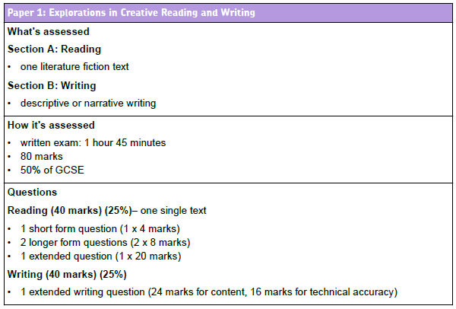
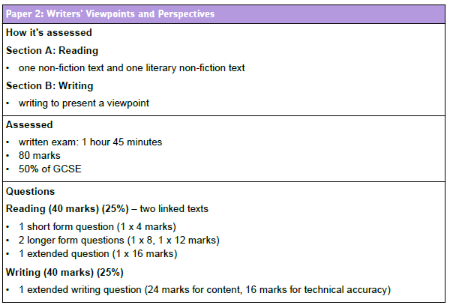
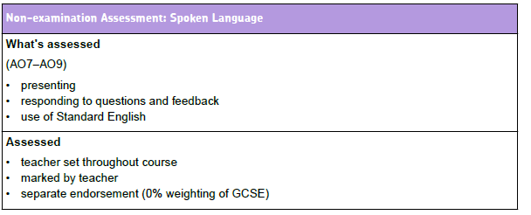
GCSE English Language

Slide 26
GCSE English Literature
Literature Paper 1
1 hour 45 minutes.
40 % of Literature GCSE.
Two sections.
Section A – Macbeth
Includes one extract question and one whole text question.
Section B – A Christmas Carol
Includes one extract question and one whole text question.
Literature Paper 2
2 hour 15 minutes.
60% of total Literature marks.
3 sections: Animal Farm, Poetry Anthology and unseen poetry texts.
Assesses comparison.

Slide 27
Term 1 | Term 2 and 3 | Key Dates
Language paper 2 Non-fiction texts. Language paper 1 Reading comprehension Descriptive writing Revision of : Language Paper 2/RAP activities on all PPEs. Speaking and Listening.* | Literature – both papers General revision There is only enough time for approximately four – six lessons per literature text (including anthology poems). This makes it even more crucial that pupils revise at home. We can focus on SKILLS not knowledge. | Y11 PPEs Language Paper 2 Before October half term Language paper 1 Beginning 12^{th - 16th} November. Literature Paper 2 Beginning 14-18th January. Literature Paper 1 *Language Paper 1 and 2 Beginning 4th – 8th March.

Slide 28
Homework
Please, please buy the texts!
‘Macbeth’
Oxford School Shakespeare
ISBN 9780198324003
‘A Christmas Carol ‘
Puffin
ISBN 9780141324524
‘Animal Farm’
Penguin
ISBN 9780141036137
Pupils will be set both weekly homework and longer project/research based tasks.
Class teachers will also set more specific homework for their own classes.
Homework will be on Show My Homework however…
as they are closed book examinations, pupils will also be required to re read texts and learn quotes. This is ongoing and may not always be set as the homework for that week – it will be an expected extra. Pupils are encouraged to create a revision file – they can add their own independent research.
Don’t forget mini quote books - £3 each

Slide 29

Mathematics
Mrs Bernadette Taylor
Faculty Leader for Mathematics

Slide 30
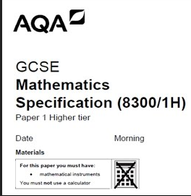
GCSE Mathematics
Foundation Paper – grades 1 – 5
Higher Paper – grades 4 - 9
Foundation Paper
8300/1F | Non Calculator | 1h 30m | 21st May 2019 | am
8300/2F | Calculator | 1h 30m | 6th June 2019 | am
8300/3F | Calculator | 1h 30m | 11th June 2019 | am
Higher Paper
8300/1H | Non Calculator | 1h 30m | 21st May 2019 | am
8300/2H | Calculator | 1h 30m | 6th June 2019 | am
8300/3H | Calculator | 1h 30m | 11th June 2019 | am

Slide 31

How to succeed in Maths?
Have a positive attitude
Ensure all the necessary equipment is brought to every lesson
Excellent attendance and punctuality
Start revising now
Learn the skills
Be proactive

Slide 32
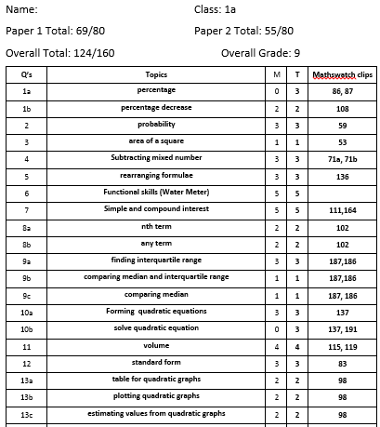
What is targeted revision?
  Diagnosis
  Therapy
  Testing

Slide 33

Useful Resources Available
Mathswatch (school id: carrhill Login: asmith@carrhill password: numbers)
Just Maths (User name: CarrStudent Password: Carr)
MyMaths ( User name: Carr Password: isosceles
Drop in Sessions (Tuesday and Thursday Lunchtime room 4)
The internet e.g Corbett Maths,
Classroom Teacher
Revision guides

Slide 34
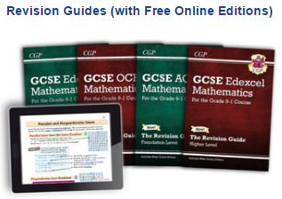
Revision Guides
Revision Guides - £3.00
Workbook and Answers - £4.00
Exam Practice Workbook - £3.00
Targeted Grade 9 Exam Practice Workbook - £3.00
Maths Buster and Mock Exam Papers - £8.00
Maths Tutor and Exam Practice Book - £6.50
All available to buy from the Maths office.

Slide 35

Science
Cathy North
Head of Science

Slide 36
GCSE Sciences - Triple
The current year 11’s will be the second cohort of students to sit the new GCSEs. The timetable of exams is as follows.
Biology
8461/1F + H | Paper 1 | 1h 45m | 14th May 2019 | pm
8461/2F + H | Paper 2 | 1h 45m | 7th June 2019 | pm
Chemistry
8462/1F + H | Paper 1 | 1h 45m | 16th May 2019 | am
8462/2F + H | Paper 2 | 1h 45m | 12th June 2019 | am
Physics
8463/1F + H | Paper 1 | 1h 45m | 22nd May 2019 | pm
8463/2F + H | Paper 2 | 1h 45m | 14th June 2019 | am

Slide 37
GCSE Sciences - Trilogy
The current year 11’s will be the second cohort of students to sit the new GCSEs. The timetable of exams is as follows.
Biology
8464/B/1F + H | Paper 1 | 1h 15m | 14th May 2019 | pm
8464/B/2F + H | Paper 2 | 1h 15m | 7th June 2019 | pm
Chemistry
8464/C/1F + H | Paper 1 | 1h 15m | 16th May 2019 | am
8464/C/2F + H | Paper 2 | 1h 15m | 12th June 2019 | am
Physics
8464/P/1F + H | Paper 1 | 1h 15m | 22nd May 2019 | pm
8464/P/2F + H | Paper 2 | 1h 15m | 14th June 2019 | am

Slide 38
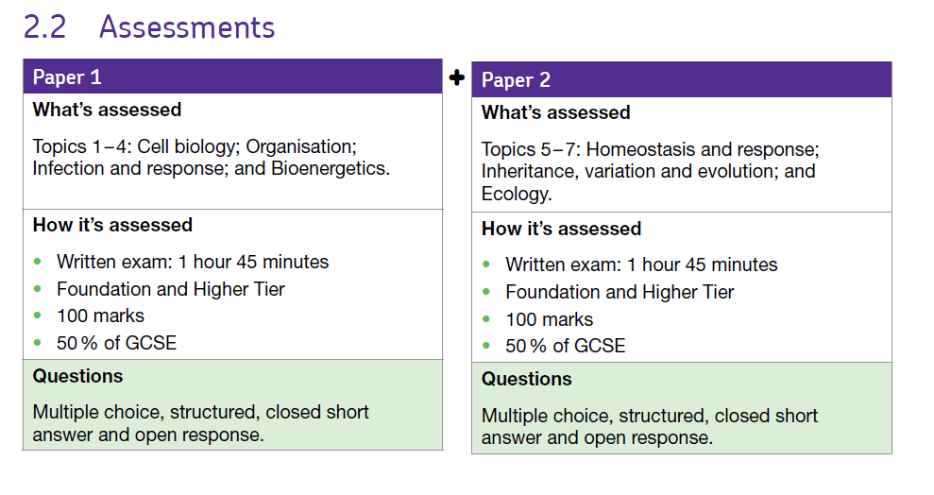
Triple Biology

Slide 39
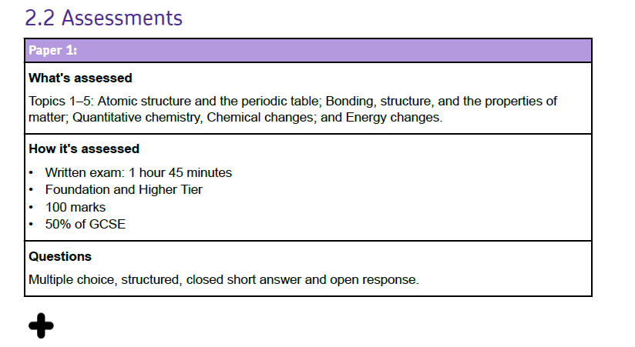
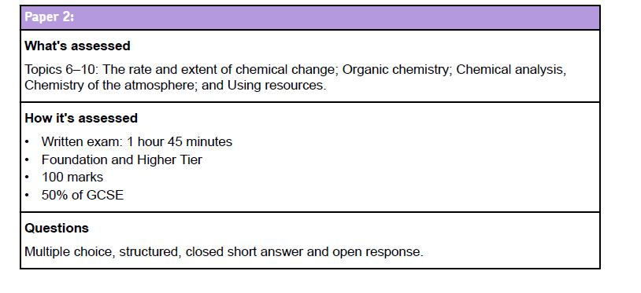
Triple Chemistry

Slide 40
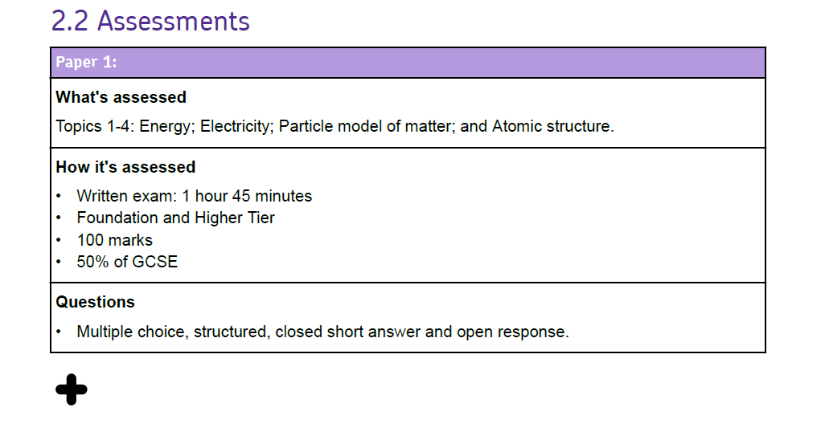
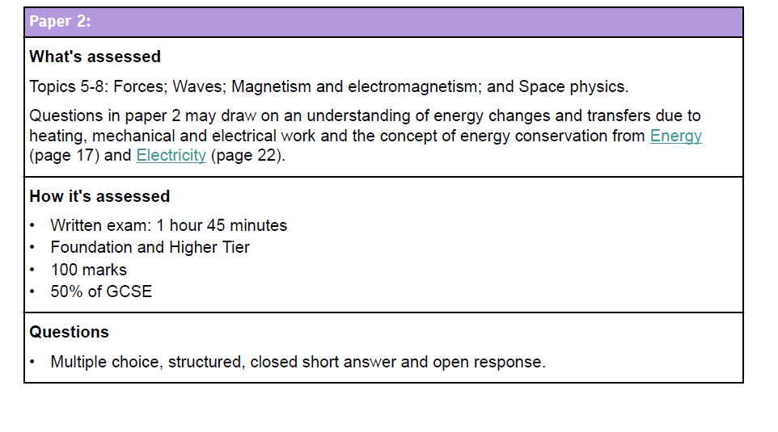
Triple Physics

Slide 41
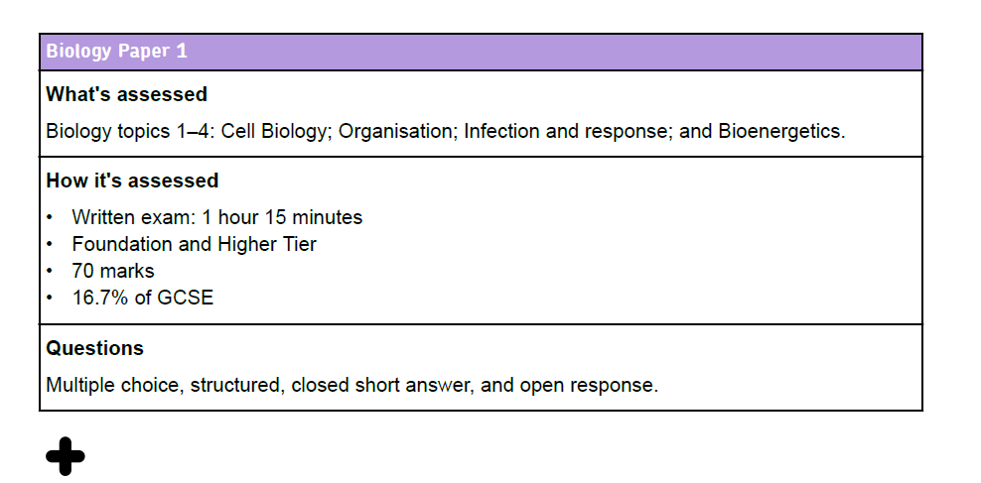
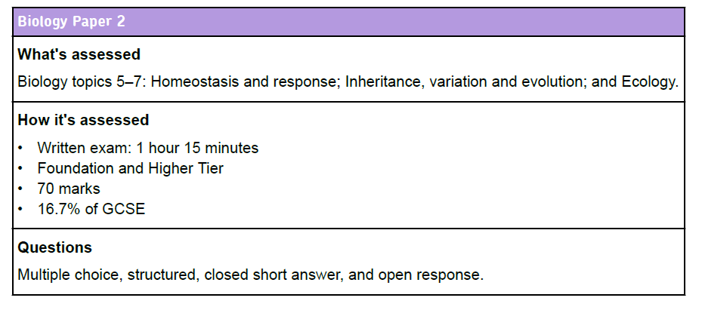
Trilogy Science

Slide 42
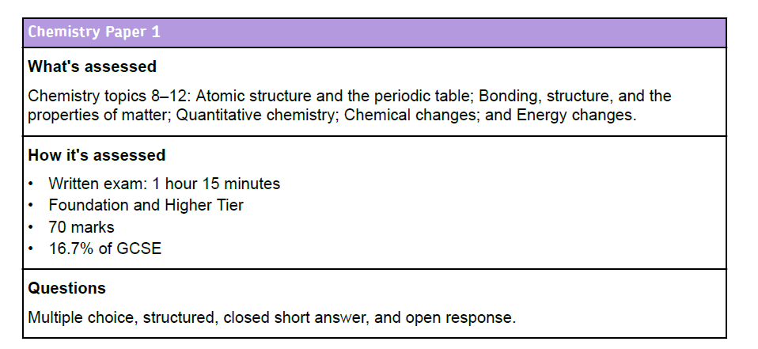
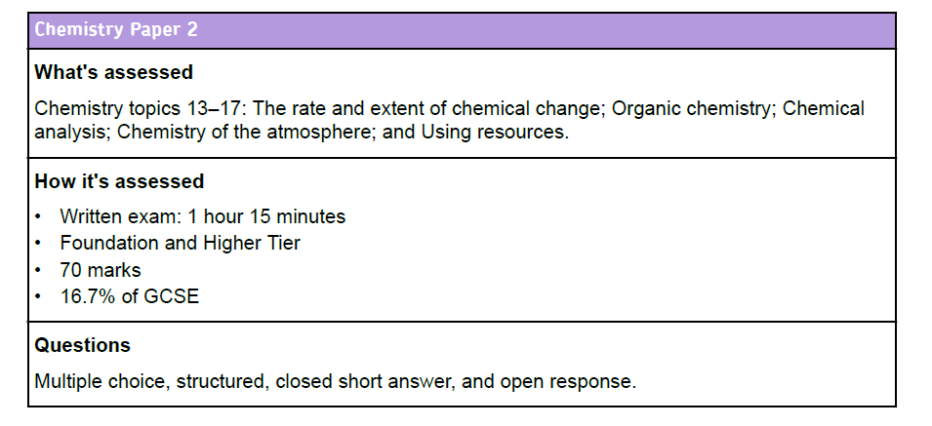

Slide 43
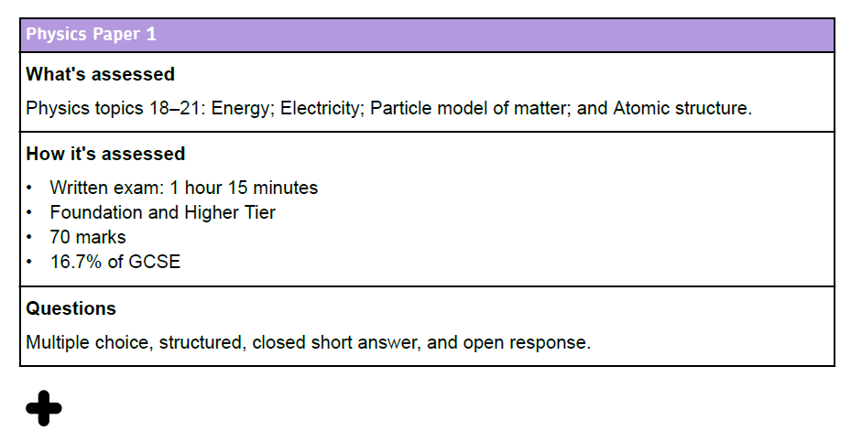
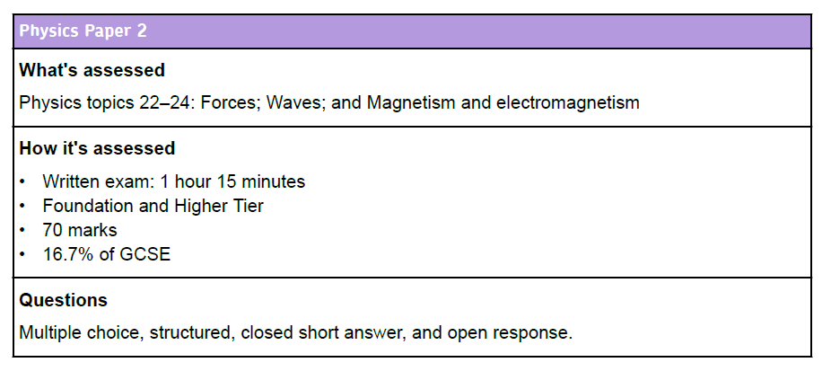

Slide 44
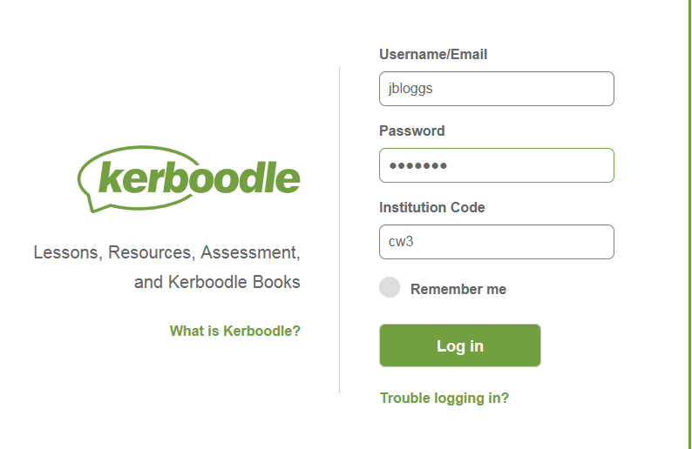


Slide 45
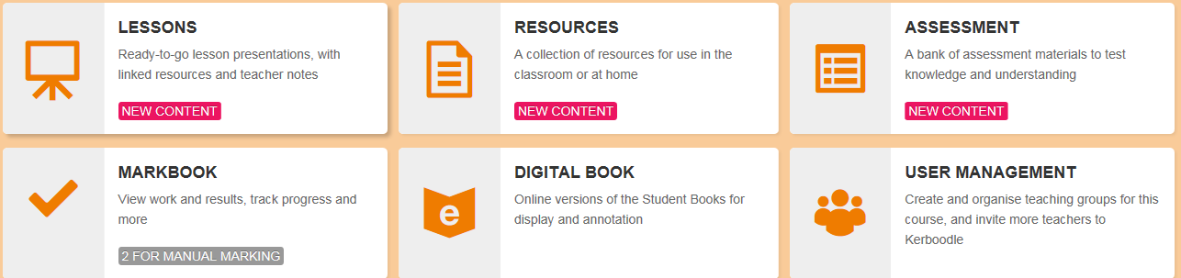
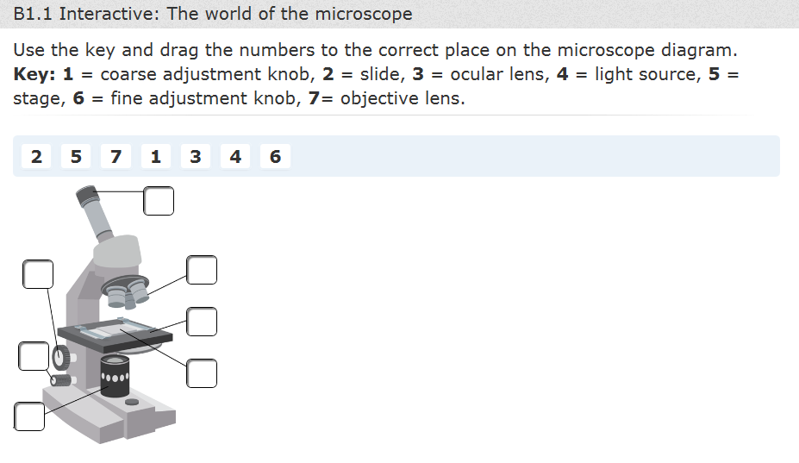
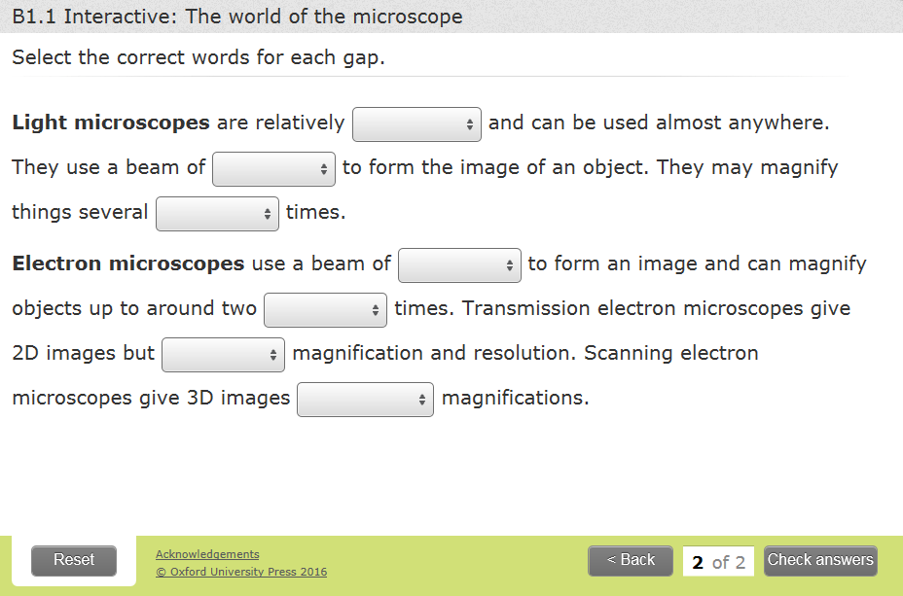

Slide 46
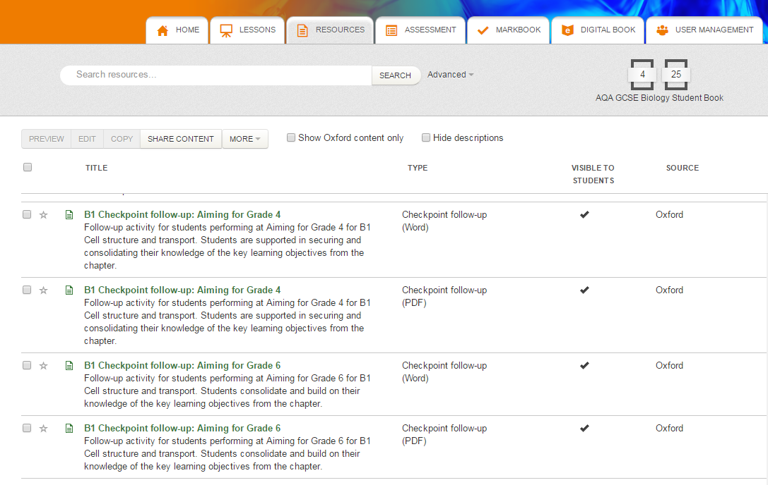

Slide 47
Revision guides - Trilogy
New Grades 9-1 GCSE Combined Science: AQA Trilogy Revision Guide with Online Edition Foundation (SAHR45)
ISBN: 9781782945604 £5.50
New Grades 9-1 GCSE Combined Science: AQA Trilogy Revision Guide with Online Edition Higher (SAHR45)
ISBN: 9781782945598 £5.50

Slide 48
Revision guides - Triple
Revision Guides:
New Grades 9-1 GCSE Combined Science: AQA Trilogy Revision Guide with Online Edition Higher (SAHR45) ISBN: 9781782945598 £5.50
or
Complete Revision and Practice:
New Grades 9-1 GCSE Biology: AQA Complete Revision & Practice with Online Edition (BAS45) ISBN:9781782945833 £5.50
New Grades 9-1 GCSE Chemistry: AQA Complete Revision & Practice with Online Edition (CAS45) ISBN:9781782945840 £5.50
New Grades 9-1 GCSE Physics: AQA Complete Revision & Practice with Online Edition (PAS45) ISBN:9781782945857 £5.50

Slide 49



Revision Techniques

Slide 50

Get organised!
Make sure your notes are in order and your books/files are organised
Make sure you have all past paper questions/sample questions and model answers.
Know your deadlines for coursework submission.

Slide 51

Eat the frog!
Don’t succumb to the temptation to revise things you already know.
Eat the frog – revise the bits you find the most difficult/least interesting – they are the bits you need to focus on.
Don’t put things off – just do them and you will feel so much better!

Slide 52

Past exam questions
As you are revising, make sure that you have all of the PEQs you can find and also the spec so that you know how the knowledge you are learning will be assessed in the actual exams.

Slide 53

Read, write, cover, check…
Write out your notes – cover over small sections and see if you can remember what you have written.
Alternatively, make a short quiz based on what you have revised and answer it at the end of your revision/get someone to test you.
Don’t go on to the next bit until you know the bit you have already revised!

Slide 54
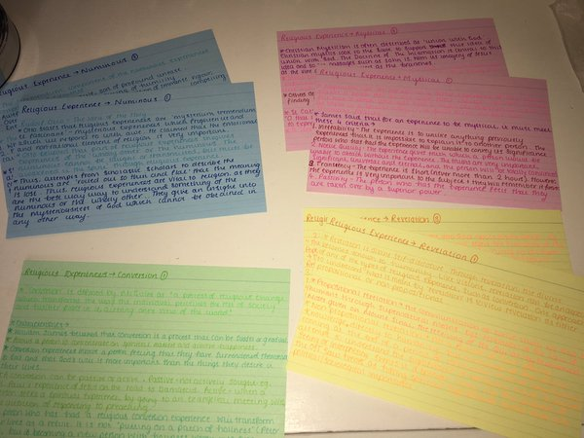
Cue cards
Try making cards with key terms/scholars on one side and an explanation on the other.
Don’t forget to test yourself by turning them over, explanation down, and trying to recall all information.
Colour stimulates long term memory, so colour coding for different topics works really well.

Slide 55

Record yourself
Some students find it really useful to record their revision notes and play them back. Hearing the notes spoken can help you to remember them if you are an auditory learner.

Slide 56
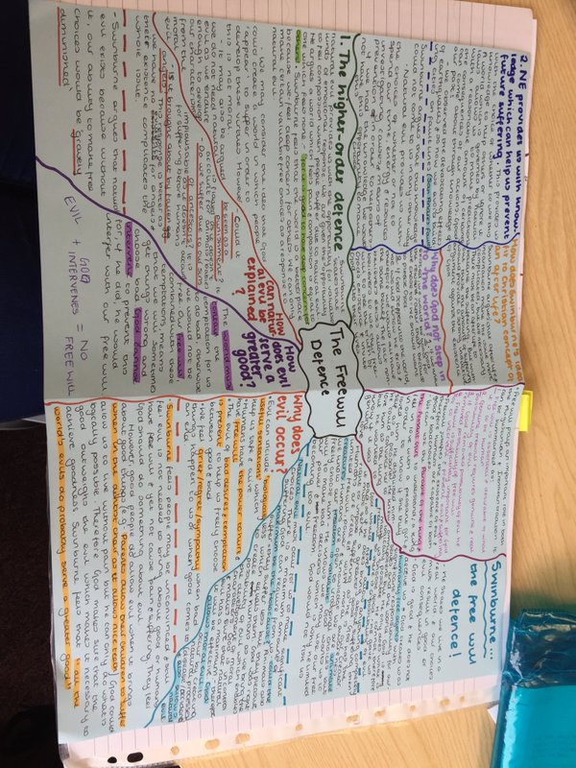
Mind-mapping
Mind-maps can really help you to consolidate the knowledge you have gained.
Many people find that mind-maps help them to recall knowledge around a central theme.

Slide 57
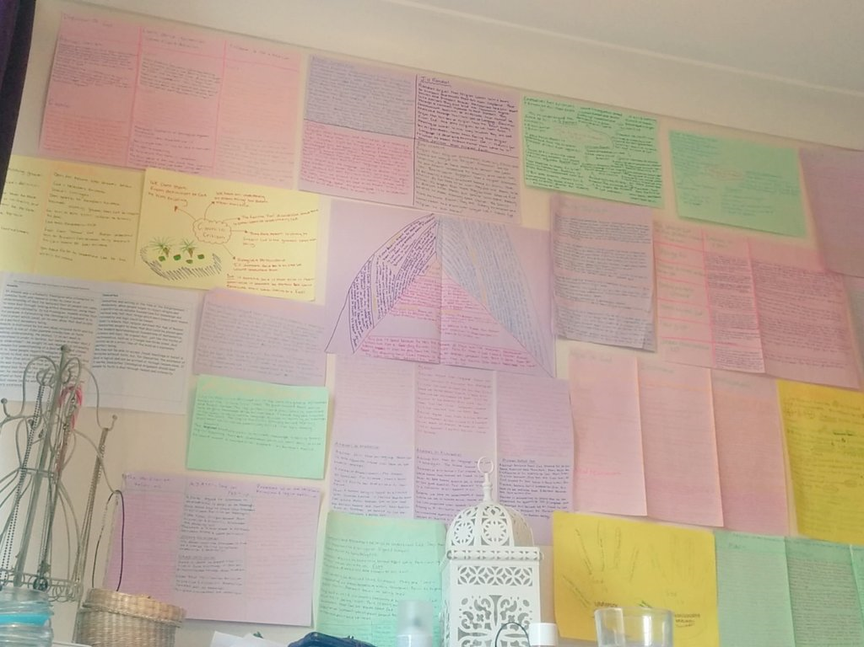
Revision Wall
Get your revision notes everywhere!
Read them whilst you’re brushing your teeth, making your breakfast – have prompts to help you remember dates/facts/people all over your house.

Slide 58
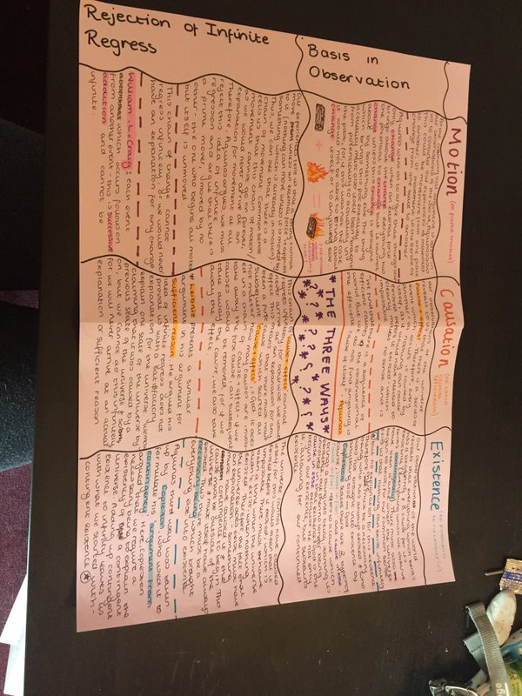
Create consolidation sheets
Bring your lesson notes, booklets and extra reading together on consolidation sheets – make sure your notes are together in one place.

Slide 59


