Slide 1
Year 11 Information Evening

Slide 2
Year 11
Miss Jordinson

Slide 3
Year 11 Key dates
Year 11 PPEs – Week beginning the 24th October
Year 11 PPEs – Week beginning the 20th February
Year 11 exams start – Week beginning 15th May

Slide 4
Revision
Start planning now – little and often!
Study Environment
Practise revision techniques
www.getrevising.co.uk
www.s-cool.co.uk
https://revisionworld.com/

Slide 5
Attendance
95% attendance = ½ a day of lessons missed every two weeks
95% attendance – TWO weeks of lessons missed each year

Slide 6
Year 11 celebration of Achievement
Tuesday 27th June – The Villa Wrea Green
Demerits/ Exclusions/ time in isolation

Slide 7
GCSE Reform
Ms Hilton-Peet

Slide 8
Why and how are GCSEs changing?
GCSEs and A levels in England are being reformed, to match the best systems in the world and keep pace with universities’ and employers’ demands.
GCSE content will be more challenging but still suitable for all abilities
GCSEs will be graded on a new scale of 9 to 1 rather than A* to G as now, with 9 the highest grade, to distinguish clearly between the reformed and unreformed qualifications
Increased rigour of GCSEs to ensure that reformed qualifications meet the needs of users now and in the future and are of comparable demand to the best in the world.

Slide 9
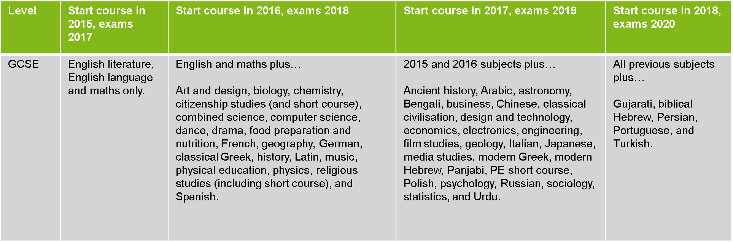
When do these reforms affect GCSE students?

Slide 10
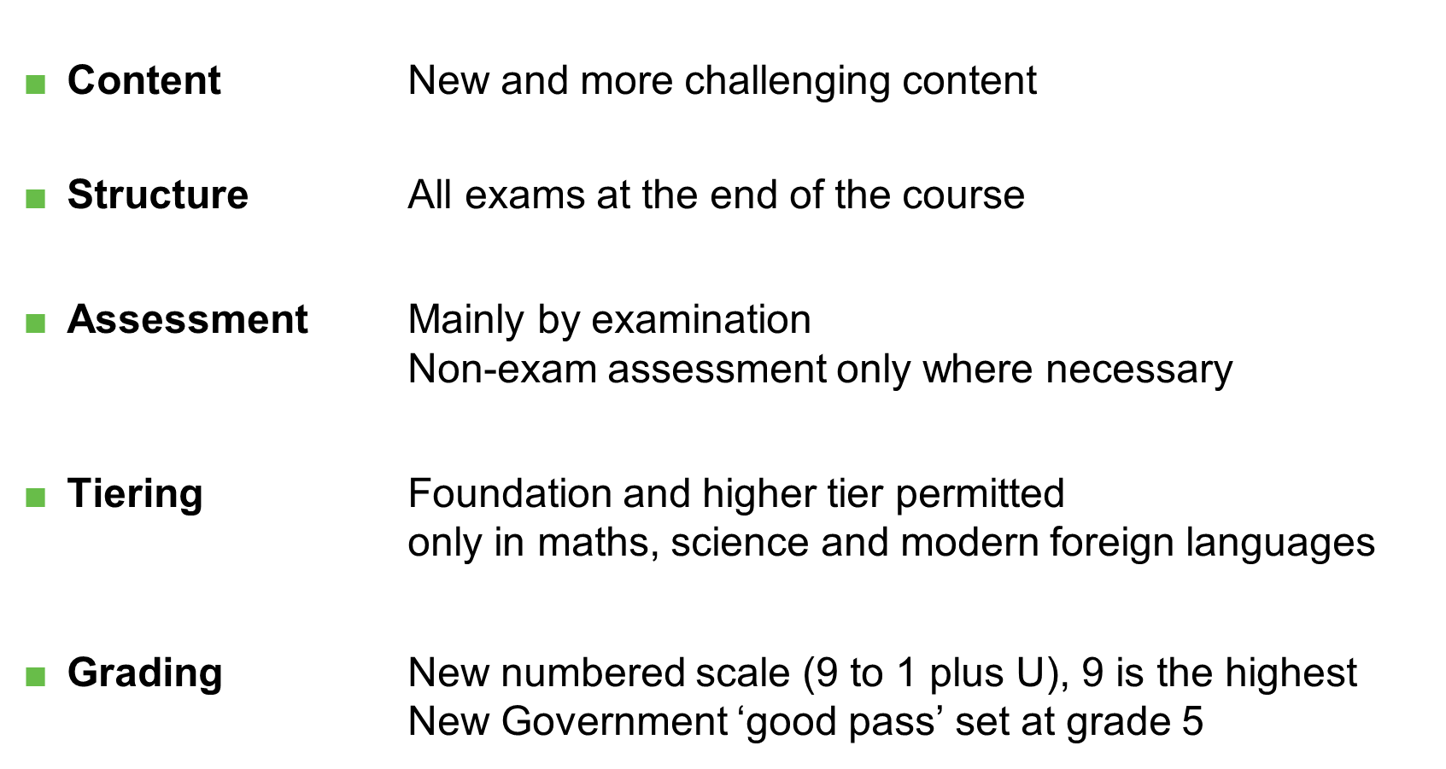
Reformed GCSEs

Slide 11
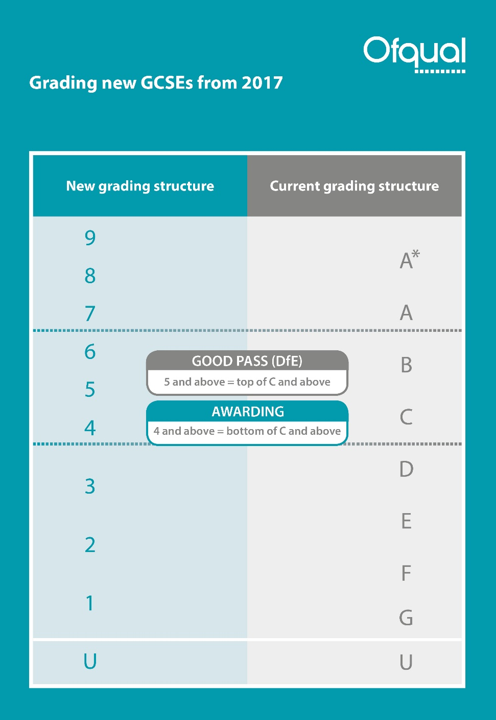
In the first year, the
same proportion of students will as currently get A and above
achieve a grade 7 and above
achieve a grade 4 and above as currently get C and above
achieve a grade 1 and above as currently get G and above

Slide 12
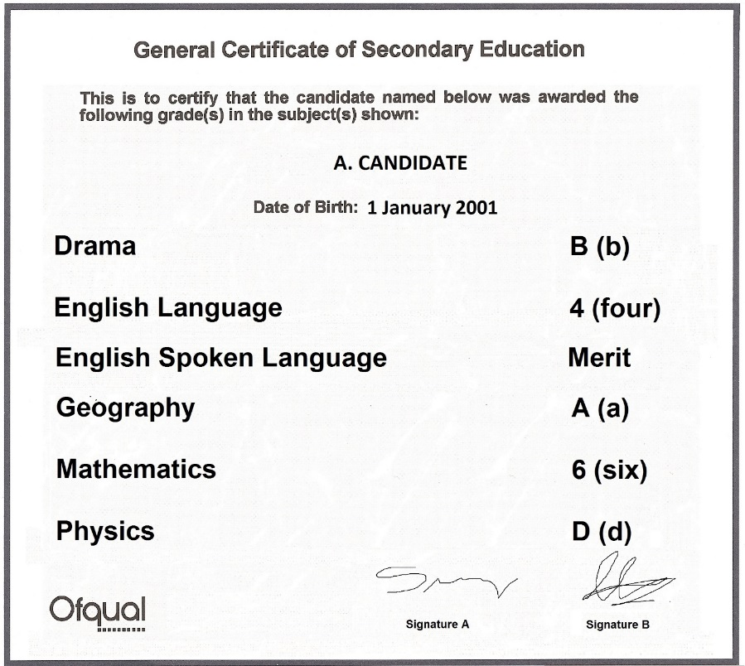
What a GCSE certificate might look like in 2017

Slide 13
English
Mrs McDonough

Slide 14
English - a quick reminder
There are actually two qualifications:
GCSE English Language (AQA)
GCSE English Literature (AQA)
They are exam only – no coursework or controlled assessments.

Slide 15
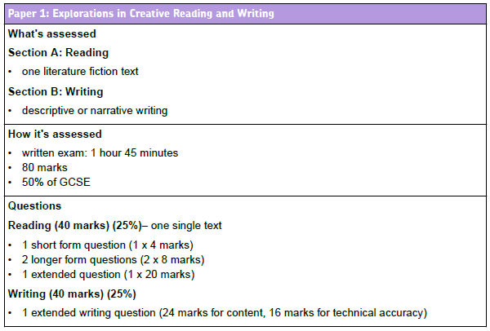
GCSE English Language

Slide 16
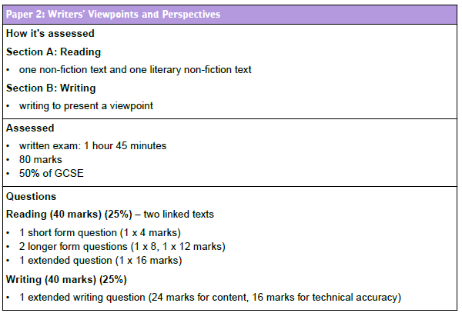
GCSE English Language

Slide 17
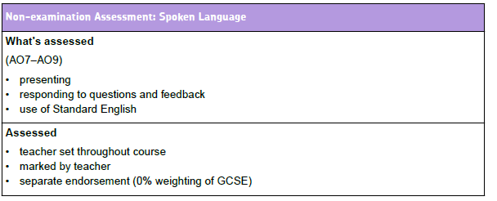
GCSE English Language

Slide 18
GCSE English Literature
Literature Paper 1
1 hour 45 minutes.
40 % of Literature GCSE.
Two sections.
Section A – Macbeth
Includes one extract question and one whole text question.
Section B – A Christmas Carol
Includes one extract question and one whole text question.
Literature Paper 2
2 hour 15 minutes.
60% of total Literature marks.
3 sections: Animal Farm, Poetry Anthology and unseen poetry texts.
Assesses comparison.

Slide 19
We will continue to teach language and literature side by side.
Pupils will see skills as transferrable.

Slide 20
 | Time Frame | Language and Literature | Key Dates
Term 1 | Until 24th October Weeks beginning: 7th, 14th and 21st November Week beginning 28th/5th December Wks. beginning 12th -19th December | Macbeth Explicit teaching of the unseen poetry section of Literature Paper 2. PPE RAP activities after results day followed by revision of Anthology Poetry. Speaking and Listening* | Y11 PPE Literature Paper 1, Language Paper 2 wks. beginning 24th October

Slide 21
 | Time Frame | Language and Literature | Key Dates
Term 2 | Weeks beginning 9th , 16th and 23rd January Mid week of 23rd Jan – half term holiday Wks. beg 27th February/6th March/13th March Wk.. Beg 20th March Wk. beginning 27th March | Explicit teaching of Language Paper 1 reading skills Revise writing skills for Paper 1 - Huge focus on SPAG and effective planning. Writing to describe/narrate Revision of Animal Farm. Feedback/RAP from Language PPEs Speaking and Listening* | Y11 PPEs wks. beg 20th February - Language Paper 1, Literature paper 2. Assessment to be completed before Easter.

Slide 22
 | Time Frame | Language and Literature | Key Dates
Term 3 | 18th April – 24th April 2 May – 8th May – 15th May 29th May – | Language Paper 1/2 A Christmas Carol ACC/Macbeth Macbeth Poetry Language Paper 1/2 | Exams: Lit Paper 1 (Shakespeare/ACC) 22 May Lit Paper 2 (Modern texts) 26 May Lang Paper 1 6th June Lang Paper 2 12th June

Slide 23
Homework
Pupils will be set both weekly homework and longer project/research based tasks.
Homework will be on Show My Homework however…
as they are closed book examinations, pupils will also be required to re read texts and learn quotes. This is ongoing and may not always be set as the homework for that week – it will be an expected extra. Pupils are encouraged to create a revision file – they can add their own independent research.

Slide 24
Please, please buy the texts!
‘Macbeth’– Oxford School Shakespeare, ISBN 9780198324003
‘A Christmas Carol ‘– Puffin, ISBN 9780141324524
‘Animal Farm’- Penguin, ISBN 9780141036137

Slide 25
Mathematics
Mr Myers

Slide 26
GCSE Mathematics
The current year 11’s will be the first cohort of students to sit the new GCSE.
The timetable of exams is as follows.
Foundation Paper
8300/1F | Non Calculator | 1h 30m | 25th May 2017 | am
8300/2F | Calculator | 1h 30m | 8th June 2017 | am
8300/3F | Calculator | 1h 30m | 13th June 2017 | am
Higher Paper
8300/1H | Non Calculator | 1h 30m | 25th May 2017 | am
8300/2H | Calculator | 1h 30m | 8th June 2017 | am
8300/3H | Calculator | 1h 30m | 13th June 2017 | am

Slide 27
Higher or Foundation?
The content in the foundation paper is easier.
Grades available in a foundation paper are 1 to 5.
Grades available in a higher paper are 4 to 9.
For both papers if you fall below the minimum grade it is a fail.
The structure of the assessments is identical for both.
The students are regularly assessed and will be put on the most appropriate tier to help maximise their performance.

Slide 28
Which exam board do we use?
We have selected the AQA specification for the following reasons.
Greater support for schools when the change became public.
Their initial exemplar assessments were of a better standard.
They intentionally keep the word count of their exams to a minimum.

Slide 29
What we expect from the students?
Bring all the necessary equipment.
Excellent attendance and punctuality.
Excellent behaviour.
Greater independence and responsibility.

Slide 30
What will this year look like?
Paper 1
Paper 2
Paper 3

Slide 31
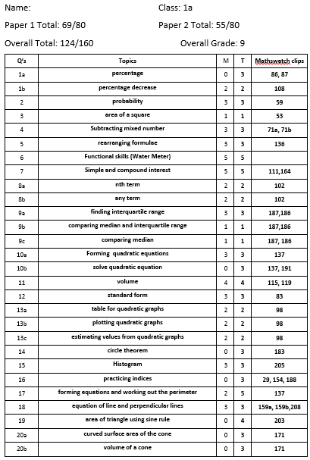
What is targeted revision?

Slide 32
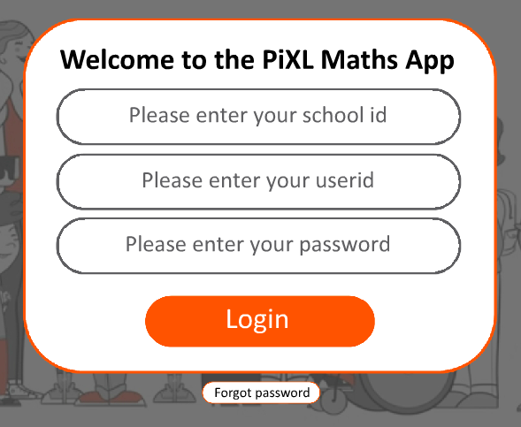
Using the PiXL Maths App
The PiXL Maths App is the first result from an internet search.
It can be used via desktop or downloaded to various devices.
Each student has a unique login.
  school id: CH2264
  user id: surnamefirstname
  Password: surnamefirstname

Slide 33
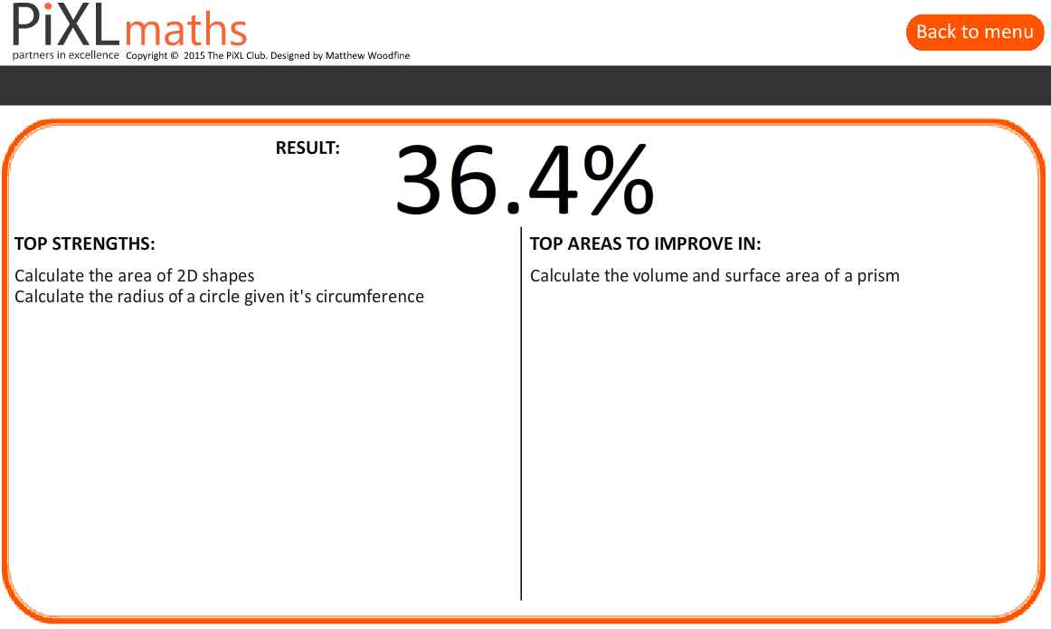
What is the PiXL Maths App
  Diagnosis

Slide 34

What is the PiXL Maths App
  Diagnosis
  Therapy

Slide 35
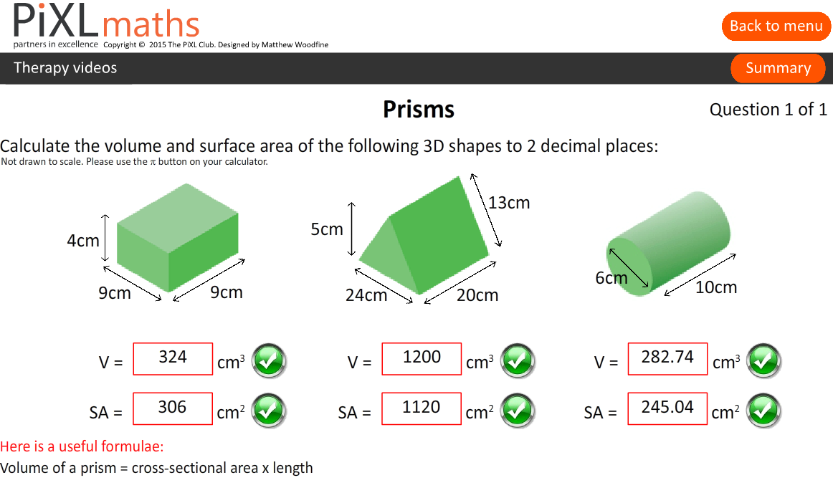
What is the PiXL Maths App
  Diagnosis
  Therapy
  Testing

Slide 36
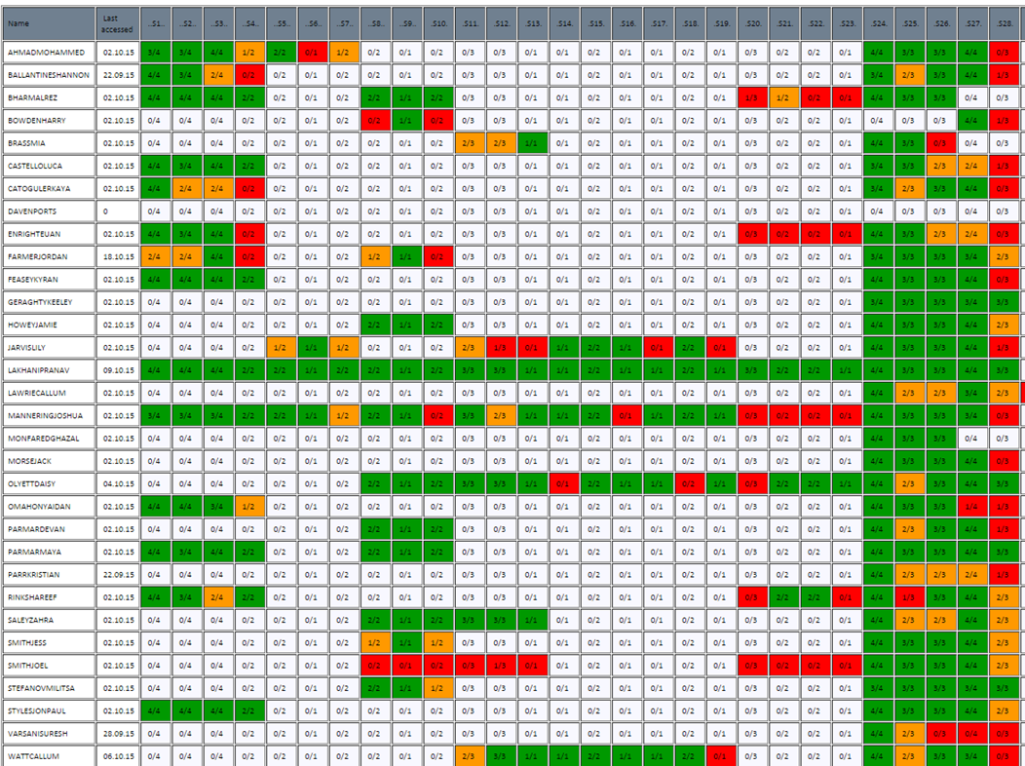
What is the PiXL Maths App
  Diagnosis
  Therapy
  Testing
  Personalised Learning
  Checklist

Slide 37
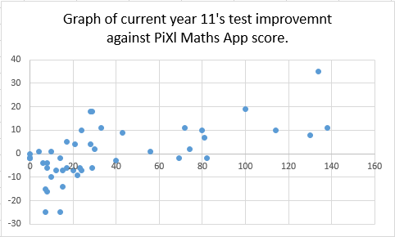
Why use the PiXL Maths App
  Greater independence.
  Bespoke individual intervention.
  Complete curriculum coverage.
  Proven impact on results.
Scatter graph of previous year 11’s GCSE mock improvement against PiXL maths app score

Slide 38
What intervention is available?
Throughout the year assessments will be used to identify the students below target.
Intervention sessions will also be provided for those students working towards level 9.
Extra sessions staffed by each classroom teacher.
Specific intervention days for targeted students.

Slide 39
Useful Resources Available
Mymaths (login: carr password: isosceles)
Mathswatch (school id: carrhill Login: asmith password: numbers)
Just Maths (User name: CarrStudent Password: Carr)
PiXL Maths App (School id: CH2264 User id: surname firstname
Kerboodle (Demonstrated in lesson)
Drop in Sessions (Tuesday and Thursday Lunchtime)
The internet
Classroom Teacher

Slide 40

Revision Guides

Slide 41

Revision Guides

Slide 42

Revision Guides

Slide 43
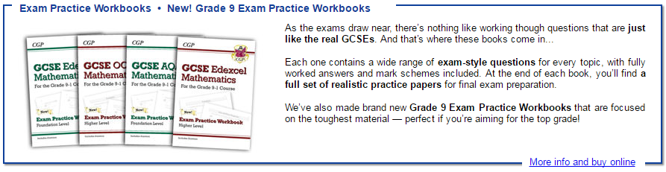
Revision Guides

Slide 44

Revision Guides

Slide 45
Revision Guides
Revision Guides - £3.00
Workbook and Answers - £4.00
Exam Practice Workbook - £3.00
Targeted Grade 9 Exam Practice Workbook - £3.00
Maths Buster and Mock Exam Papers - £8.00
Maths Tutor and Exam Practice Book - £6.50
All available to buy from the Maths office.

Slide 46
Show My Homework

Slide 47
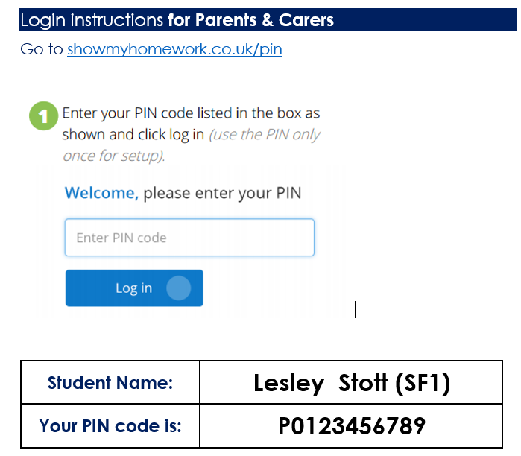
Show my homework

Slide 48
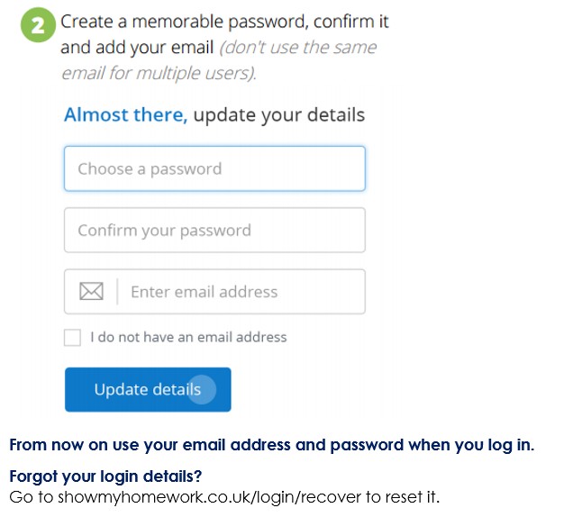
Show my homework

Slide 49
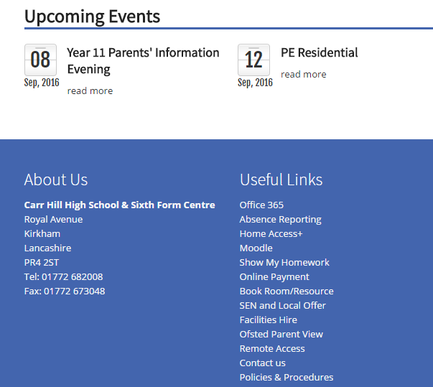
Show my homework

Slide 50
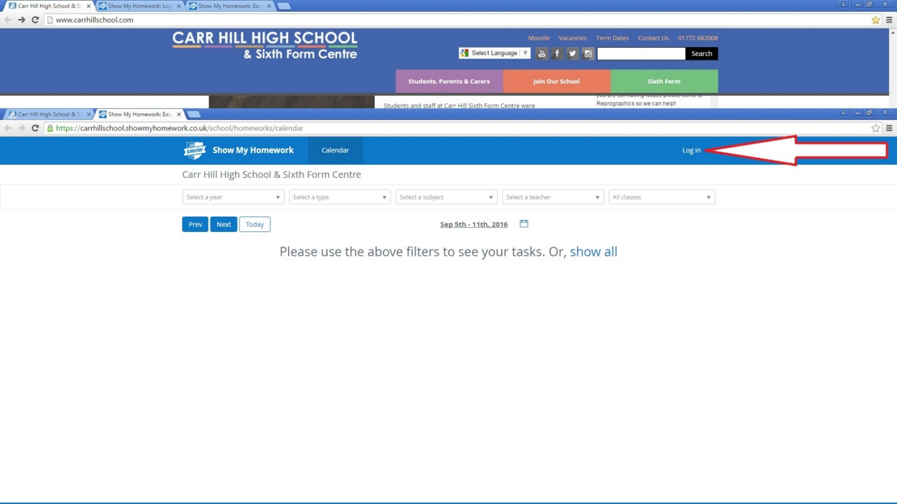
Show my homework

Slide 51
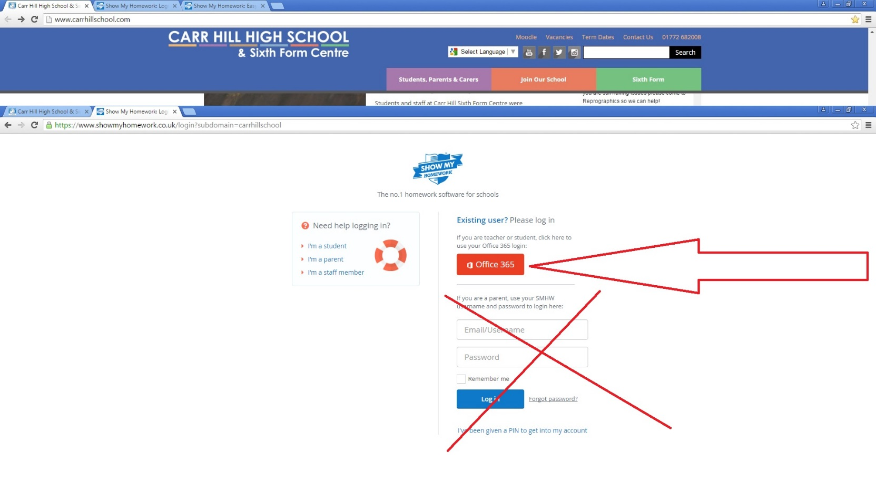
Show my homework

Slide 52
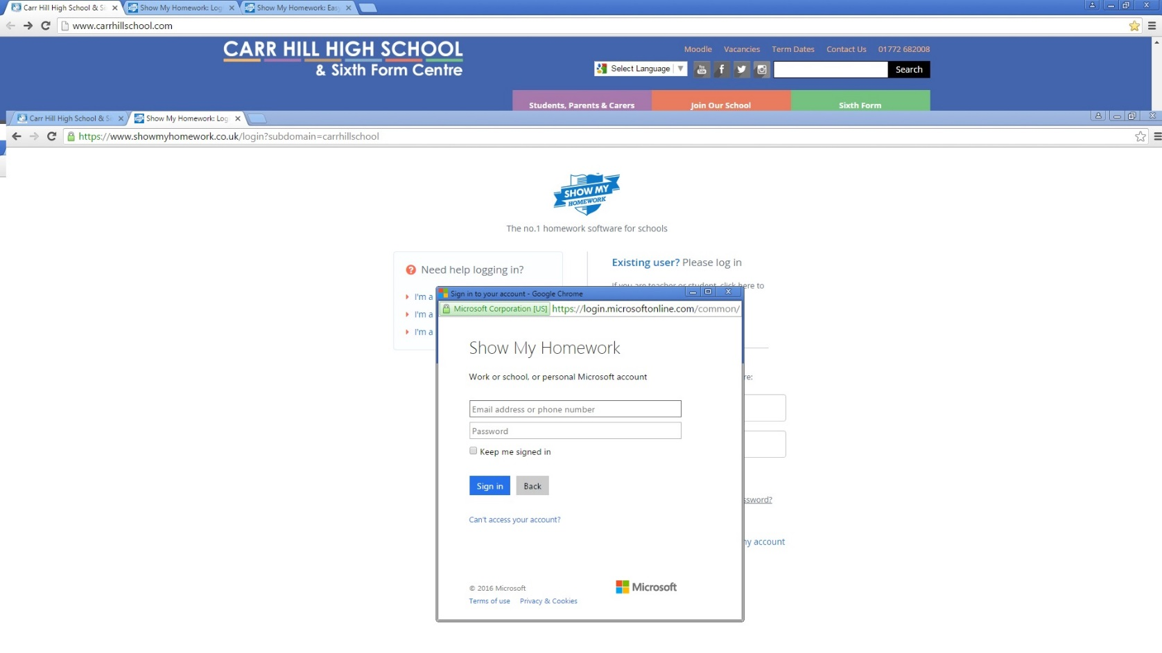
Show my homework

Slide 53
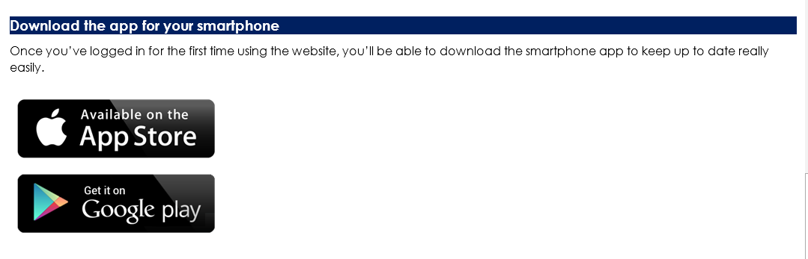
Show my homework

Slide 54

Mr Napier

Slide 55
As a student at Carr Hill Sixth Form, you are at the heart of everything we do. We will endeavour to ensure that you are happy and fulfilled during your time in sixth form and that you fulfil your potential and acquire the skills that will equip you to achieve your future goals and ambitions.

Slide 56
A Curriculum Planned for you
High Quality Academic Programmes, Vocational & Work-Related Programmes
Curriculum Enhancement Programmes
Specialist Employment Preparation Programmes
Sporting Elite Programmes

Slide 57
What’s Changed?
Previously students have typically completed 4 AS courses in Year 1 at sixth form, reducing to 3 A2 courses in Year 2.
We’re offering a fully flexible programme with a range of different subjects, from which you can study either 3 or 4 to make up your study programme.
University offers are made on the basis of 3 A Level grades. Taking more than 3 subjects to A Level is therefore not the best approach for most students. Whether you choose 3 or 4 subjects in the first year, most students would reduce to 3 in Year 2.

Slide 58
Thinking Ahead…
Do you have a particular career in mind?
What university course/apprenticeship do you need to be applying for?
What are the entry requirements for the course?
What P16 courses do you need to be applying for?
What GCSE grades will you need?

Slide 59
Applying for Sixth Form
Spend some time thinking about your options at 16 and 18
Attend the Sixth Form Open Evening on 6 October 2016
Apply for Sixth Form place by 2 December 2016

