Slide 1



Thanks for Joining Us
Show my Homework
GCSE reform, targets and making progress
Success in English
Success in mathematics
Success in science
Behaviour for Learning
Teaching and Learning including Chromebooks
Get the latest news, updates and reminders every day.
Carr Hill High School
@CarrHillSchool

Slide 2
Show my Homework
Liz Hilton-Peet
Assistant Headteacher
Notes:
Help clubs – Friday lunch room 26
Apps for phones – not always available
Emailed presentation.
Presentation on school website
Majority of problems – wrong password or email

Slide 3
Before a student can access
Show My Homework they need to have logged into their school email

Slide 4
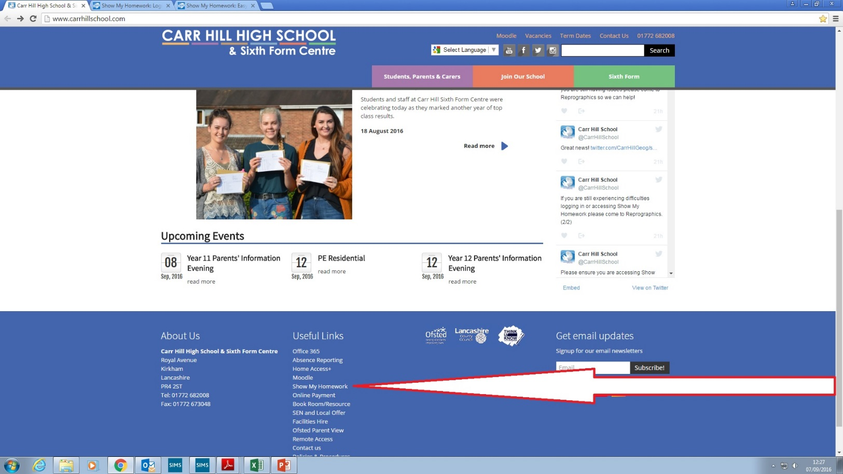
Show my Homework
Using Chrome access the Carr Hill Website and at the bottom under “Useful Links” click “Show my Homework”
Click here

Slide 5
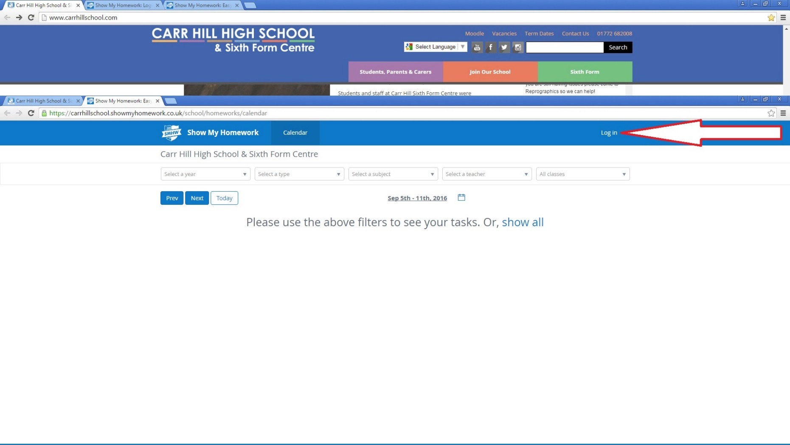
Log in
Click here

Slide 6
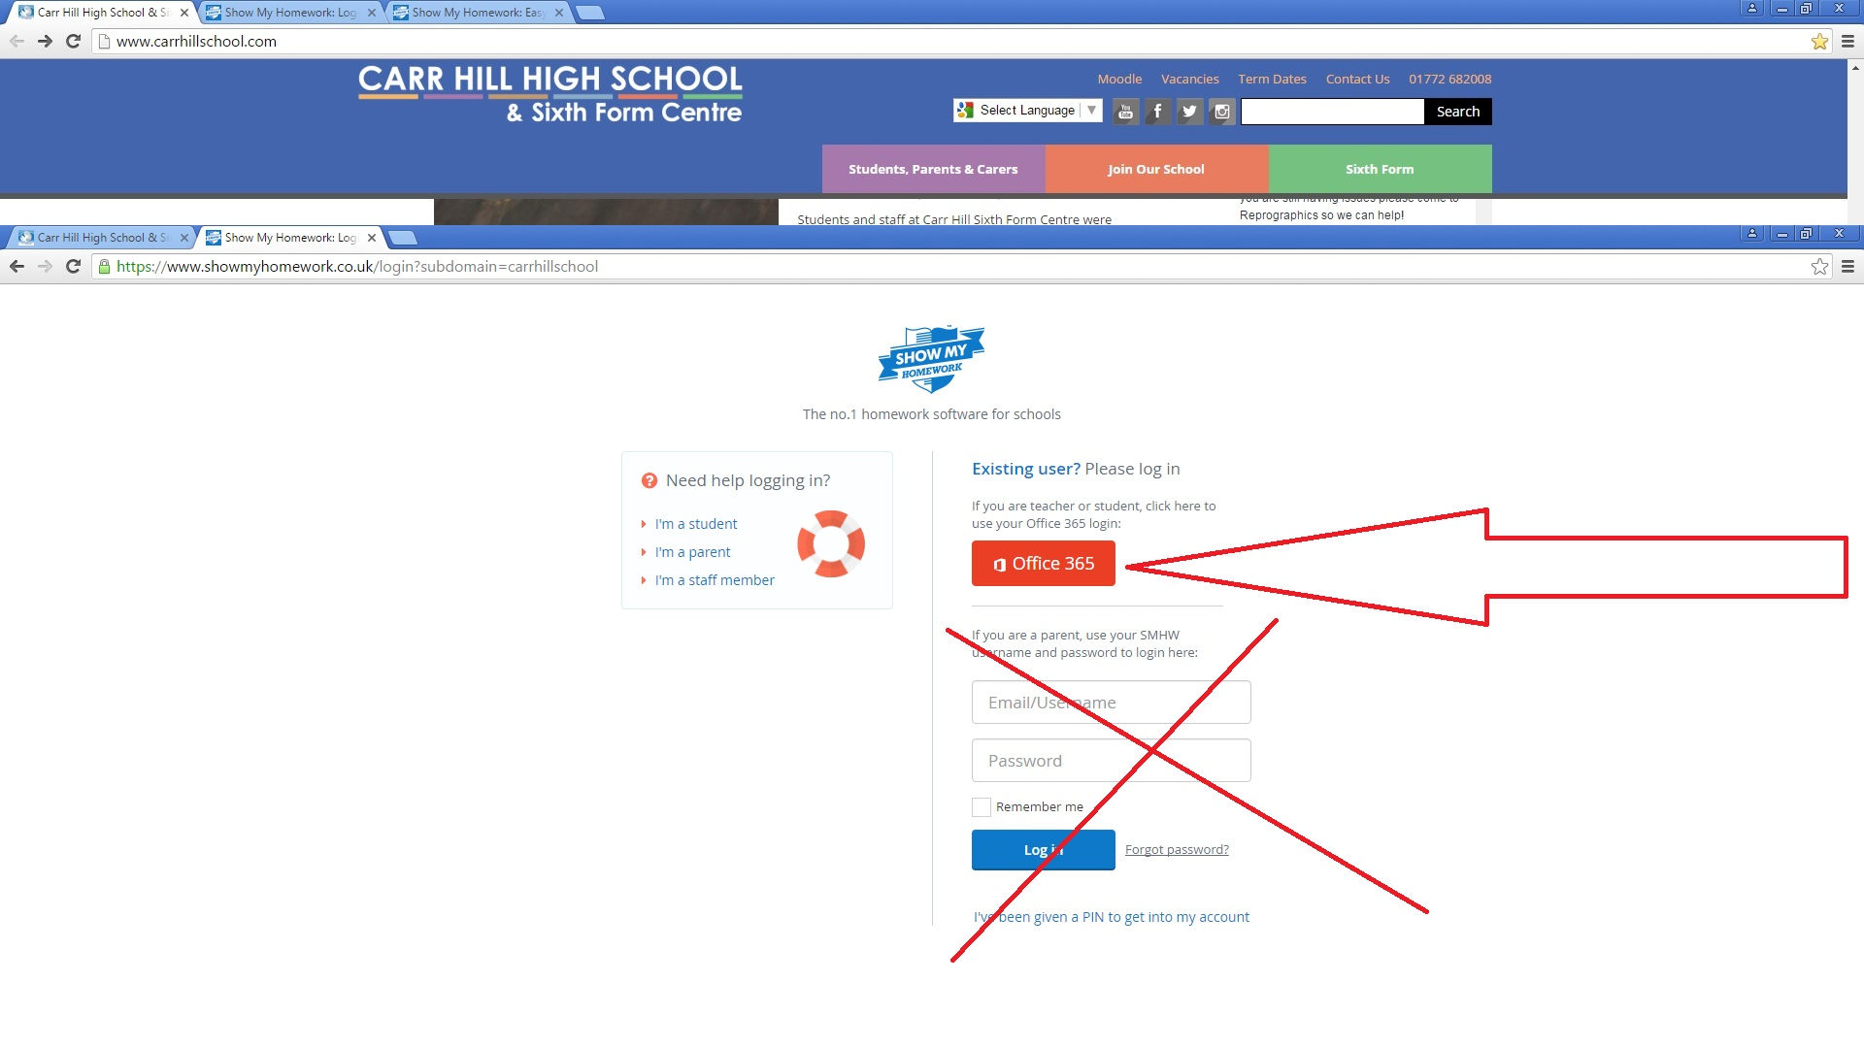
Click here - Use the Red Office 365 button to log in
DO NOT USE THIS SECTION TO LOGIN USE THE ABOVE RED OFFICE 365 BUTTON

Slide 7
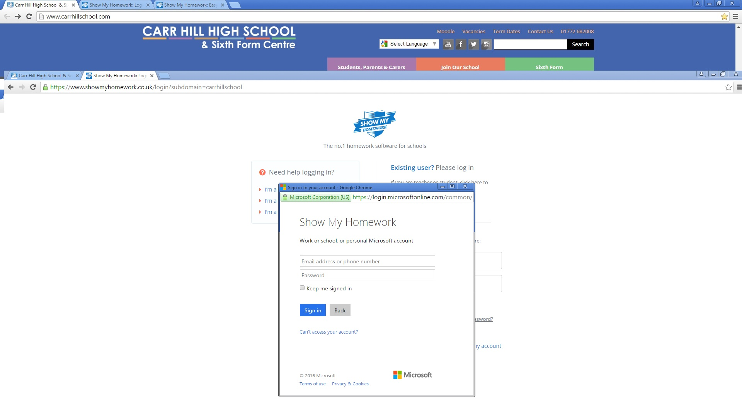
Log in with their full school email address and password

Slide 8
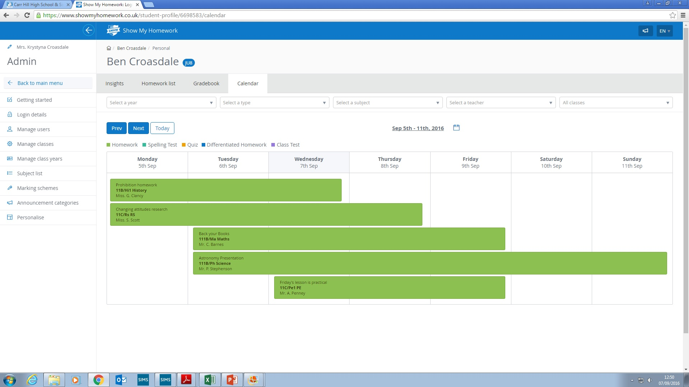
They now have access to their account on Show My Homework

Slide 9
GCSE reform, targets and monitoring progress
Liz Hilton-Peet
Assistant Headteacher

Slide 10
Why and how are GCSEs changing?
GCSEs and A levels in England are being reformed, to match the best systems in the world and keep pace with universities’ and employers’ demands.
GCSE content will be more challenging and rigorous but still suitable for all abilities.
GCSEs will be graded on a new scale of 9 to 1 rather than A* to G, with 9 the highest grade, to distinguish clearly between the reformed and unreformed qualifications.
Assessment is mostly by examination rather than partly by coursework.
Foundation and higher tiers are now only available in maths, science and languages.
Grading is now on a 1-9 scale rather than on an A*-G scale.

Slide 11
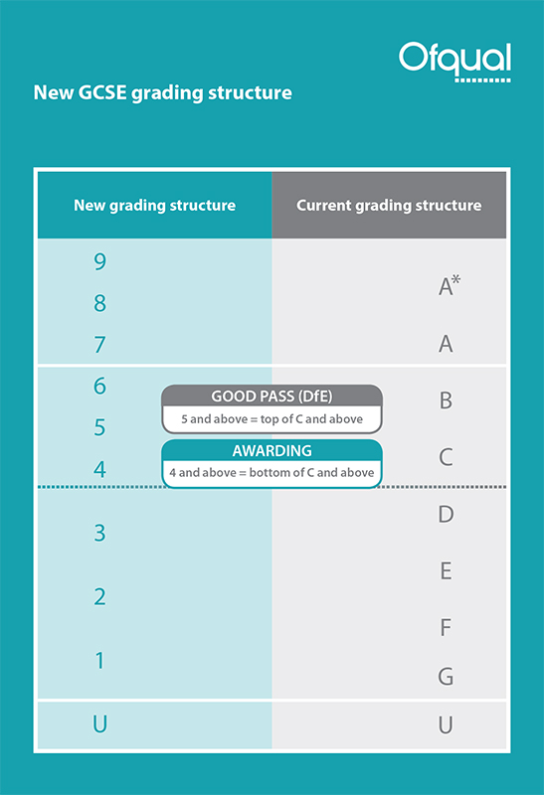
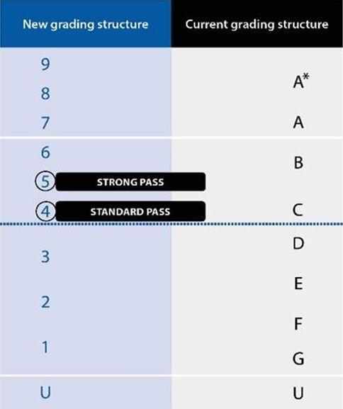

Slide 12
Setting Targets
Above Average School - Physics
KS2 | KS3 |  |  | KS4
Average Scaled Score (Reading / Maths) | Year 7 Target | Year 8 Target | Year 9 Target | Year 10 Target | Year 11 Target
112-120 |  |  |  |  | 8
110-111 |  |  |  |  | 8
107-109 |  |  |  |  | 7
103-106 |  |  |  |  | 6
99-102 |  |  |  |  | 5
93-98 |  |  |  |  | 4
89-92 |  |  |  |  | 3
80-88 |  |  |  |  | 2
Below Level Test |  |  |  |  | 2

Slide 13
Keeping track of progress
Flight paths.
Allows tracking of progress against targets.
Find them in student planners.

Slide 15
Reports
1-9 grade and A-C confidence level reported in all subjects. For example 1A.
A – very confident of grade.
B – confident of grade.
C – not as confident of grade.
Available on Moodle. Paper copies can be requested from the data manager.
December, March, May and July.
A subject in the “red” is a cause for concern.

Slide 16

English

Slide 17
English
There are actually two qualifications:
GCSE English Language (AQA)
GCSE English Literature (AQA)
ALL pupils at Carr Hill will follow a joint programme of study and the vast majority will be entered for both qualifications at the end of two years. They are exam only – no coursework or controlled assessments.
Your child will already be familiar with the exam requirements as they will have completed similar work and assessments in Y9.

Slide 18
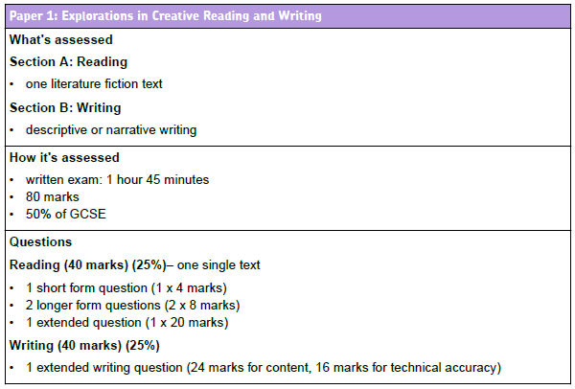
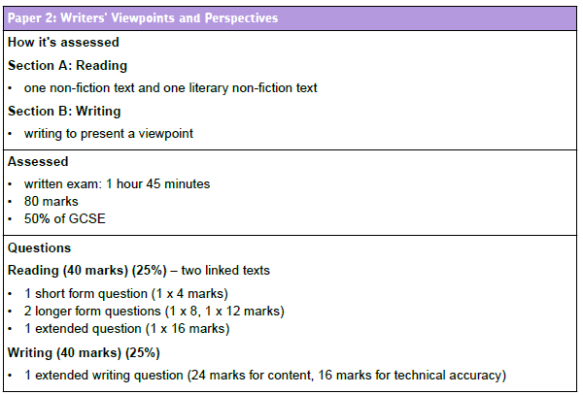
English Language

Slide 19
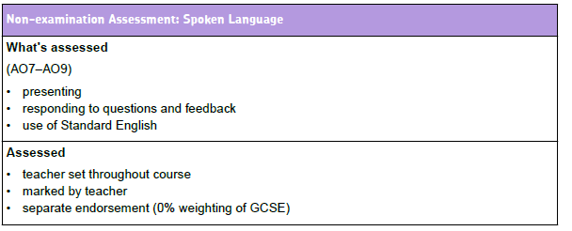
GCSE English Language

Slide 20
English Literature
GCSE English Literature
Paper 1
1 hour 45 minutes.
40 % of Literature GCSE.
Two sections.
Section A – Shakespeare
Includes one extract question and one whole text question.
Section B – The 19th century novel
Includes one extract question and one whole text question.
GCSE English Literature
Paper 2
2 hour 15 minutes.
60% of total Literature marks.
3 sections: modern prose or drama, poetry and unseen texts.
Assesses comparison.

Slide 21
Our selected literature texts
In Year 10
A Christmas Carol ( Paper 1 – 19th century text)
Animal Farm ( Paper 2 – modern prose)
AQA Conflict themed anthology of poetry (Paper 2 – poetry)
In Year 11:
Macbeth (Paper 1 – Shakespeare)

Slide 22
 | First term - novel ‘A Christmas Carol’
Literature Reading/writing and spoken language skills (below) threaded through literature teaching. | Full first term 19th Century novel Understanding of main themes, characters and ideas Critical response Personal interpretation Use of quotations and close reference to text Key extracts and relate them to the novel Analysis of language Context
Reading | C19th non-fiction texts linked to and to support the text studied for Literature • Identify and interpret explicit and implicit information and ideas • Analysis of how writers use language and structure • Critical evaluation
Writing | Thematic links to texts studied in reading /literature Writing to describe/narrate Teach use of sentence structure and punctuation for effect. Emphasis on crafting writing.
We will teach language and literature side by side.
Pupils will see skills as transferrable.
Although a key writing focus will be addressed each term, other types will still be covered.
Spoken language will be assessed in the second term but will also form an important part of many lessons.

Slide 23
Homework and Support
Pupils will be set both weekly homework and longer project/research based tasks on SMH.
As they are closed book examinations, pupils will also be required to re read texts and learn quotes. This is ongoing and may not always be set as the homework for that week – it will be an expected extra.
They will also be directed to start a revision file – ring binders are best.
‘Belong’ is a literature focused group that is in place to support, stretch and challenge pupils. Your child should ask their teacher for information about this lunch time activity.
If your child’s teacher has concerns about your child’s progress, they will always flag up any problems and we will put appropriate support and intervention into place.

Slide 24
Texts
Students will be issued with copies of the Literature set texts. They are for use in class and they will not be able to take the texts home.
A Christmas Carol
Animal Farm
Macbeth
Texts are also available on Moodle.
Your child has been issued with a letter regarding the above texts. We recommend buying the set texts so that your child can annotate them in class and complete additional revision at home.
Mini quote books are available for purchase. They are £3.00 and you can pay online or at the Finance Office. Currently, we have ‘A Christmas Carol’ and ‘Macbeth’.

Slide 25
Should you have any cause for concern or need any further information, please contact either:
Adele McDonough - Faculty Leader
Christina Fry – Assistant Faculty Leader
Kathryn Gardner – Assistant Faculty Leader

Slide 26
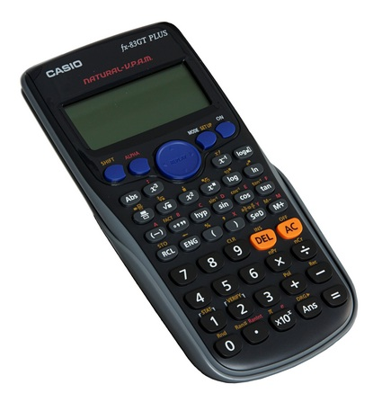
Mathematics
Laura Potts
Assistant Head of faculty

Slide 27
GCSE Mathematics
The timetable of exams is as follows.
Foundation Paper
8300/1F | Non Calculator | 1h 30m | May 2019
8300/2F | Calculator | 1h 30m | June 2019
8300/3F | Calculator | 1h 30m | June 2019
Higher Paper
8300/1H | Non Calculator | 1h 30m | May 2019
8300/2H | Calculator | 1h 30m | June 2019
8300/3H | Calculator | 1h 30m | June 2019

Slide 28
Higher or Foundation?
The content in the foundation paper is easier.
Grades available in a foundation paper are 1 to 5.
Grades available in a higher paper are 4 to 9.
For both papers if you fall below the minimum grade it is a fail.
The structure of the assessments is identical for both.
The students are regularly assessed and will be put on the most appropriate tier to help maximise their performance.

Slide 29
Which exam board do we use?
We have selected the AQA specification for the following reasons.
Greater support for schools when the change became public.
Their initial exemplar assessments were of a better standard.
They intentionally keep the word count of their exams to a minimum.

Slide 30
What we expect from the students?
Bring all the necessary equipment.
Excellent attendance and punctuality.
Excellent behaviour.
Greater independence and responsibility.
Notes:
The first 3 just enable the smooth running of a classroom allowing the teachers to concentrate on the curriculum as much as possible.
The final point I will refer to several times throughout the presentation.
“The one person who has the greatest impact on a students results are the student themselves.

Slide 31
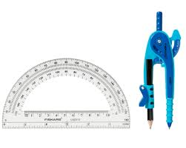
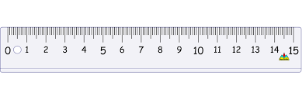
Reminders
Your Maths book should be backed.
On your desks should be:
Your pens: Blue/Black, Red and Purple.
Maths Book (backed). Planner. Calculator.
Geometry Equipment: Ruler, Compass and Protractor.
At the start of each lesson:
Rule off from the previous lesson.
Always write ‘cwk’ and the date and underline both.

Slide 32
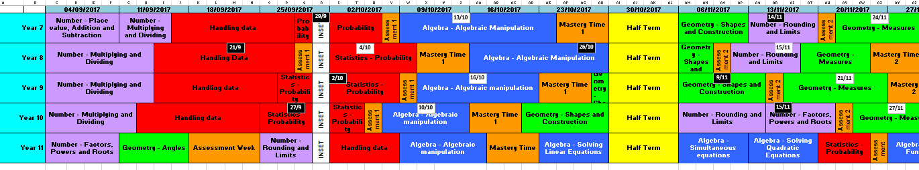
What will they be learning?
Notes:
The first 3 just enable the smooth running of a classroom allowing the teachers to concentrate on the curriculum as much as possible.
The final point I will refer to several times throughout the presentation.
“The one person who has the greatest impact on a students results are the student themselves.

Slide 33
What will this year look like?
Notes:
All staff work from this timeline.
Each row is an half term.
First coloured sections are different topics within the subject.
Each section has a detailed sow associated with it.
The entire curriculum is completed by mid January.
From then on it is all targeted revision. Which I will explain on the next slide.

Slide 34
How to prepare for an Assessment.
Students will be set a revision homework.
Their teacher will go through this before the assessment.
Covering the topics instructed by their classroom teacher.
They can complete a revision sheet.
Take this in to their assessment.
Is not compulsory but may be of benefit.

Slide 35
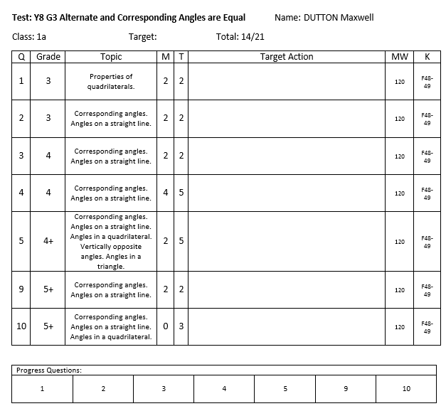
What is mastery time?
Notes:
Once we have covered the entire specification we then concentrate on using the assessments to identify each students areas of weakness.
After each assessment the teacher will receive a class report and each individual will receive an individual feedback sheet.
The teacher will initially address any misconceptions and areas of weakness shared by the class and then go onto deal with any individual issues using appropriate resources ( i.e. laptops and computer rooms).
It is essential students take responsibility at this point and take the opportunity to address issues independently maximise their final grade.

Slide 36
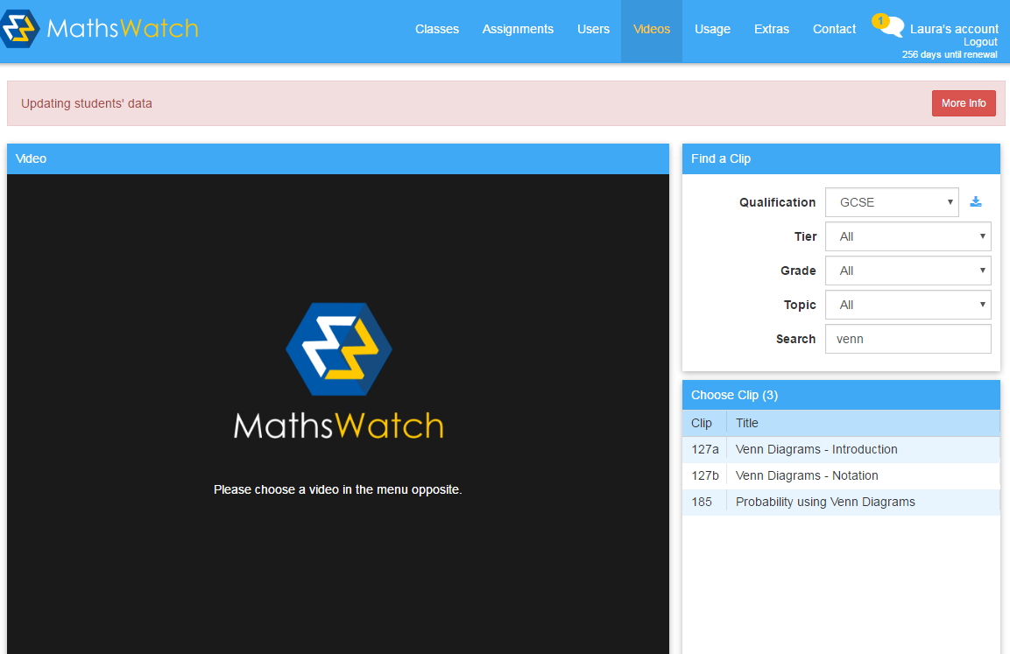
What is Mathswatch?
Notes:
Once we have covered the entire specification we then concentrate on using the assessments to identify each students areas of weakness.
After each assessment the teacher will receive a class report and each individual will receive an individual feedback sheet.
The teacher will initially address any misconceptions and areas of weakness shared by the class and then go onto deal with any individual issues using appropriate resources ( i.e. laptops and computer rooms).
It is essential students take responsibility at this point and take the opportunity to address issues independently maximise their final grade.

Slide 37
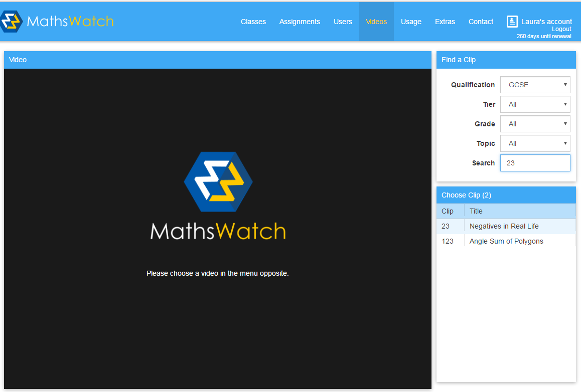
Mathswatch
For all students, you need to log on to vle.mathswatch.com
Your username now has @carrhill at the end of it
so for Mrs Potts rather than lpotts it is lpotts@carrhill
Your password is still numbers
To watch a video:
Click video
Select GCSE
Search for the clip number
Select the one you want to watch

Slide 38
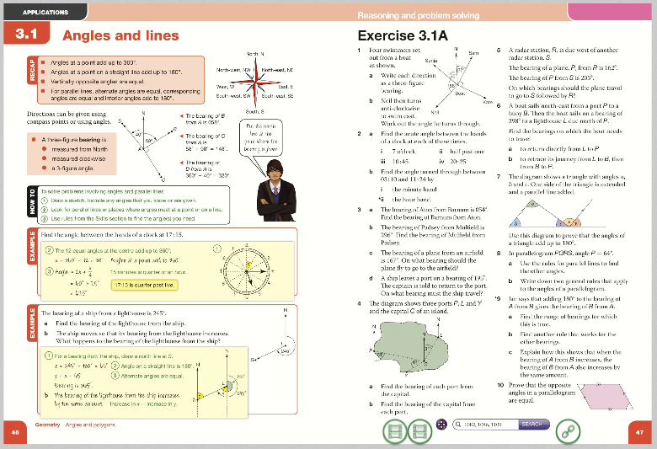
What is Kerboodle?
Notes:
Once we have covered the entire specification we then concentrate on using the assessments to identify each students areas of weakness.
After each assessment the teacher will receive a class report and each individual will receive an individual feedback sheet.
The teacher will initially address any misconceptions and areas of weakness shared by the class and then go onto deal with any individual issues using appropriate resources ( i.e. laptops and computer rooms).
It is essential students take responsibility at this point and take the opportunity to address issues independently maximise their final grade.

Slide 39
What support is available?
Their classroom teacher (at the appropriate time).
Tuesday and Thursday lunchtime room 4.
The Maths office.
Their mentor.
Web based resources.
Notes:
Intervention has already begun and will be changing throughout the year depending on assessment results. When students are timetabled for extra intervention you will be informed.
The intervention days are run throughout the year and have proved to be quite successful.

Slide 40
Useful Web Based Resources Available
Mymaths (login: carr password: isosceles)
Mathswatch (school id: carrhill Login: asmith password: numbers)
Just Maths (User name: CarrStudent Password: Carr)
Kerboodle (Demonstrated in lesson)
The internet
Notes:
Students should know about all these resources and the powerpoint is being made available on the website.
I have put the teacher down as a resource to make it clear that they are more than happy for students to see them outside of lessons with any problems. This does not mean rushing up to them two minutes before lesson because they are struggling with their homework.

Slide 41
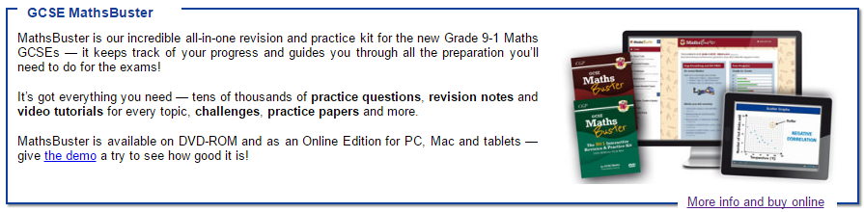
Revision Guides

Slide 42
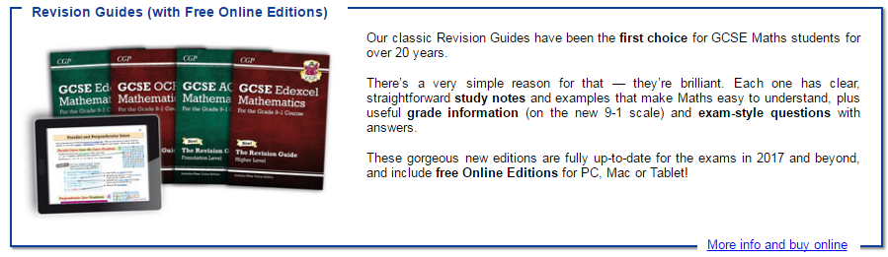
Revision Guides

Slide 43

Revision Guides

Slide 44
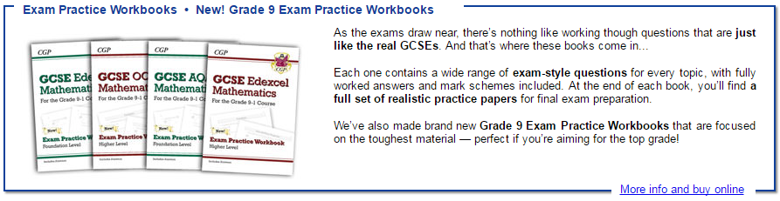
Revision Guides

Slide 45
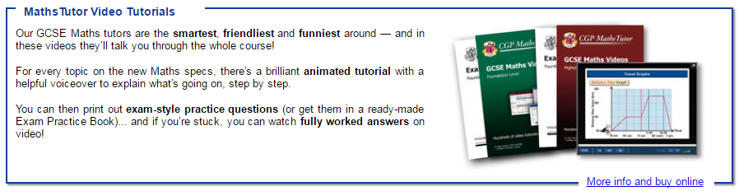
Revision Guides

Slide 46
Revision Guides
Revision Guides - £3.00
Workbook and Answers - £4.00
Exam Practice Workbook - £3.00
Targeted Grade 9 Exam Practice Workbook - £3.00
Maths Buster and Mock Exam Papers - £8.00
Maths Tutor and Exam Practice Book - £6.50
All available to buy from the Maths office.

Slide 47
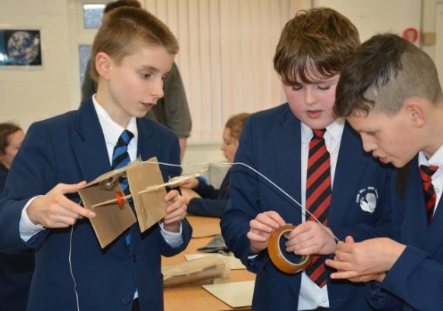
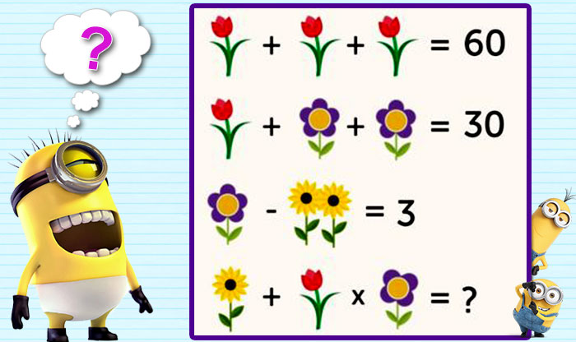
Extra-Curricular Activities
STEM Club (Every Thursday Room 6)
Maths Club (Wednesday Lunch Time)

Slide 48
Positive Attitude
Students’ ideas about their ability and potential are extremely important.
Messages students pick up from their parents about maths can change students’ learning and achievement.
It was not their parents lack of maths knowledge that harmed students’ performance but their parents’ anxiety.
Communicate positive messages, saying that maths is exciting and it is an open subject that anyone can learn with hard work.

Slide 49

Science
Cathy North
Head of Science

Slide 50
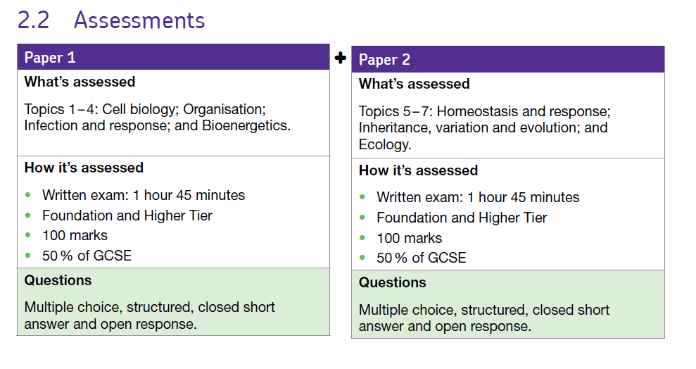
Triple Biology

Slide 51
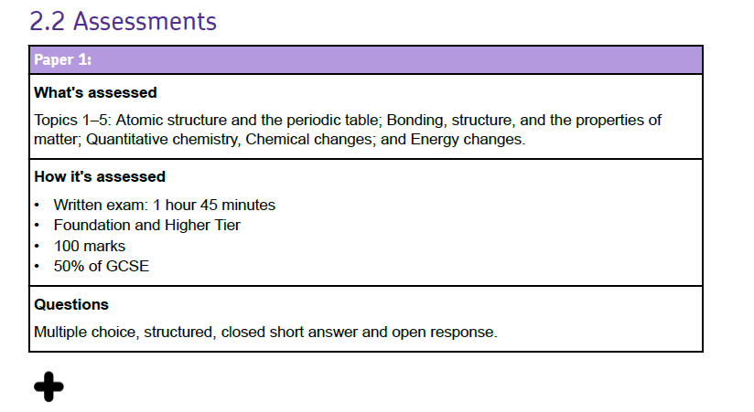
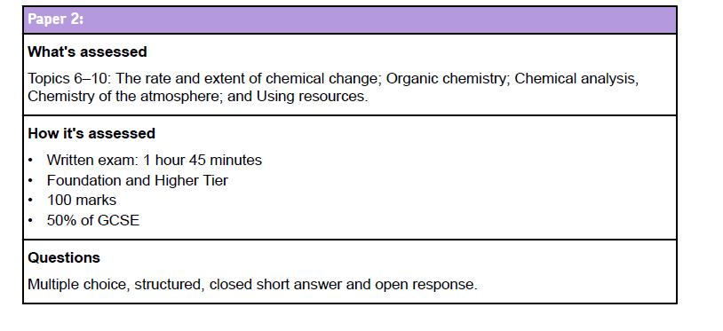
Triple Chemistry

Slide 52
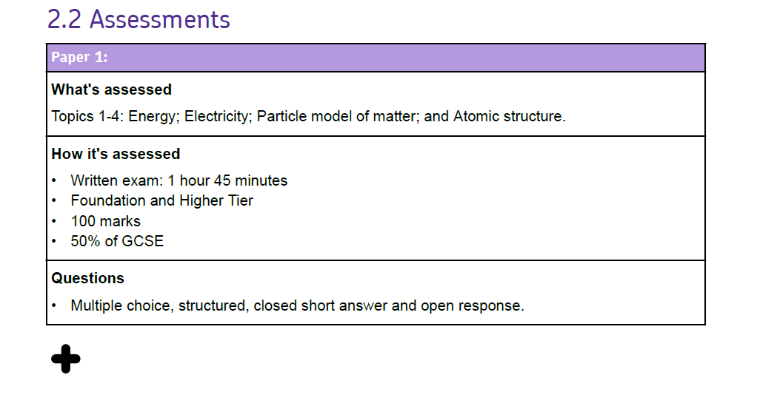
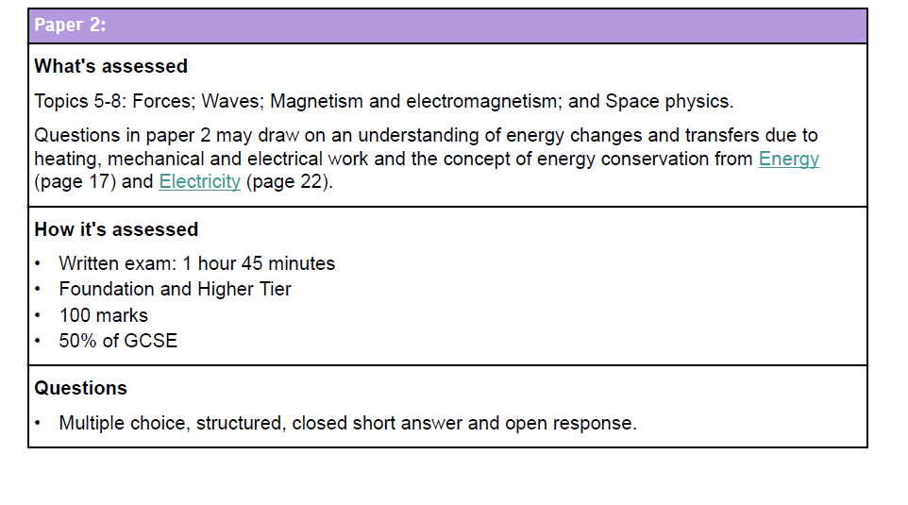
Triple Physics

Slide 53
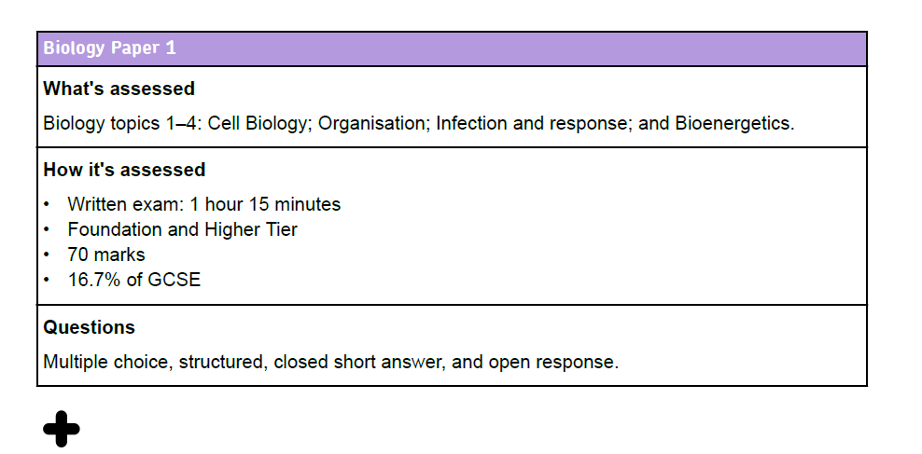
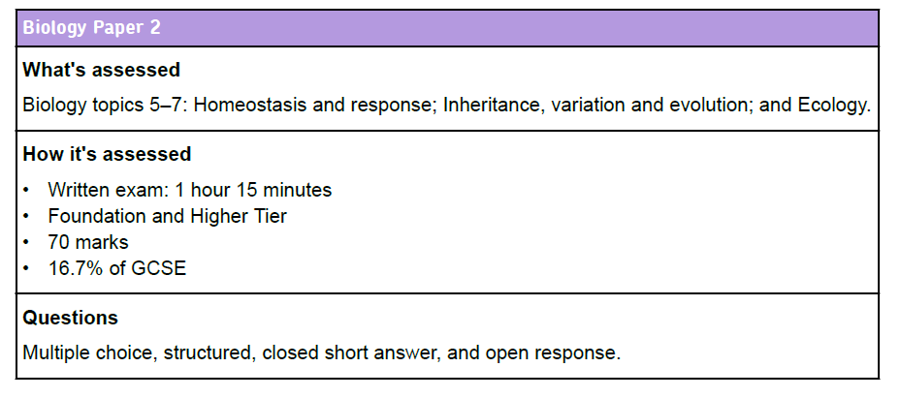
Trilogy Science

Slide 54
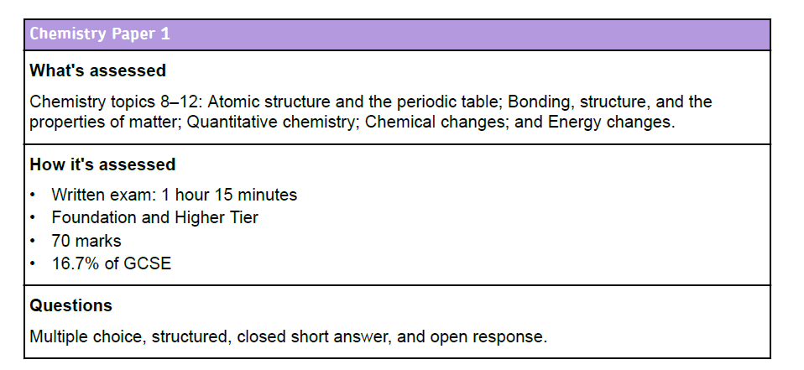
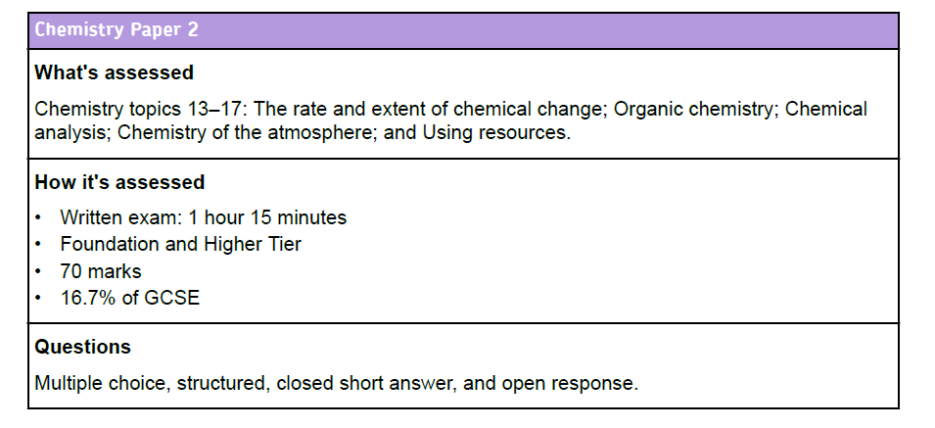

Slide 55
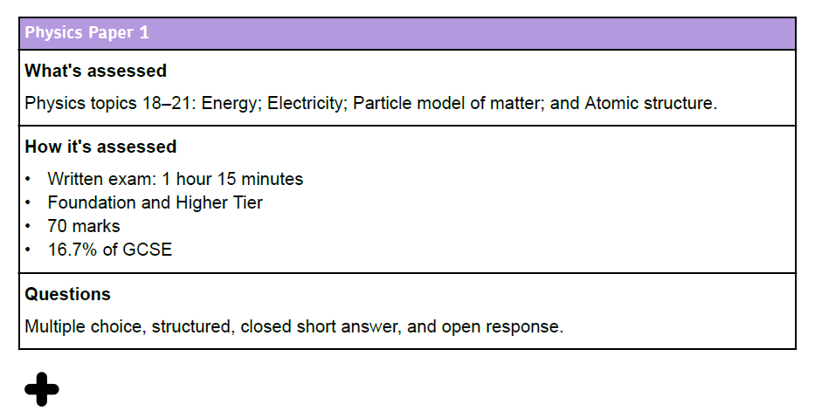
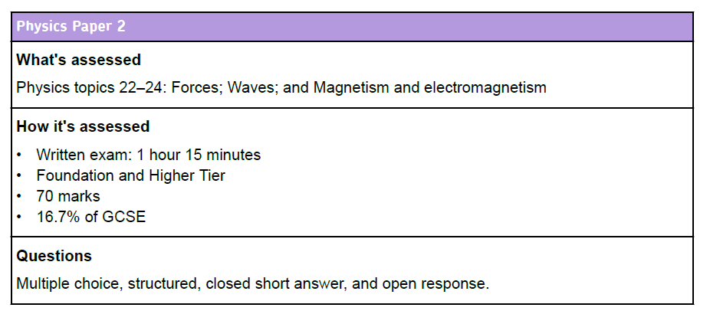

Slide 56
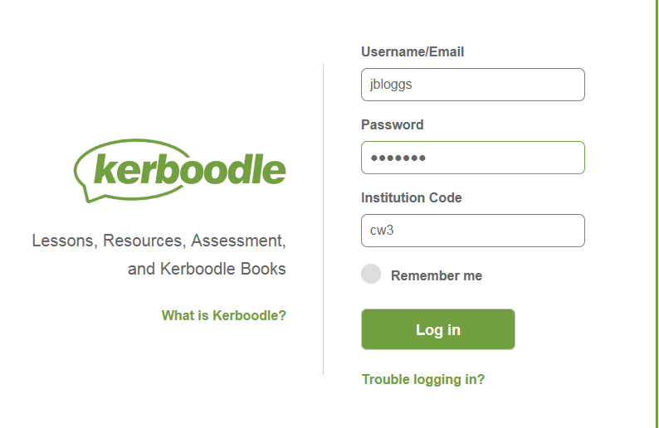
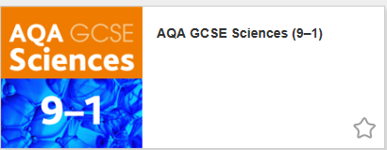

Slide 57
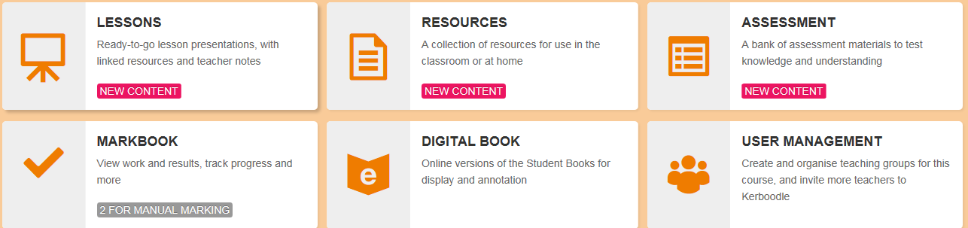
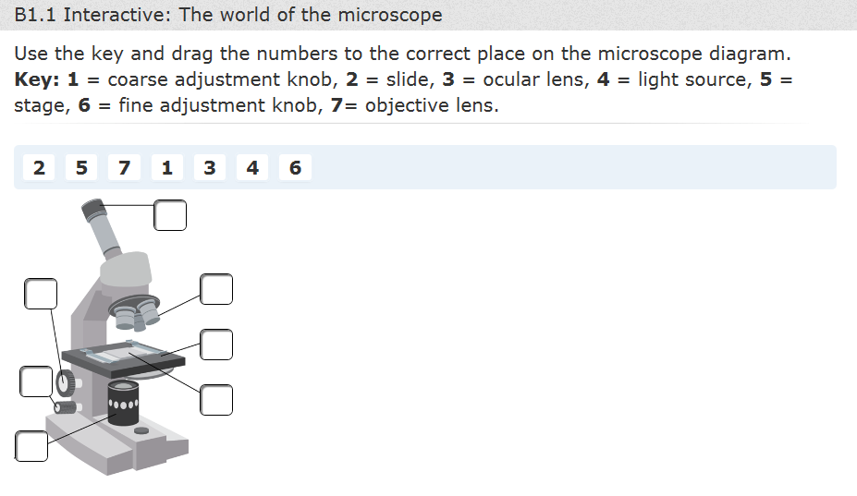
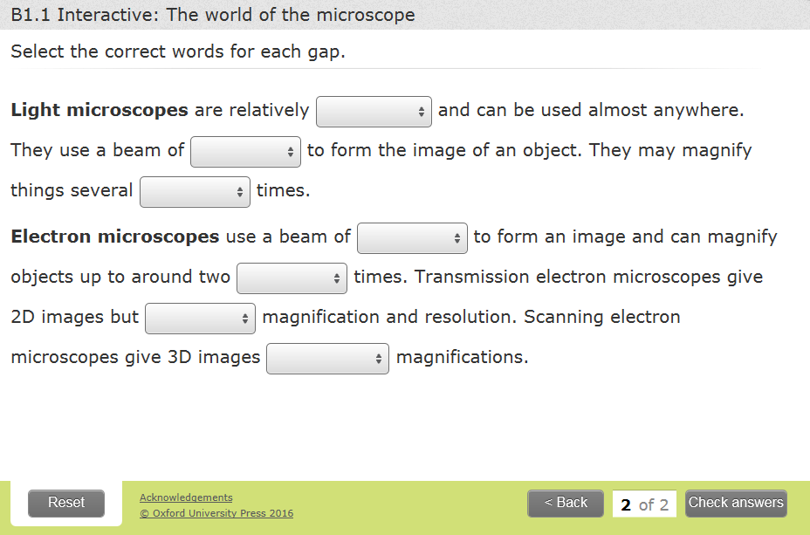

Slide 58
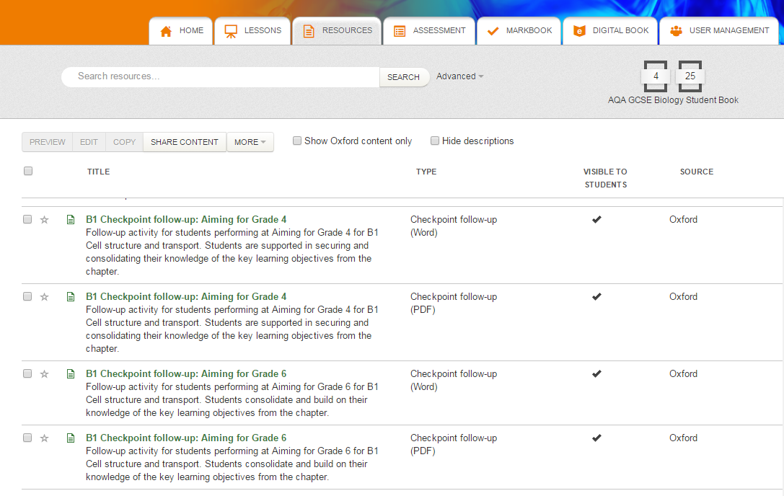

Slide 59
Revision guides - Trilogy
New Grades 9-1 GCSE Combined Science: AQA Trilogy Revision Guide with Online Edition Foundation (SAHR45)
ISBN: 9781782945604 £5.50
New Grades 9-1 GCSE Combined Science: AQA Trilogy Revision Guide with Online Edition Higher (SAHR45)
ISBN: 9781782945598 £5.50

Slide 60
Revision guides - Triple
Revision Guides:
New Grades 9-1 GCSE Combined Science: AQA Trilogy Revision Guide with Online Edition Higher (SAHR45) ISBN: 9781782945598 £5.50
or
Complete Revision and Practice:
New Grades 9-1 GCSE Biology: AQA Complete Revision & Practice with Online Edition (BAS45) ISBN:9781782945833 £5.50
New Grades 9-1 GCSE Chemistry: AQA Complete Revision & Practice with Online Edition (CAS45) ISBN:9781782945840 £5.50
New Grades 9-1 GCSE Physics: AQA Complete Revision & Practice with Online Edition (PAS45) ISBN:9781782945857 £5.50

Slide 61
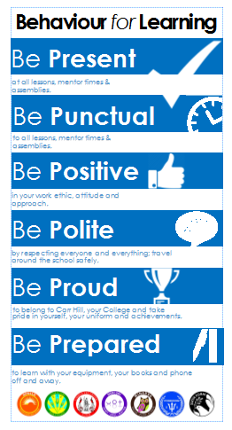
Behaviour For Learning
Lisa Coulthard, Assistant Headteacher

Slide 62
Expectations:

Slide 63
Reward Systems:
  Merits - these are issued on a daily basis to recognise achievement across the school and are recorded on SIMs.
  On a half termly basis student merits will be counted and recognised through College Celebration Assemblies.
  College badges in recognition of annual merit totals .
  Faculty rewards – positive text messages, praise post cards, telephone calls, verbal praise.
  6 ‘P’ Card, which reflects our code of conduct and recognises achievement and behaviour out of the classroom.
  End of year College Celebration Events
  End of year Whole School Celebration Events which takes place at Ribby Hall for invited students.

Slide 64
6 – P Card:
6 P Card – Achievement and conduct out of the class
Each student begins each half term with 10 merits recorded on their ‘P Card’. At the end of a half term these merits will be transferred a students behaviour record and will count towards yearly totals.
These Merits will be entered into a prize draw each half-term, 1 merit = 1 entry.
There will be 2 draws in each College – one for those who have maintained 10 merits and one for those with 6-9 merits
Opportunities will be given to students to earn additional merits
Each half term certificates will be awarded to students based on the number of merits earned on their P Card.
Merits can be earned by getting involved in activities, and by enhancing the life of the school.
Merits be can lost for failing to adhere to our code of conduct outside of the classroom.
There is an expectation that all students will have their card on their person at all times. Failure will result in a College Detention.

Slide 65
Starting Lessons off positively:
In classrooms students must follow this agreed procedure that staff will enforce:
They will enter quietly when instructed to do so
Students stand in silence behind chairs
Wait for teachers instructions
When asked, ensure that they have out all equipment including handbooks.

Slide 66
Consequences of not following instructions:
Lesson Time:
Stage 1 - Formal Warning
Stage 2 – Demerit & Move
Stage 3 – Time Out
Break/Lunch:
Serious Defiance Detentions
Serious Defiance
Exclusion (run from 8.55am – 4pm)
Members of SLT also have the authority to use serious defiance detentions and exclusion where they see appropriate.

Slide 67
We want to all students to have access to a happy and safe learning environment where they can thrive to achieve great success in the future.

Slide 68
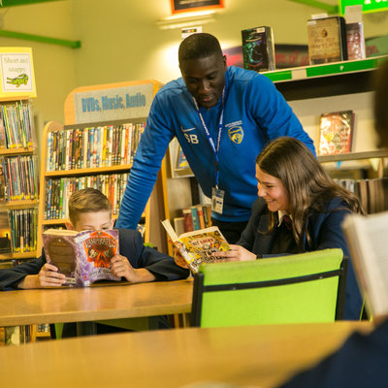
Learning at Carr Hill
Danny Morton
Assistant Headteacher

Slide 69
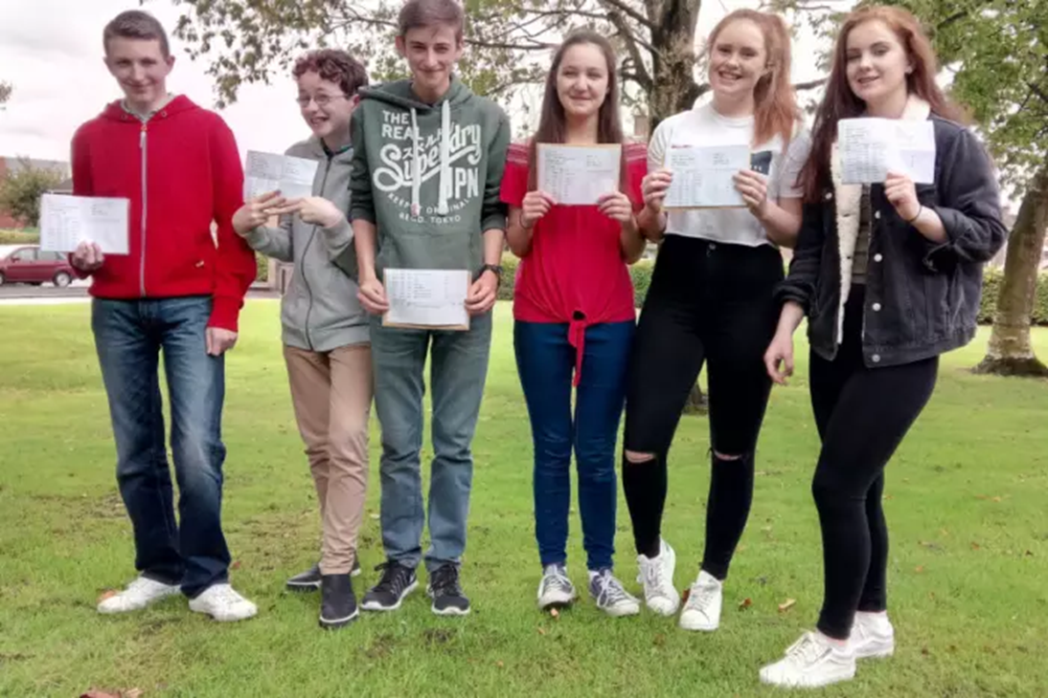
Our Aim Your Aim
Engagement
Challenge
Progression

Slide 70

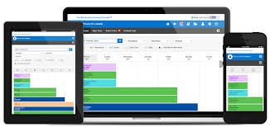
Homework

Slide 71



Feedback

